Slide 1
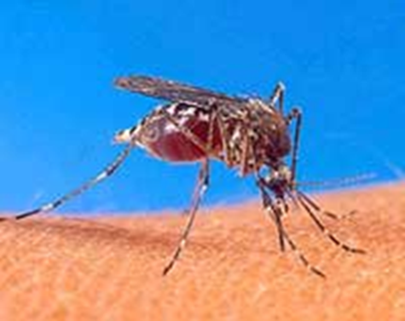
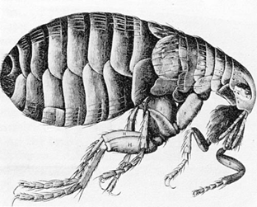
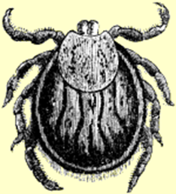
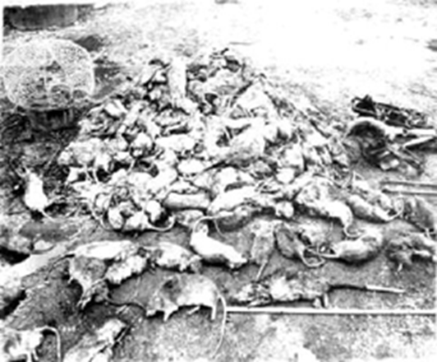
Diseases Transmitted from Animals to Humans

Slide 2
Avian- Another word for birds
Influenza- A contagious disease of the lungs; abbreviated as “flu”
Domesticated Animals- Animals that live around humans
Contagious- Capable of transmitting disease
Pandemic- An infectious disease that affects people globally
Zoonotic- An infectious disease that can be passed from animals to humans
Supportive care- medical attention focused on providing comfort rather than a curing an illness

Slide 3
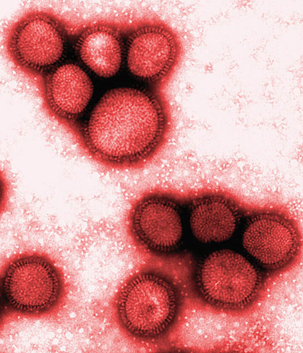
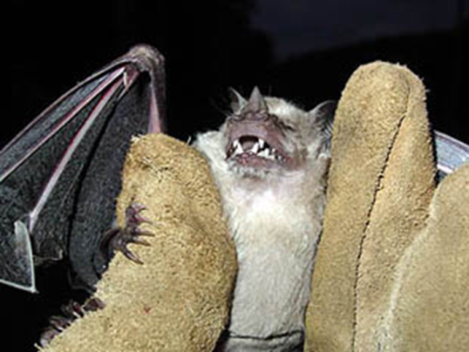
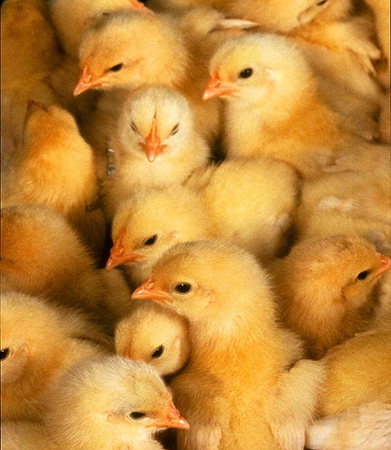
Rabies Virus
West Nile Virus
Toxoplasmosis
Creutzfeldt-Jakob Disease
Lyme Disease
Ringworm
Avian Flu
Swine Flu

Slide 4
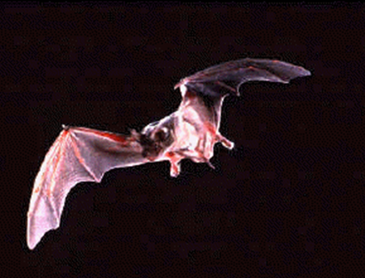
Reservoir: Bats, raccoons, cats, dogs
Agent: Virus
Transmission: Saliva of infected animals
Human symptoms: Seizure, paralysis, fever, fear of water
Treatment: Vaccines can be effective if given immediately after exposure; however if victim is not treated quickly, only supportive care is possible (often fatal)

Slide 5
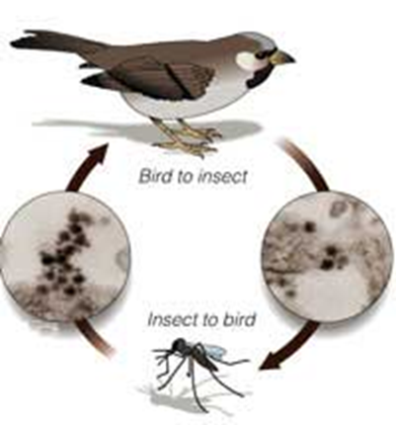
Reservoir: Birds
Agent: Virus
Transmission: Mosquito bites bird, picks up virus, and then bites human
Human symptoms: Fever, flu like symptoms
Treatment: Supportive, usually clears in a few weeks in healthy individuals

Slide 6
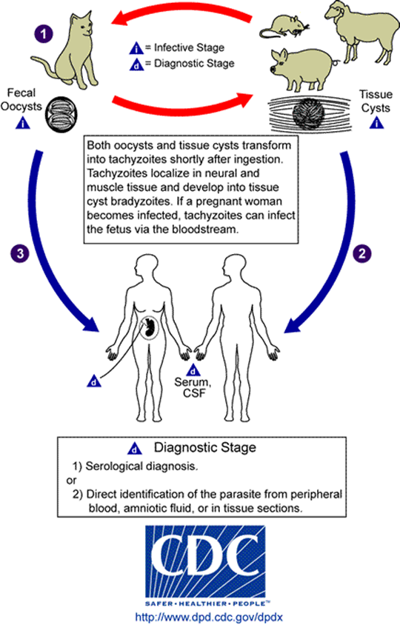
Reservoir: Pigs, cats, rats, deer, sheep
Agent: A single-celled parasite called Toxoplasma gondii
Transmission: Touching infected cat feces, eating undercooked meat, drinking contaminated water
Human symptoms: Flu like symptoms
Treatment: Medications if needed

Slide 7
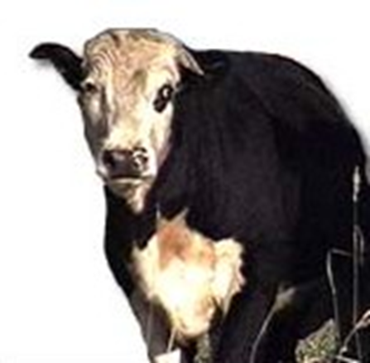
Also known as “Mad Cow Disease”
Reservoir: Cattle
Agent: Prion
Transmission: Eating infected beef
Human symptoms: Memory loss, emotional instability, weakness
Treatment: Supportive (usually fatal within one year)

Slide 8
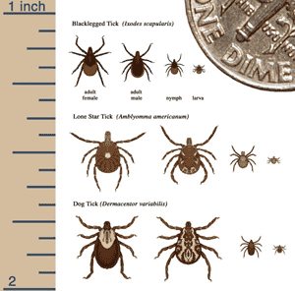
Reservoir: Deer
Agent: Borrelia burgdorferi, a bacterium
Transmission: Black legged tick feeds on infected deer, picks up bacterium, and bites human
Human symptoms: Rash, arthritis, fever, swollen lymph nodes, neurologic signs, heart problems
Treatment: Antibiotics can be used for successful treatment when caught early

Slide 9
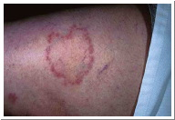
Reservoir: Any surface contaminated with fungus
Agent: Several kinds of fungus
Transmission: Touching a contaminated surface, brushes or combs, cows, horses, and other animals
Human symptoms: Rash shaped in a ring on the skin, including scalp, groin area, and feet
Treatment: Medicated creams, keeping area clean and dry

Slide 10
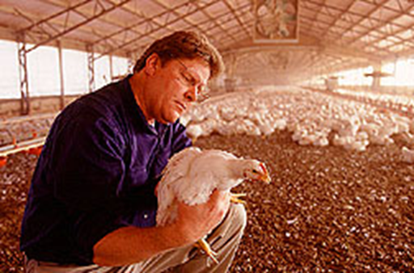
Reservoir: Birds (especially domestic poultry)
Agent: Virus
Transmission: Contact with infected poultry or environments
Human Symptoms: Flu-like symptoms (coughing, fever, sore throat), pneumonia
Treatment: Seasonal flu medications

Slide 11
The deadly flu pandemic of 1918 (the Spanish flu) was a strain related to bird flu.
Bird flu has reappeared in the past decade.
There is growing concern that another pandemic will occur in the near future.
Wild birds can spread the virus to domestic poultry flocks.
Bird flu is especially devastating to domestic poultry.
In the 1997 Hong Kong outbreak, every chicken was killed to prevent the spread to humans.
This virus has the ability to infect young and healthy people unlike most flu viruses that primarily infect the elderly and young children.

Slide 12
Reservoir: Pigs
Agent: Virus
Transmission: Coughs, sneezes, droplets, touching infected surfaces
Human Symptoms: Flu-like symptoms, pneumonia, diarrhea, vomiting
Treatments: Antiviral medications

Slide 13
Swine Flu is less deadly than Avian Flu; however, Swine Flu is much more contagious
It is also a descendent of the 1918 Spanish Flu.
The H1N1 strand of Swine Flu was first discovered in 1976.
This type of virus is normally seen in birds and pigs, but managed to mutate itself in order to be virulent in humans.

Slide 14
Influenza pandemics are rare, but have a high fatality rate.
Four flu pandemics have occurred in the past century:
The Spanish Flu of 1918
The Asian Flu of 1957
The 1968 Hong Kong Flu
The 2009 Swine Flu
Pandemic viruses are “new” and most humans have no immunity.
The ease of modern international travel contributes to the quick spread of deadly diseases.

Slide 15
Death toll from the Spanish flu of 1918 was estimated to be 20-50 million worldwide.
Over half a million people died in the U.S. from the Spanish Flu.
More people died from the Spanish flu than were killed in World War I.

Slide 16
What to Do During a Possible Flu Pandemic Outbreak
Stay CLEAR of contact with infected people. Use a protective mask.
Although not 100% protective, a mask can help trap some of the virus particles.
WATCH for flu-like symptoms.
If you are around an infected person, take your temperature often.
CALL your doctor to discuss treatment.
Seek medical attention within 24 hours of symptoms.

Slide 17
DO NOT panic.
DO keep eating.
You cannot get flu from eating fully cooked chicken, duck, or pig.
Avoid eating undercooked eggs or poultry.
DO get a flu vaccine.

Slide 18
DO NOT hoard drugs, such as Tamiflu.
Patients will need all available medication if a pandemic hits.
DO avoid areas with a widespread outbreak
DO stay clean by washing your hands frequently.
Use soap, water, and alcohol-based gels.

Slide 19
Receive your vaccinations
Wash your hands frequently and effectively.
Never touch your mouth, nose or eyes without washing your hands first.
Do not share food.
Cover your mouth when you sneeze or cough with a tissue or cough and sneeze into your elbow.
Avoid sharing toiletries and pillows
Get enough sleep and good nutrition

Slide 20
More people died from the Spanish Flu of 1918 than were killed in World War I.
A. True B. False
There is no known cure for Creutzfeldt-Jakob Disease.
A. True B. False
Most people that had the flu in 1918 are still living.
A. True B. False
Because of earlier outbreaks our generation is immune to rabies.
A. True B. False

