Slide 1
Therapeutic Physical Modalities
Angie Guggino, MS, ATC, LAT

Slide 2

Learning Target
The use and effectiveness of physical modalities.

Slide 3
Therapeutic Modalities
Heating, cooling, and mechanical/electrical methods of treatment used on the human body
Hot and cold treatments, therapeutic ultrasound, and various electrical modalities

Slide 4
Therapeutic Modalities
Used along with other forms of treatment
  To relieve pain, reduce or retard swelling, decrease spasm, and promote healing
Can minimize time lost from participation
Used improperly, condition may worsen

Slide 5
Cryotherapy
Use of cooling agents (e.g., cold packs, cold bucket baths, and ice massage)
Most widely used therapy
Responses include
  reduction of tissue metabolism
  decreased nerve conduction velocity
  reduced muscle spasm
  secondary vasodilatation
  increase in muscle strength after treatment
If left on too long, counter effects may occur

Slide 6
Ice packs
Effective for local areas of concern
Quick and economical
  Plastic bags with ice cubes
  Gel packs
  Chemical-activated cold pack

Slide 7
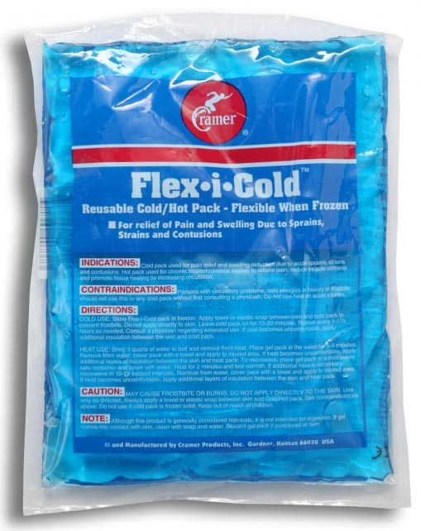
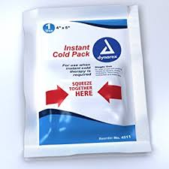
Ice Packs

Slide 8
Cryotherapy
Ice massage
  Used for localized problems (e.g., tennis elbow)
  Only takes about five – ten minutes
Cold water compression
  Cold and compression applied simultaneously
  Cryo-cuff
Ice baths
  Immersion in a bucket of ice water or whirlpool
  Allows complete, uniform coverage
  Some exercise movements may be performed

Slide 9
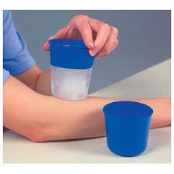
Ice Massage

Slide 10
Contraindications and Precautions
Cryotherapy should be used with caution on persons who have:
  Thermoregulatory problems
  Sensory deficits
  Hypersensitivity to cold
  Impaired circulation
  Heart disease
  Malignant tissue

Slide 11
Heating Agents
Heat is applied superficially (skin deep), or with a modality capable of heating tissues up to a few inches beneath the skin
Beneficial effects:
  Reduced pain
  Promotion of healing
  Increased range of motion
  Muscle relaxation

Slide 12
Heating Agents
Localized vigorous heating effects:
  Substantially increased vasodilatation
  Increased metabolic rate and capillary pressure and flow
  Clearance of metabolites
  Oxygenation of tissue

Slide 13
Hydrocollator Packs
Moist hot packs used for superficial heating
Kept warm in a heated stainless-steel container filled with hot water in the range of 160º F
Left in place for 10 to 20 minutes

Slide 14
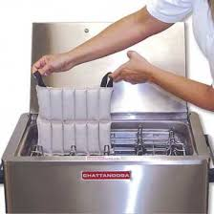
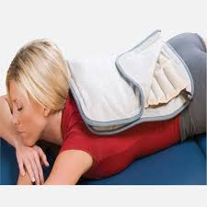
Hydrocollator Packs

Slide 15
Contraindications and Precautions
Heat is not used until 48 to 72 hours after injury
  Heat dilates the vessels and could cause additional bleeding if healing is not adequate
Heat should not be used:
  Acute injury
  Athletes with impaired circulation
  Areas of diminished sensation
  Athletes who may be heat intolerant

Slide 16
Hydrotherapy
Superficial heating
Agitated, heated water in a whirlpool
Larger area on an extremity can be treated
Athlete can perform range-of-motion exercises while in whirlpool

Slide 17
Contrast Therapy
Alternating hot and cold water bath for specified time periods
May be used in the sub-acute injury stage
  48 to 72 hours after the injury occurs

Slide 18
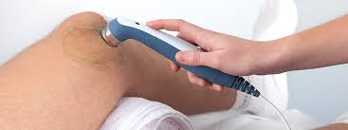
Ultrasound
Deep-heating modality
Not recommended during acute injury stage

Slide 19
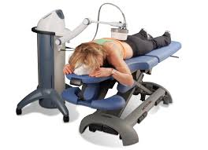
Diathermy
high-frequency electric current is delivered via shortwave, microwave, or ultrasound to generate deep heat in body tissues

Slide 20
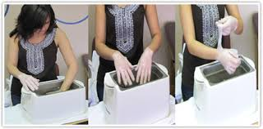
Paraffin bath
Wax

Slide 21
Electrical Modalities
Pass electrical currents through skin into the body causing nerve tissue stimulation
Use is limited by law
Two main categories:
  Electrical stimulation
  Transcutaneous electrical nerve stimulation

Slide 22
Electrical Stimulation
E-stim or muscle stim
Effects include:
  increasing range of motion and muscle strength
  reeducating muscles
  improving muscle tone
  controlling pain
Neuromuscular electrical stimulation is most common

Slide 23
Transcutaneous Electrical Nerve Stimulation
T.E.N.S.
Commonly applied with a portable unit for pain control
Electric current is applied through a surface electrode pad that is in contact with the external skin surface

Slide 24
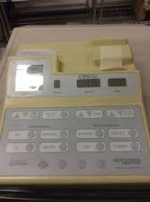
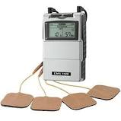
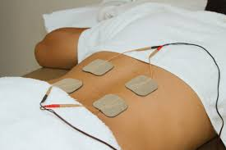
E-stim

Slide 25
Contraindications
Electrical stimulation should not be used:
  Over the carotid sinus
  During pregnancy
  In individuals with pacemakers
  On people who are sensitive to electricity
  Any time active motion is contraindicated

Slide 26
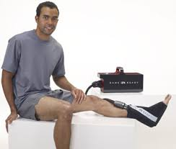
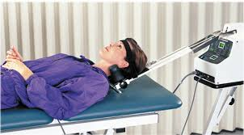
Manual Modalities
Massage
Intermittent compression unit
Traction

Slide 27
Medications
Anti-pyretic
Anti-inflammatory
Analgesic
Anti-fungal
Gastrointestinal
Antibiotics
Asthma medication

Slide 28
Rx vs. OTC’s
Prescription medications require physician approval
Over-the-counter medications are often less doses of prescription medications

Slide 29
Anti-Pyretic
Used to decrease fever
Acetaminophen (Tylenol)
Ibuprofen (Motrin, Advil)
Aspirin

Slide 30
Anti-inflammatory
Steroidal requires Rx
  prednisone
Non-Steroidal (NSAIDS) – Rx
  diclofenac (Cambia, Cataflam, Voltaren)
  etodolac (Lodine)
  fenoprofen (Nalfon)
  flurbiprofen (Ansaid)
  naproxen (Anaprox, Naprosyn)
  oxaprozin (Daypro)
Non-steroidal (NSAIDS) - OTC
  Ibuprofen (Motrin, Advil)
  Aspirin
  Naproxen (Aleve)

Slide 31
Analgesic
Pain killers
Rx usually narcotic
  Morphine, hydrocodone, fentanyl oxycodone
OTC’s
  Aspirin, Tylenol, NSAID’s

Slide 32
Asthma Medication
Long-term control to prevent attacks
  Rx only
Quick-relief from attack symptoms
  Rx only
  Albuterol
OTC medication provide temporary relief
  Primatene Mist and Bronkaid

Slide 33
Common in Sports Medicine
Anti-fungal: used to treat a variety of fungal infections
  Ring worm, jock itch, athlete’s foot
Gastrointestinal: used to treat a variety of conditions
  Nausea, diarrhea, gas, acid reflux
Antibiotics: used to treat bacterial infections
  Topical and oral
  Several different classifications

Slide 34

The End

