Slide 1
Kinesiology
Angie Guggino, MS, ATC, LAT

Slide 2
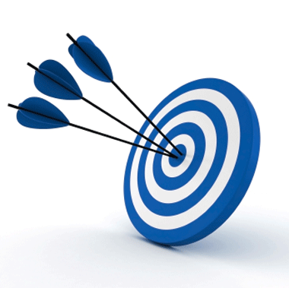
Learning Target
The articular system and its importance to movement.

Slide 3
Kinesiology
Study of physical activity or movement
Anatomy, biomechanics, physiology, psychomotor behavior, and various social and cultural factors
Focuses on exercise stress, movement efficiency, and fitness

Slide 4
Articular System
Series of joints that allows movement
  Combined with neuromuscular system, enables locomotion
Joint articulation
  Formed when two bones come into contact
  Can be freely movable
Arthrology
  Study of joints

Slide 5
Classifications of Joints
Synarthroses (Immovable)
  Joints that lack a synovial cavity
  Held closely together by fibrous connective tissue
  3 structural types (Sutures, Syndesmosis, Gomphosis)
Amphiarthroses (Slightly moveable)
  Bones are connected by hyaline cartilage or fibrocartilage
Diarthroses or synovial joint (Freely movable)
  Ends of opposing bones are covered with articular cartilage
  Separated by joint cavity
  Components are enclosed in fibrous joint capsule

Slide 6
Movement of Diarthroses
Range of motion in movable joints varies
Synovial joints move most freely
Shoulders have the greatest range of motion
Joint stability is determined by:
    Shape of the bones where they come together
    Ligaments that join the bones
    Muscle tone

Slide 7
Types of Synovial Joints
Gliding (plane)
Hinge
Pivot
Condyloid
Saddle
Ball-and- Socket

Slide 8
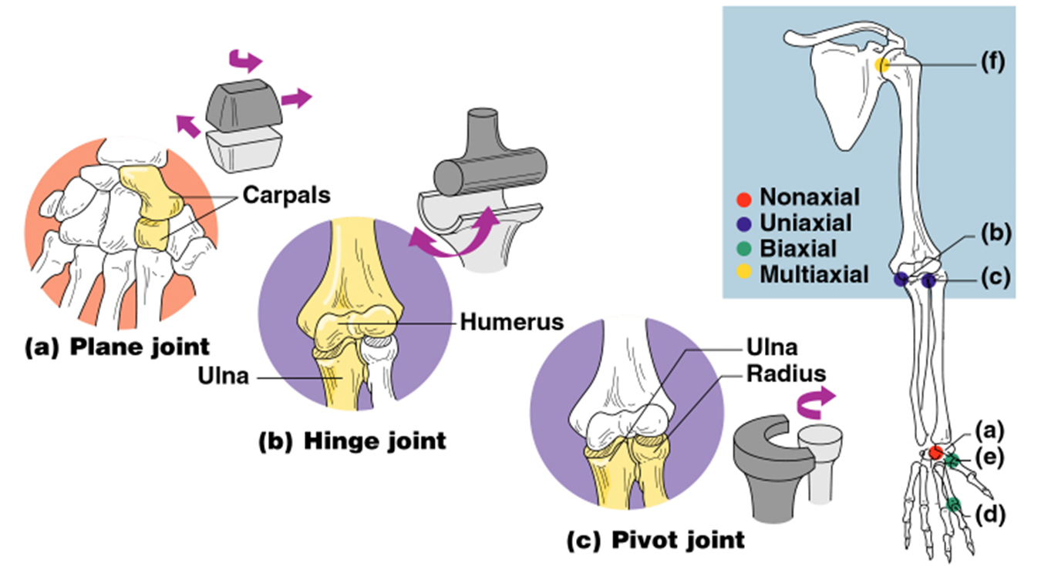

Slide 9
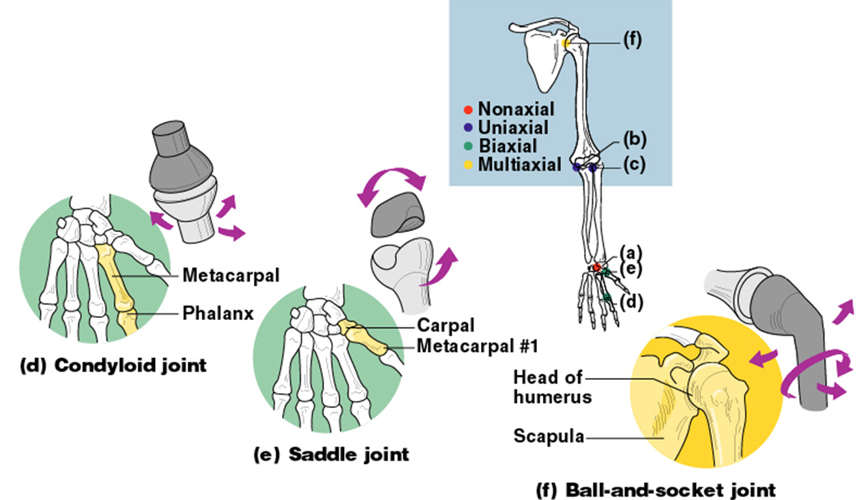

Slide 10
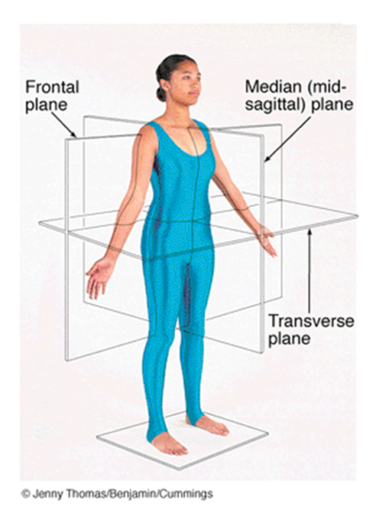
Body Planes

Slide 11
Joint Disorders
Bursitis
  Inflammation of synovial bursa
  Can be caused by excessive stress or tension
Arthritis
  Inflammation of the entire joint
  Usually involves all joint tissues (cartilage, bone, muscles, tendons, ligaments, nerves, etc.)

Slide 12
Joint Disorders
Rheumatic fever
  Disease involving a bacterial infection
  If undetected, bacterium can be carried by the bloodstream to the joints
  Results in rheumatoid arthritis
Rheumatoid arthritis
  Connective-tissue disorder
  Severe inflammation of small joints
  Severely debilitating

Slide 13
Joint Disorders
Primary fibrositis
  Inflammation of fibrous connective tissue
  Called rheumatism
  Lower back called lumbago
Osteoarthritis
  Degenerative joint disease
  Occurs with advancing age
Gout
  Accumulation of uric acid crystals in joint at base of large toe and other joints of feet and legs
  Waste-product crystals can accumulate in kidneys, causing kidney damage

Slide 14
Closed and Open Kinematic Chains
Closed kinematic chain
  Movement or exercise at the end of the chain, farthest from the body, is fixed
  In a squat feet are fixed and the rest of leg chain moves
Open kinematic chain
  Movement or exercise at the end of the chain is free
  Seated leg extension

Slide 15
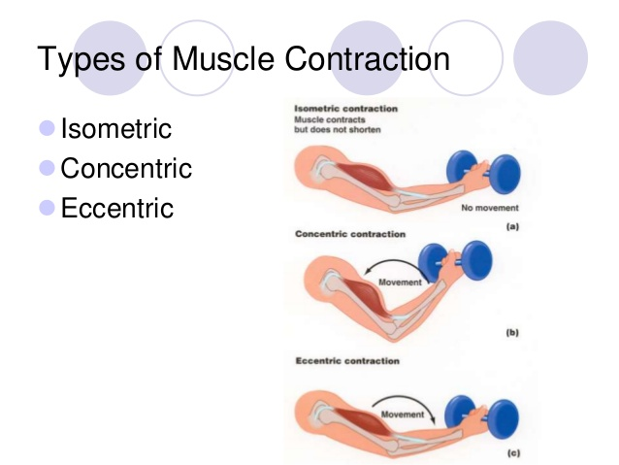
Concentric vs eccentric
Concentric
Eccentric

Slide 16
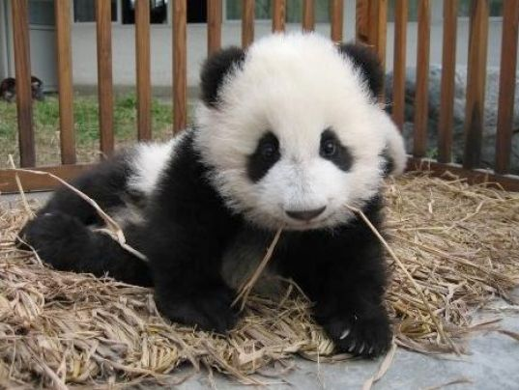
The End

