Slide 1
Bleeding and Shock
Angie Guggino, MS, ATC, LAT

Slide 2

Learning Target
The dangers associated with shock.

Slide 3
The Cardio-Respiratory Systems
Includes functions of the heart, blood vessels, circulation, and gas exchange between the blood and atmosphere
Heart pumps blood through the body through blood vessels
    Blood is enriched with oxygen when it passes through lungs
    As oxygen enters the bloodstream, carbon dioxide leaves it (respiration)

Slide 4
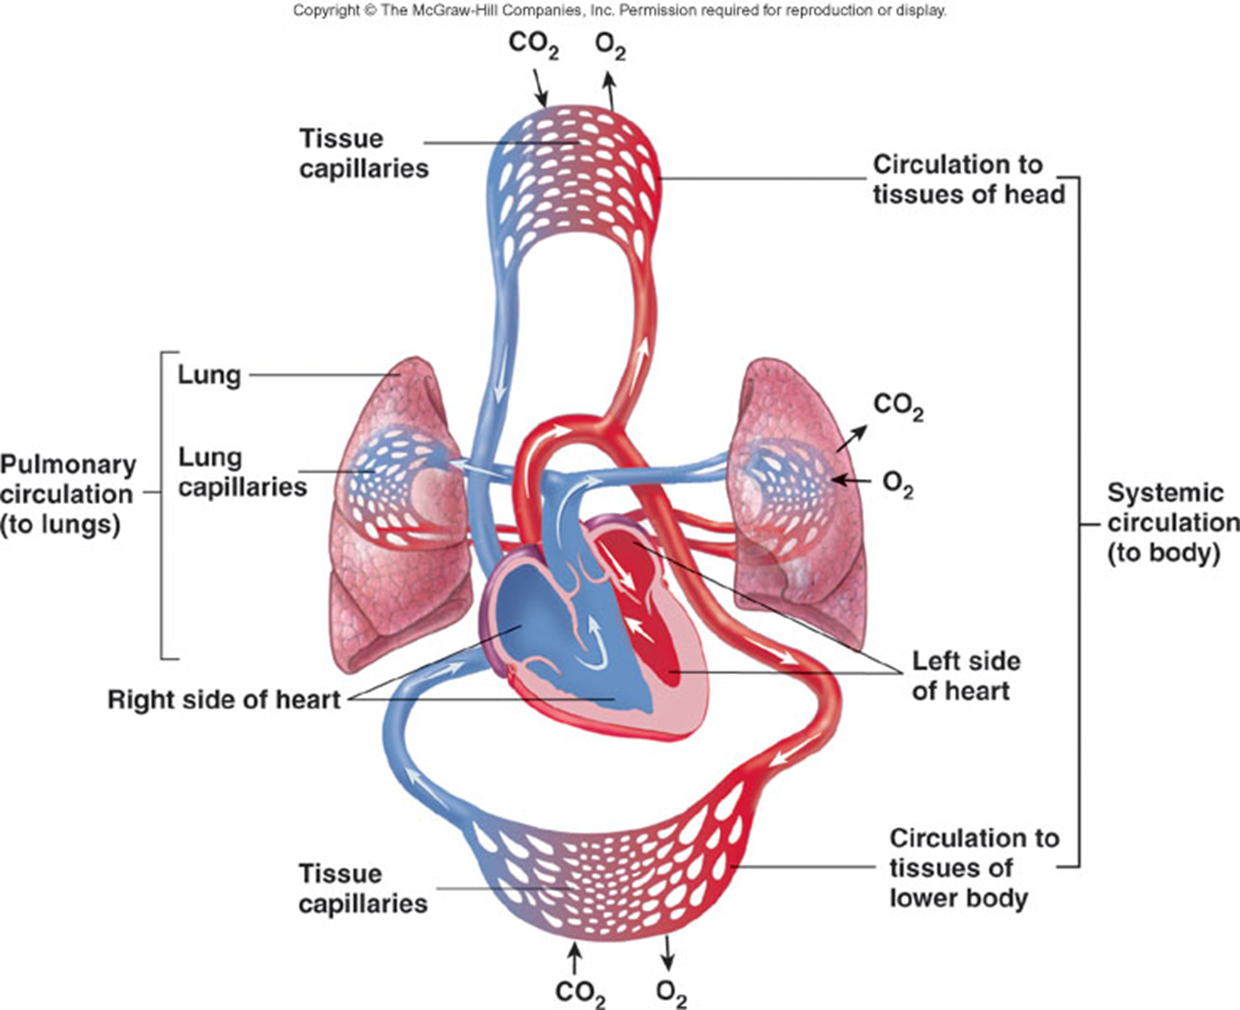

Slide 5
The Circulatory System
Course taken by blood through arteries, capillaries, and veins and back to the heart
Uses blood to transport dissolved materials throughout the body (oxygen, carbon dioxide, nutrients, waste)

Slide 6
The Heart
Two major circulations (systemic and pulmonary)
  Each has its own pump
  Both pumps are incorporated into the heart
Heart structure
  Shell with four chambers inside
  https://www.youtube.com/watch?v=Q-kYYuStShI –
    recap the flow of blood in the heart

Slide 7
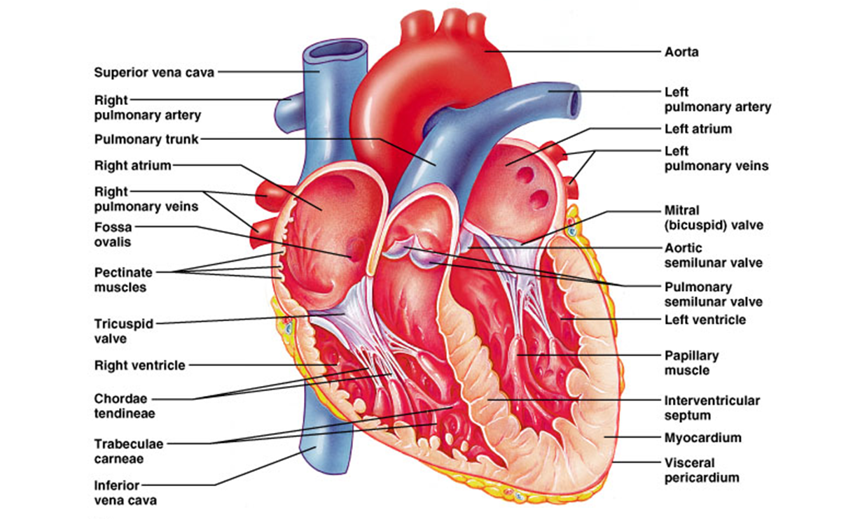

Slide 8
The Blood
Only tissue that flows throughout the body
Carries oxygen and nutrients to all body parts
Transports waste products back to the lungs, kidneys, and liver for disposal

Slide 9
Plasma
River in which blood cells travel (mostly water)
Makes up 55% of blood's total volume
Also carries nutrients, waste products, antibodies, clotting proteins, chemical messengers, and proteins

Slide 10
Blood Cells
Red blood cells (erythrocytes)
  Highly specialized cells
  “Stripped” of everything that might get in the way of transporting oxygen
  Contain Hemoglobin
    Picks up oxygen in areas where it is abundant and releases it in tissues where oxygen is low

Slide 11
Blood Cells
White blood cells (leukocytes)
  neutrophils, monocytes, lymphocytes, eosinophils, and basophils
Platelets (thrombocytes)
  Release agents to help initiate clotting and protect integrity of the vasculature

Slide 12
Blood Vessels
Hollow tubes, running throughout the body, through which blood circulates
Types:
  Arteries
  Arterioles
  Veins
  Venules
  Capillaries

Slide 13
The Heart’s Conduction System
Made up of specialized cells within heart muscle tissue
  Carries electrical signals to muscle cells throughout the heart
  Signals trigger muscles to contract and pump blood throughout the body
  SA Node

Slide 14
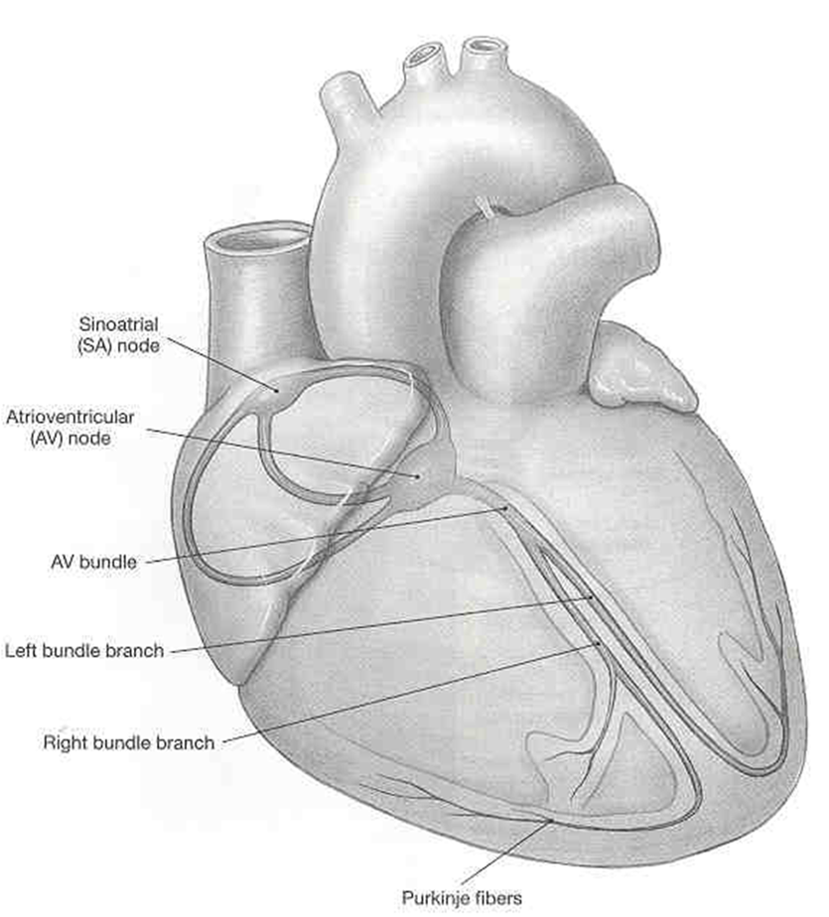
Heart’s Electrical System
Sinoatrial Node (SA Node)
Atrioventricular Node (AV Node)
AV bundle
Right and Left Bundle Branch
Purkinje fibers

Slide 15
Blood Pressure
Diastolic
  Lowest pressure
  Represents ventricle relaxation
Systolic
  Highest pressure
  Corresponds to ventricle contraction
Pulse pressure
  Difference between systolic and diastolic

Slide 16
Pulse and Heart Rate
Pulse
  Rhythmical beating of the heart
  Heart rate or pulse rate = per minute
  Locations (radial and common carotid)
Target heart rate
  Range of percentages of maximum heart rate safe to reach during exercise

Slide 17
Body Substance Isolation
Protective equipment includes:
  Sterile gloves
  Protective eyewear
  Surgical mask

Slide 18
Infectious Disease Control
OSHA
Centers for Disease Control and Prevention
  Monitors outbreaks of infections
  Advises on how to handle and control disease spread
Standard precautions
  Infection-control guidelines
  Designed to protect workers from exposure to diseases spread by blood and bodily fluids

Slide 19
Wound Care
Irrigate wound with clean, cool water
Gently wash with mild soap (superficial cuts)
All foreign particles must be removed or infection will result
Minor cuts and abrasions should be washed, dried with a sterile gauze sponge, treated with a first-aid cream, and covered with a sterile dressing

Slide 20
Bandages and Dressings
Proper bandaging and dressing of a wound will ensure proper healing and infection control
Two primary types of dressings:
  Gauze
  Occlusive
What is the difference?

Slide 21
Bleeding
Three basic types of bleeding:
  Arterial
  Venous
  Capillary

Slide 22
Shock
Circulation system fails to send blood to all parts of the body
Hemorrhagic shock
  Loss of blood from an injury
Neurogenic shock
  Loss of vascular control by the nervous system
Cardiogenic shock
  Inadequate functioning of the heart
Septic shock
  Life-threatening reaction to a severe infection

Slide 23
Shock
Psychogenic shock
  Physiological response to fear, stress, or emotional crisis that causes the person to faint
Metabolic shock
  Severe loss of bodily fluids
Anaphylactic shock
  Severe allergic reaction
Respiratory shock
  Lungs are unable to supply enough oxygen to blood

Slide 24
Signs and Symptoms
Restlessness and anxiety
Weak and rapid pulse
Cold and clammy skin
Profuse sweating
Pale face or cyanotic (blue) around the mouth
Shallow respirations
Dull eyes with dilated pupils
Thirst
Nausea and vomiting
Blood pressure that falls gradually and steadily
Loss of consciousness

Slide 25
Treatment for Shock
Goal is to keep the victim from getting worse
  Activate EMS
  Airway
  Control bleeding
  Elevate extremities (only if no neck or back injury)
  Splint fractures
  Control body temperature
  Do not give food or water
  Record and monitor vital signs
  Reassure the victim

Slide 26

The End

