Slide 1
Bones
Consist of osteocytes (mature bone cells)
35% organic material
65% inorganic mineral salts, and water
Axial Skeleton vs. Appendicular Skeleton

Slide 2
Functions of the Skeletal System
Aids in body movement
Supports and protects internal body organs
Produces red and white blood cells
Provides a storehouse for minerals

Slide 3
Bone Cells
Osteocytes
Mature bone cells
Osteoblasts
Bone-forming cells
Osteoclasts
Bone-destroying cells
Break down bone matrix for remodeling and release of calcium

Slide 4
Shape Categories of Bone
Short bones
Generally cube-shape
Contain mostly spongy bone
Examples: Carpals, tarsals
Long bones
Typically longer than wide
Have a shaft with heads at both ends
Contain mostly compact bone
Examples: Femur, humerus

Slide 5
Shape Categories of Bone
Flat bones
Thin, flattened and usually curved
Thin layers of compact bone around a layer of spongy bone
Examples: Skull, ribs, sternum
Irregular bones
Irregular shape
Do not fit into other bone classification categories
Example: Vertebrae

Slide 6
Anatomical Structure of Long Bones
Diaphysis
Shaft
Composed of compact bone
Epiphysis
Ends of the bone
Composed mostly of spongy bone

Slide 7
Long Bones
Periosteum
Outside covering of the diaphysis
Fibrous connective tissue membrane
Sharpey’s fibers
Secure periosteum to underlying bone
Arteries
Supply bone cells with nutrients

Slide 8
Long Bones
Articular cartilage
Covers the external surface of the epiphyses
Made of hyaline cartilage
Decreases friction at joint surfaces
Medullary cavity
Cavity of the shaft
Contains yellow marrow (mostly fat) in adults
Contains red marrow (for blood cell formation) in infants

Slide 9
Adult Bone
Bone mineral peaks
Women age 25-28
Men age 30-35
Remodeling
Process through which adult bone can change in density, strength, and sometimes shape
When bone is subjected to high force it tends to increase density
Bone only accounts for about 15% of body weight

Slide 10
Types of Fractures
Magnitude and direction of force
Closed
– Bone fragments do not pierce skin
Open/compound
– Bone fragments pierce skin
Displaced or non-displaced

Slide 11
Transverse Fracture
Usually caused by directly applied force to fracture site

Slide 12
Spiral or Oblique
Caused by violence transmitted through the distal limb
twisting movement

Slide 13
Greenstick
Occurs in children
Bones soft and bend without fracturing completely

Slide 14
Avulsion Fracture
Traction
Bony fragment usually torn off by a tendon or ligament

Slide 15
Stress fracture
Abnormal stress on normal bone
Fatigue fracture
Normal stress on abnormal bone
Insufficiency fracture

Slide 16
Fractures
Fracture signs and symptoms
Swelling, deformity, pain, tenderness, and discoloration
Treatment
Bones must sometimes be put back in proper position (reduction)
Open vs. closed

Slide 17
Reduction
Open reduction (surgery)
very accurate
risk of infection
Usually when internal fixation is needed
Closed reduction (manipulation)
Usually with anesthesia
Traction (pulling)

Slide 18
Holding the Reduction
4-12 weeks
External fixation
Internal fixation
Frame fixation

Slide 19
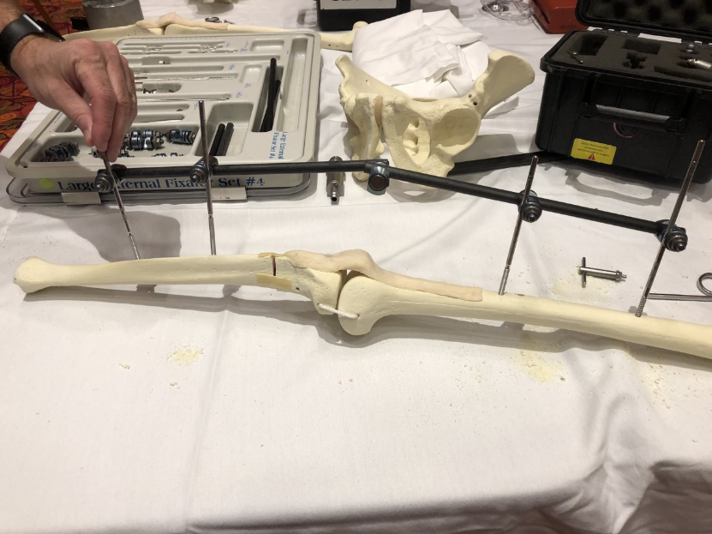
External fixation
Used for fractures that are too unstable for a cast.
Can shower and use the hand gently with the external fixator in place.

Slide 20
Frame fixation
Allows correction of deformities by moving the pins in relation to the frame.

Slide 21
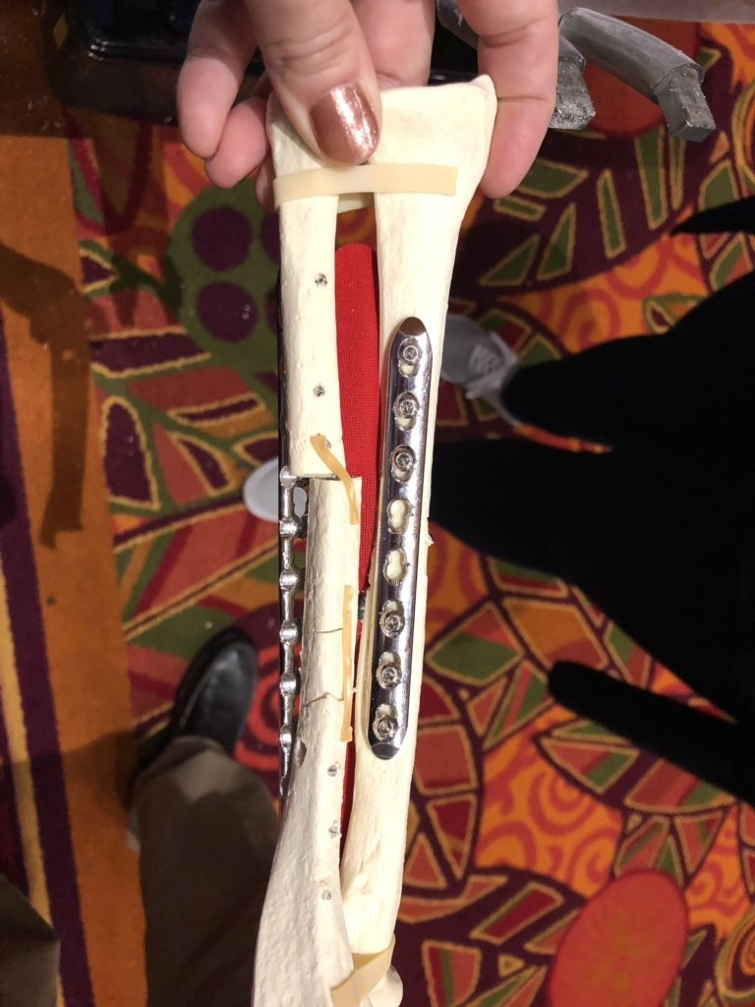
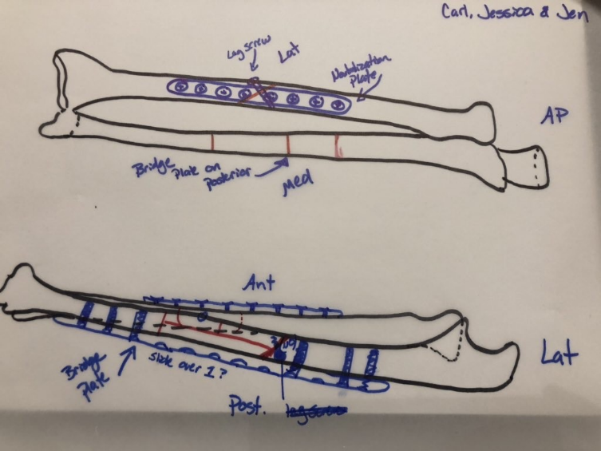
Internal fixation
“Homedepot Method”
Rods
Screws
Pins
Plates

Slide 22
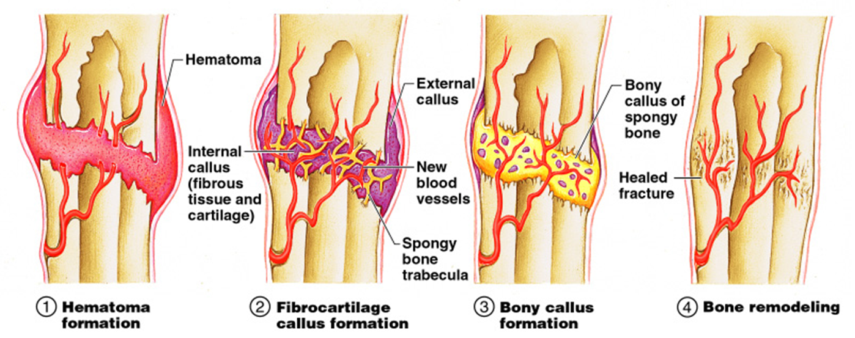
Fracture Healing

Slide 23
Types of Muscle Tissue
Skeletal
Under voluntary control
Smooth
Involuntary
Cardiac
Only found in the heart
Involuntary

Slide 24
Sphincter Muscles
Circular muscle
Opening and closing
Esophagus and stomach
Stomach and small intestine
Anus
Urethra
Mouth

Slide 25
Characteristics of Muscle Tissue
Excitability
tissue can receive & respond to stimulation
Contractibility
tissue can shorten & thicken
Extensibility
tissue can lengthen
Elasticity
after contracting or lengthening, tissue always wants to return to its resting state

Slide 26
Muscle Attachments and Functions
More than 650 muscles in the body
Muscles only pull, never push
Muscles attached to bones by tendons
Bones are connected at joints
Muscles are attached at both ends to bones, cartilage, ligaments, tendons, skin, or other muscles

Slide 27
Skeletal Muscles
Origin
Point of attachment that remains fixed
Insertion
Point of attachment that moves
Action
What joint movement is produced
Flexion, extension, abduction, etc. . .

Slide 28
Agonist, Antagonist, and Synergist
Muscles can only pull, not push
Muscles in the body rarely work alone, and are usually arranged in groups surrounding a joint
A muscle that contracts to create the desired action is known as an Agonist or prime mover
A muscle that helps the Agonist is a Synergist
A muscle that opposes the action of the Agonist, therefore undoing the desired action is an Antagonist

Slide 29
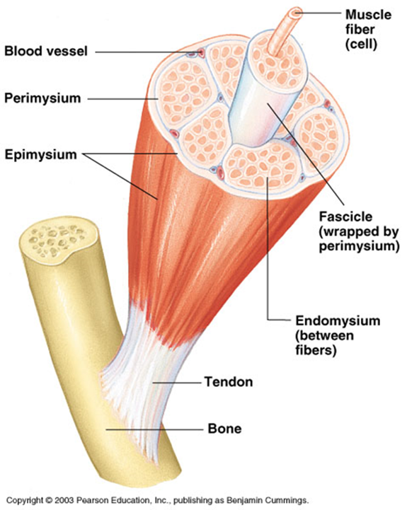
Muscle Fibers
Muscle cell
Sarcolemma – muscle cell membrane
Sarcoplasm – material within the muscle cell, excluding the nucleus

Slide 30
Sources of Energy and Heat
When muscles work, they move the body and produce heat
For muscles to contract and work, they need energy
Major source of energy is adenosine triphosphate (ATP)
Cell requires oxygen, glucose, and other materials
When a muscle is stimulated, ATP is broken down, producing energy

Slide 31
Cellular Respiration
Oxygen (O₂) is used by the cells
O₂ needed in conversion of glucose to cellular energy (ATP)
Carbon dioxide (CO₂) is produced as a waste product

Slide 32
Glycolysis
The breakdown of glucose
Glucose
Pyruvic acid
With O₂
No O₂
cytoplasm
Pyruvic acid
Lactic Acid
2 ATP
& Lactic acid
Kreb’s Cycle
Mitochondria
36 ATP

Slide 33
Contraction of Skeletal Muscle
Muscle movement occurs as a result of:
Myoneural stimulation
Contraction of muscle proteins
Skeletal muscles must be stimulated by nerve impulses to contract
Begins with action potential, which travels along muscle fiber length
Basic source of energy is glucose

Slide 34
Muscle Contraction
Electrical impulse travels down a motor neuron and acetylcholine is released into the synapse.
Acetylcholine binds to special receptors on the muscle cell and causes an electrical impulse (Action Potential) to spread over the cell

Slide 35
Generating Action Potentials
Acetylcholine makes the sarcolemma more permeable
Channels open and Na+ rapidly invade the fiber
At the same time K+ rush out of the fiber
More Na+ enters than K+ exits and a positive charge is created
Flood of positive ions into the fiber generates and electrical charge called an Action Potential

Slide 36
Muscle Contraction
Ca²⁺ released by the sarcoplasmic reticulum
Enables the attachment of actin and myosin
Contraction of the sarcomere

Slide 37
Summary
Skeletal muscle fibers shorten as thin filaments interact with thick filaments and sliding occurs.
The trigger for contraction is the calcium ions released by the sarcoplasmic reticulum when the muscle fiber is stimulated by its motor neuron (action potential)
Contraction is an active process; relaxation and the return to resting length is passive

Slide 38
Muscle Fatigue
Caused by accumulation of lactic acid in muscles
During vigorous exercise, blood is unable to transport enough oxygen for complete oxidation of glucose in the muscles
Causes muscles to contract anaerobically (without oxygen)

Slide 39
Muscle Tone
Muscles should always be slightly contracted and ready to pull (muscle tone)
Muscle atrophy:
Wasting or loss of muscle tissue resulting from disease or lack of use
Hypertrophy:
Increase in the mass (size) of a muscle

Slide 40
Strain
Caused by twisting or pulling a muscle or tendon
Acute or chronic
Signs and Symptoms: pain, muscle spasm, and muscle weakness
Treatment: reduce swelling, anti-inflammatory drugs, surgery, rehabilitation
Delayed Onset Muscle Soreness (DOMS)

Slide 41
Sprain
Caused by sudden twist, or a blow to the body
Ligament injury
Signs and Symptoms: pain, swelling, bruising, and loss of ability to move
Treatment is similar to care for a strain

Slide 42
Tendonitis
Inflammation of the tendon
Overuse injury
Signs and Symptoms: pain and inflammation along a tendon
Treatment: avoid aggravating movements, medications, rehabilitation

Slide 43
Bursitis
Inflammation of a bursa
Overuse injury
Signs and Symptoms: joint pain often mistaken for arthritis
Treatment: avoid aggravating movements, medications, rehabilitation

Slide 44
Contusion
Direct blow that does not break the skin
Signs and Symptoms: swelling, pain to the touch, redness, and ecchymosis
Treatment: monitoring, ice, medications, compressive dressing
Myositis Ossificans

Slide 45
Nerves
Nerve tissue consists of nerve cells:
Neuroglia
Insulate, support, and protect neurons
Neurons
Sensory (afferent)
Motor (efferent)
Associative (interneuron): carry impulses from sensory to the motor neuron

Slide 46
Membrane Excitability
Nerves carry impulses by creating electric charges through membrane excitability
Myelin Sheath – provides insulation and increases the velocity of impulse transmission
A synapse is the space between adjacent neurons through the impulse is transmitted

Slide 47
Injury to Nerves
Nerves are fragile and can be damaged by pressure, stretching, or cutting
Injury to a nerve can stop signals to and from the brain
Causes muscles to become unresponsive and a loss of feeling in the injured area
Neuroma – nerve scar

Slide 48
Soft-Tissue Injuries
Open
Abrasions, lacerations, avulsions, and puncture wounds
Closed
Contusions, hematomas, ecchymoses, sprains, strains, tendonitis, bursitis, and stress-related injuries

Slide 49
Inflammation
Reaction to invasion by an infectious agent or physical, chemical, or traumatic damage
Dilation of the vessels increasing blood supply to the damaged tissue.
Capillary permeability increases permitting specialized cells to reach the site of injury
Leukocytes, neutrophils, monocytes and lymphocytes migrate toward the site of injury
Can become chronic leading to mononuclear phagocytes if ineffective elimination of damaged tissues

Slide 50
Cell Regeneration
Act of wound healing
Cells around the area work to close and heal the wound
Scar tissue formed

Slide 51
Dedifferentation
Regeneration
Cells revert to an earlier stage of development and reenter the cell cycle to produce more cells with the same function

Slide 52
Transdifferentiation
Cells revert to earlier stage of development and then become cells with completely different function

Slide 53
Tissue Remodeling
Cells and molecules of tissue are modified and reassembled to yield a new composition of cell types and extracellular matrix
Formation of new blood vessels (angiogenesis)
Migration and proliferation of fibroblasts to fill and bridge the wound
Deposition of ECM
Maturation and reorganization of the fibrous tissue into a scar
The phase can last over a year

