Slide 1
The Foot, Ankle, and Lower Leg
Angie Guggino, MS, ATC, LAT

Slide 2

Learning Target
The common injuries to the foot, ankle, and lower leg

Slide 3
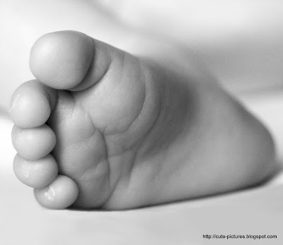
Foot and Ankle
26 bones in the foot
  7 tarsals
  5 metatarsals
  14 phalanges
38 joints in the foot
Ankle joint
  Talocrural joint
  Subtalar joint

Slide 4
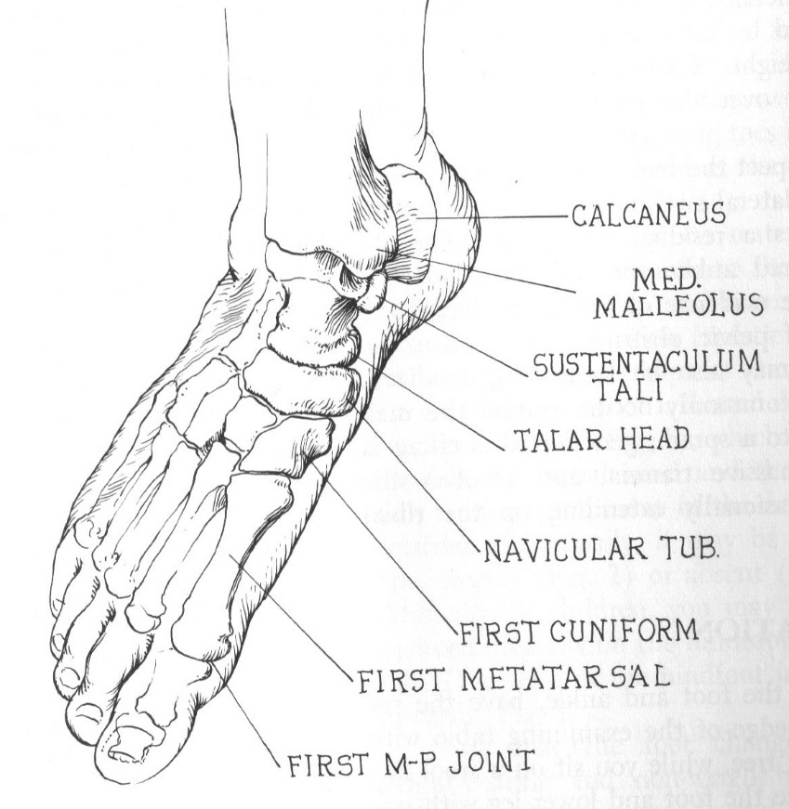
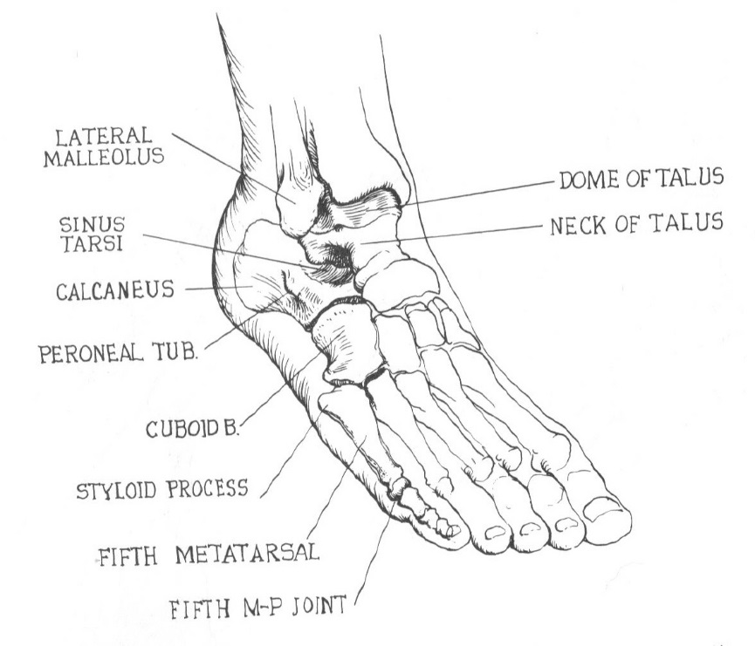
Foot and Ankle Anatomy
Medial
Lateral

Slide 5
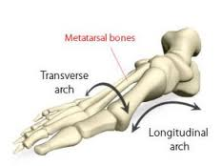
Arches

Slide 6
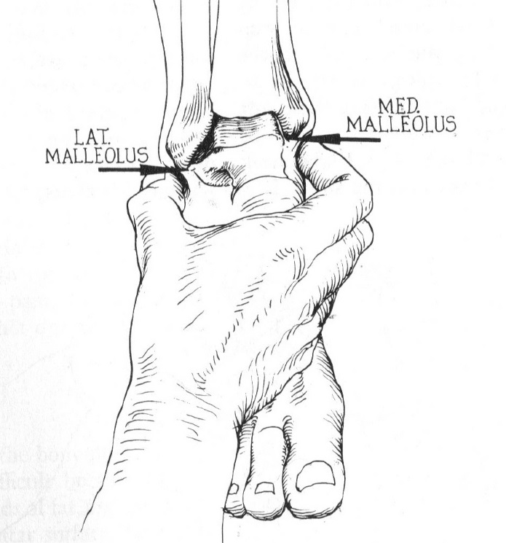
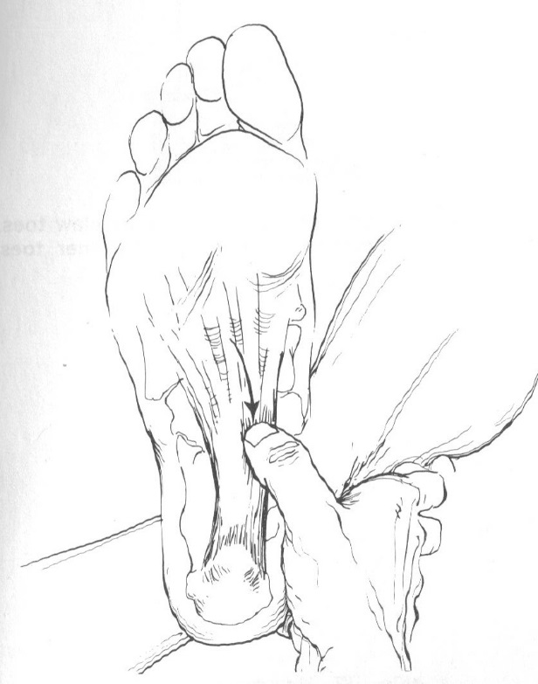
Foot and Ankle Anatomy
Medial & Lateral Malleolus
Plantar fascia

Slide 7
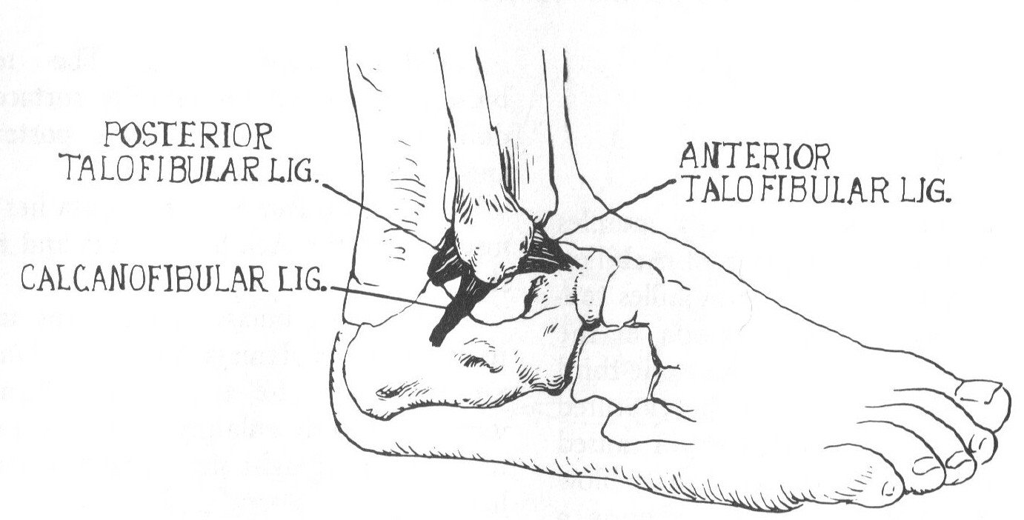
Lateral Ankle Ligaments

Slide 8
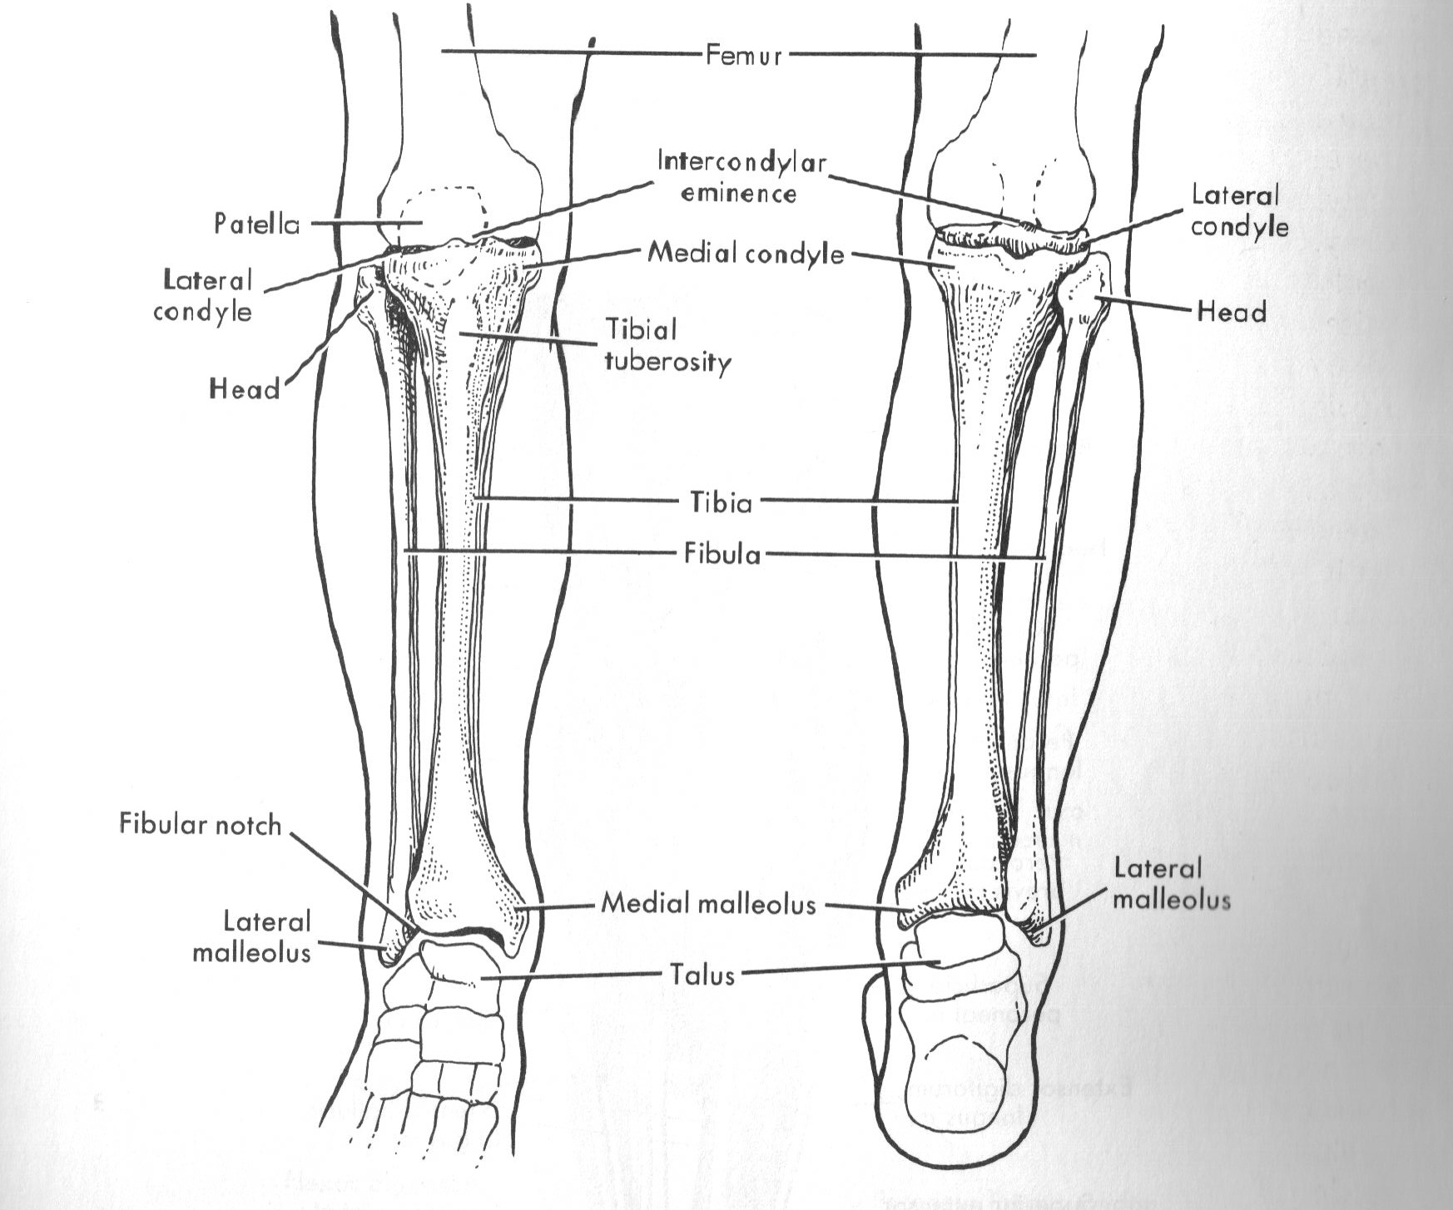
Lower Leg Bones

Slide 9
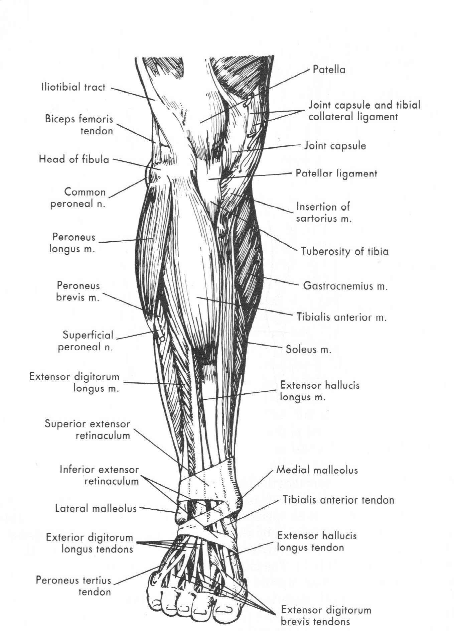
Anterior Lower Leg Muscles

Slide 10
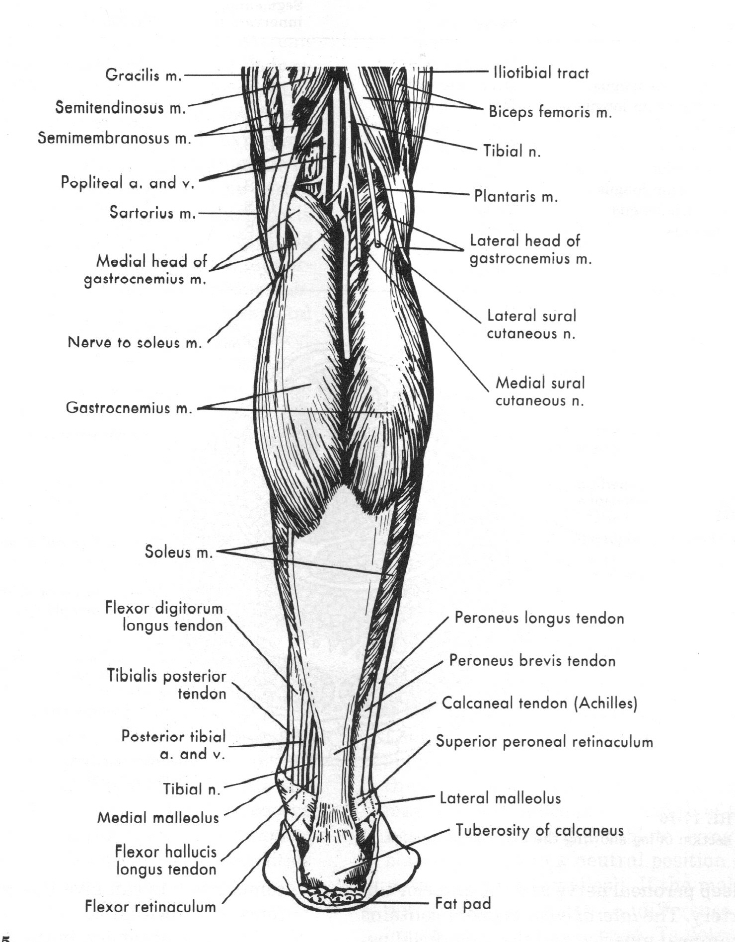
Posterior Lower Leg Muscles

Slide 11
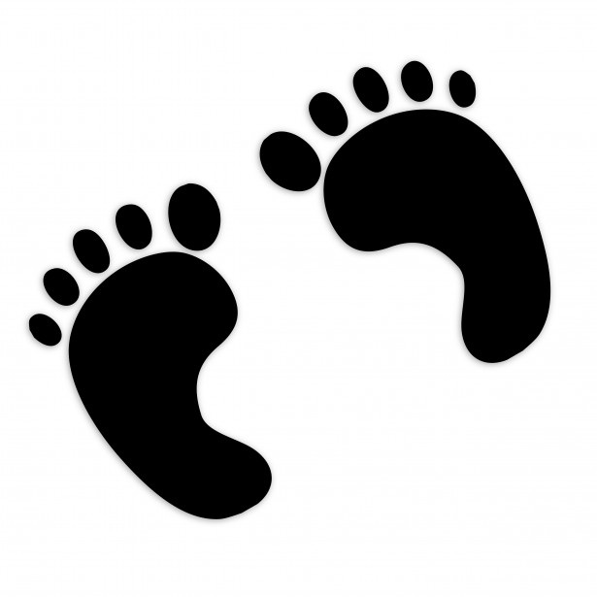
Injuries
Foot and Ankle

Slide 12
Ankle Sprains
Excessive inversion & plantar flexion
Lateral ligaments are usually involved
Medial sprain less common
“High” ankle sprain involves the structures between the tibia and fibula

Slide 13
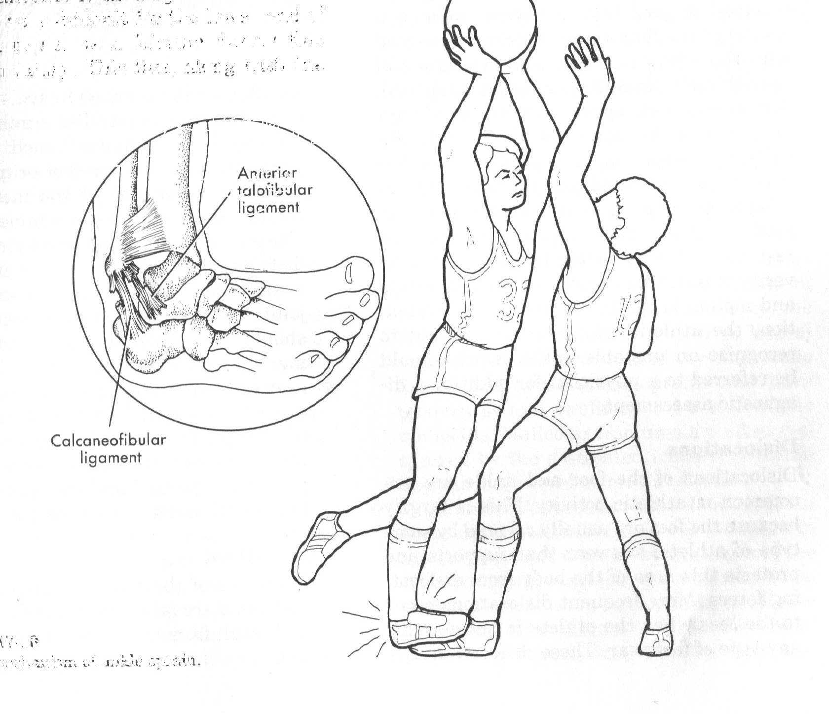
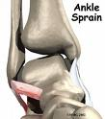
Lateral Ankle Sprain
Mechanism of Injury

Slide 14
Signs and Symptoms
Determined by Grade of injury
Grade I
  One or more ligaments stretched
Grade II
  One or more ligaments torn
Grade III
  One or more ligaments completely torn
  Sever joint instability

Slide 15
Lateral Ankle Sprain
Treatment
Prevention
P.R.I.C.E.
Rehabilitation exercises to improve range-of-motion should begin as soon as possible
Does wearing an ankle brace make the ankle weaker?
Strengthen the lower leg muscles

Slide 16

Arch Sprain
Mid-foot sprain
Transverse or Longitudinal
Improper footwear, repetitive stress, hard surfaces
Signs and symptoms will vary

Slide 17
Arch Sprain
Treatment
Prevention
P.R.I.C.E.
Can take several weeks to heal and may require a protective boot
Proper footwear for the activity

Slide 18
Blisters
Caused by friction
Separation of the dermis and the epidermis
Drain fluid if necessary
Keep clean and protected
Watch for signs of infection
Prevent by wearing appropriate shoes, socks, and reducing friction

Slide 19
Large Toe Sprain
“turf toe”
Forced flexion or extension
Signs and symptoms will vary
P.R.I.C.E.
Proper footwear can help prevent

Slide 20

Plantar Faciitis
Strain to the plantar aponeurosis or fascia
Pain increase first thing in the morning
Overuse injury from repeated forceful plantar flexion
Shoe inserts
Stretching exercises
  Gastrocnemius
  Soleus

Slide 21
Heel Injuries
Bruise
Spur
Contusion to the calcaneus or other tissue around the heel
Running and jumping activities
P.R.I.C.E.
Proper footwear can prevent injury
Bony growth on the calcaneus usually at the attachment of the plantar fascia
Goal for treatment should be to increase the flexibility of the plantar fascia
Proper footwear can prevent injury

Slide 22
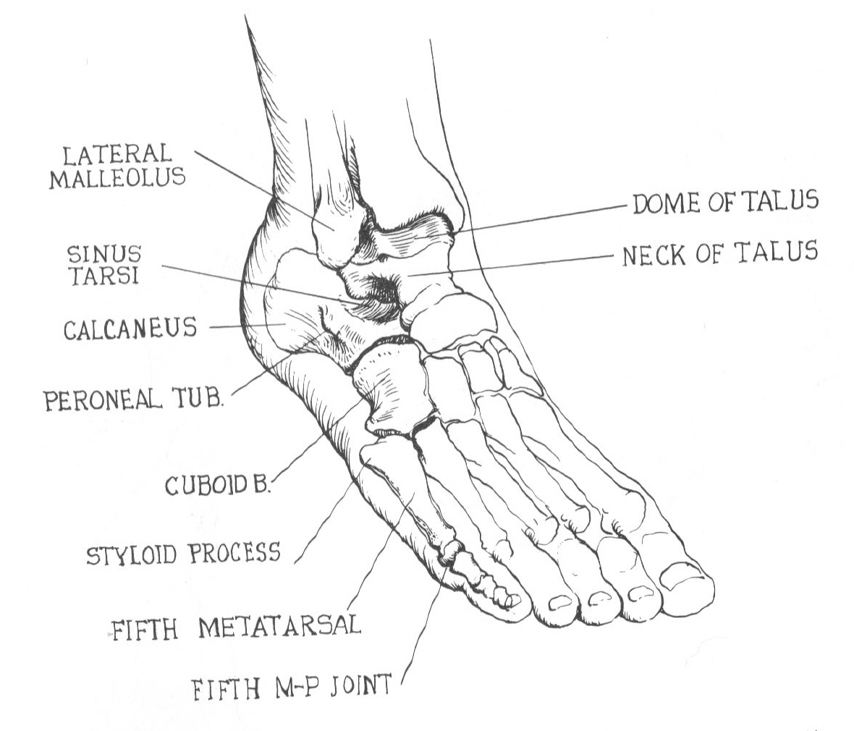
5th Metatarsal Avulsion Fracture
“Jones Fracture”
Peroneus brevis tendon pulls away from its attachment to the 5th metatarsal
Inversion force with forceful eversion

Slide 23


Toe Abnormalities
Halux Valgus - bunion
Hammer toes

Slide 24
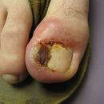

Ingrown Toenail
The skin extends over the edge of the nail while the nail grows into the nail bed
Causes pain and possible infection
Proper cutting of the nail is important

Slide 25
Athlete’s Foot (Tinea Pedis)
Fungal infection of the foot
Moisture, heat, darkness
Itching, rash, pimples or blisters
Keep feet clean and dry as much as possible

Slide 26
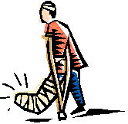
Injuries
Lower Leg

Slide 27
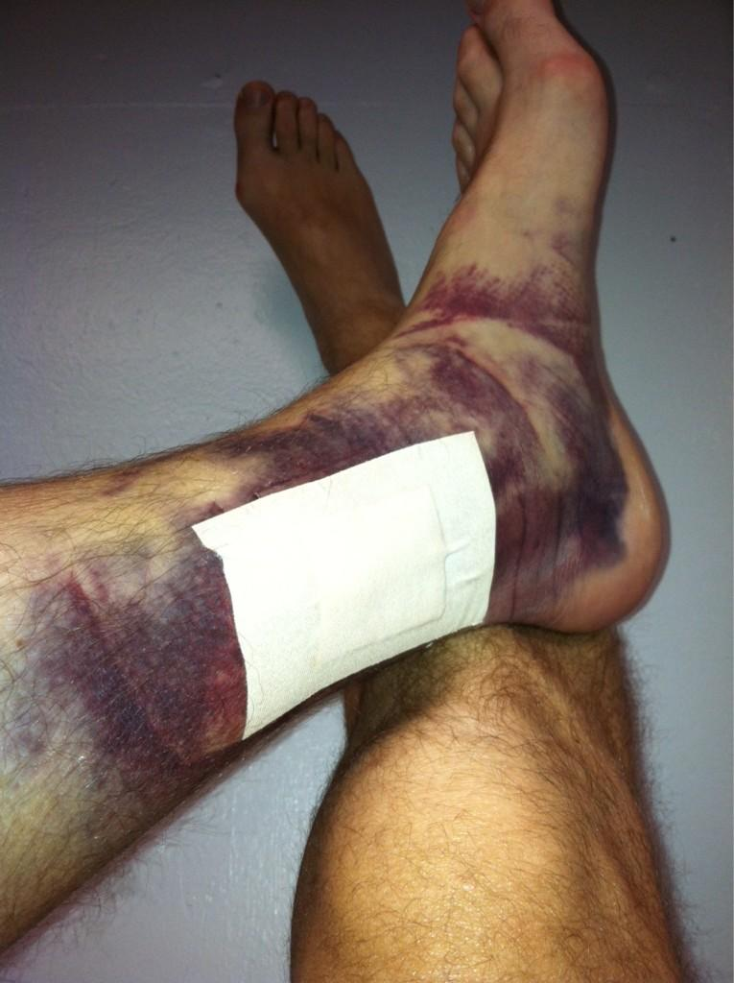
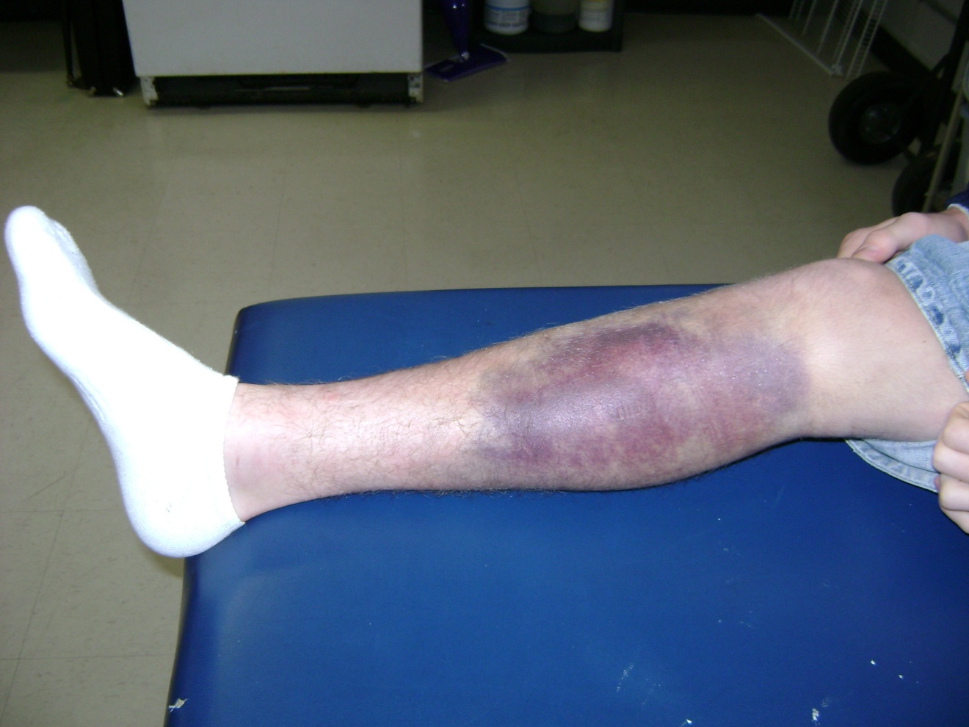
Contusions

Slide 28
Contusion Complications
Compartment syndrome (discussed later)
Myositis ossificans
Peroneal nerve damage that can cause “foot drop”

Slide 29
Muscle Strains
Gastrocnemius muscle the most common
Forceful contraction, overstretching, or overuse
Signs and symptoms will vary
Usual treatment and prevention for any muscle strain

Slide 30
Muscle Cramp
Sudden and involuntary contraction of the muscle
  Fatigue
  Dehydration
  muscle atrophy after fracture
  lack of nutrient
  poor flexibility
  improperly fitted equipment
Rest, passive stretching, and massage
Prevention will vary depending upon the cause

Slide 31
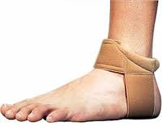
Achilles Tendonitis
Usually caused by repeated running, jumping, and landing
Symptoms develop gradually
P.R.I.C.E.
Best treatment is prevention
Proper condition and warm-up exercises
Improve flexibility

Slide 32

Achilles Tendon Rupture
Feels like a kick to the area
Inability to plantar flex the foot
Usually occurs in people over 30
Will require surgery to fix
Could take up to one year to recover

Slide 33
Shin Splints
Describes a variety of conditions characterized by pain and irritation or inflammation in the lower leg
Medial Tibial Stress Syndrome
Overuse injury
Tightness in the soleus and gastrocnemius muscles
R.I.C.E.
Strengthen the lower leg muscles and improve flexibility
Address any biomechanical issues such overpronation

Slide 34
Stress Fracture
Common in the tibia
Definite “hot spot” with palpation
Hurts to walk, especially at the end of the day
Rest – usually 4-8 weeks with gradual, progressive return to activity
Need to answer why this happened to this person?

Slide 35
Compartment Syndrome
Swelling of the compartment, or muscular area, between the tibia and the fibula
Usually the Anterior Compartment
Overuse or direct blow
Symptoms similar to shin splints
Intense pain that is exacerbated by movement, touch, pressure, and stretching
Muscle will feel tense with palpation
Acute cases are medical emergencies

Slide 36
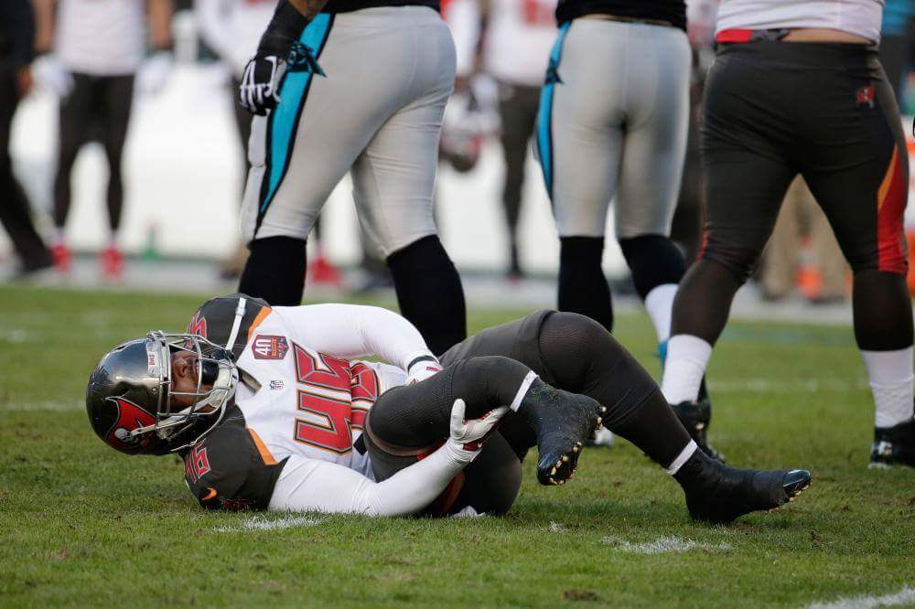
Fractures
Tibia and Fibula
Twisting force, direct blow, or overuse (stress fractures)
Is it an ankle sprain or a fibula fracture?
Stress fractures are common in the Tibia

Slide 37
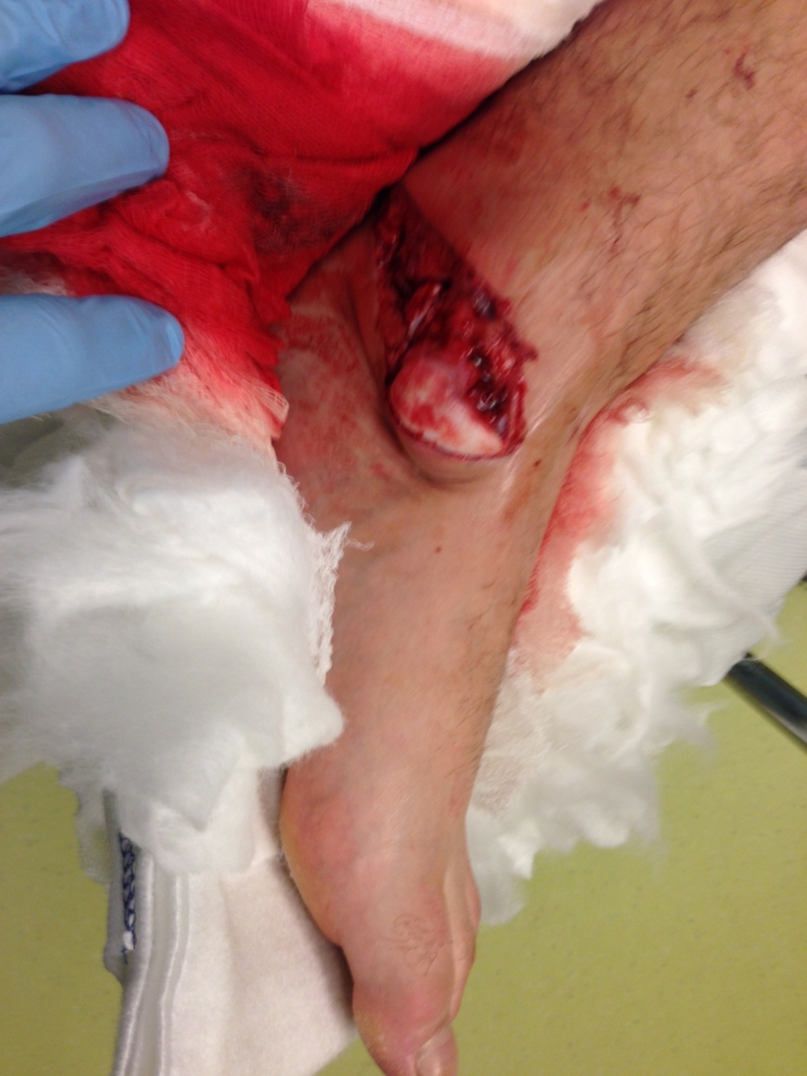
Compound fracture

Slide 38
Evaluations
Foot, Ankle, and Lower Leg

Slide 39
S.O.A.P.
Subjective
  History – chronic or acute injury?
Objective
  Observation
  Palpation
  Range of Motion (active, passive, resistive)
  Special Testing
Assessment
Plan

Slide 40
Observation
Foot
Ankle

Slide 41
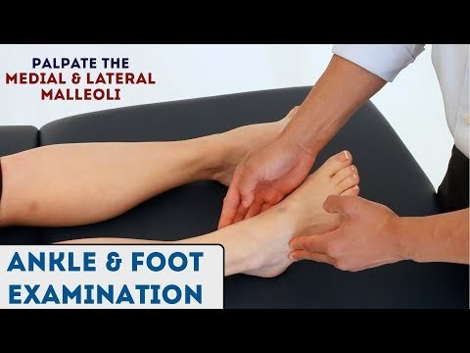
Foot Palpation
https://www.youtube.com/watch?v=NZocTa8RqR8

Slide 42
Ankle Range of Motion
Dorsiflexion & Plantarflexion
Inversion & Eversion

Slide 43
Ankle Special Test
Anterior Drawer
Talar Tilt - Inversion
https://www.youtube.com/watch?v=vAcBEYZKcto
https://www.youtube.com/watch?v=UHNbm6Z3XK4

Slide 44
Fracture Special Tests
Bump Test
Squeeze Test

Slide 45
Thompson Test
https://www.youtube.com/watch?v=z-7cJ7LpCqY

Slide 46

The End

