Slide 1
The Knee
Angie Guggino, MS, ATC, LAT

Slide 2
Learning Target
The common injuries to the knee joint.

Slide 3
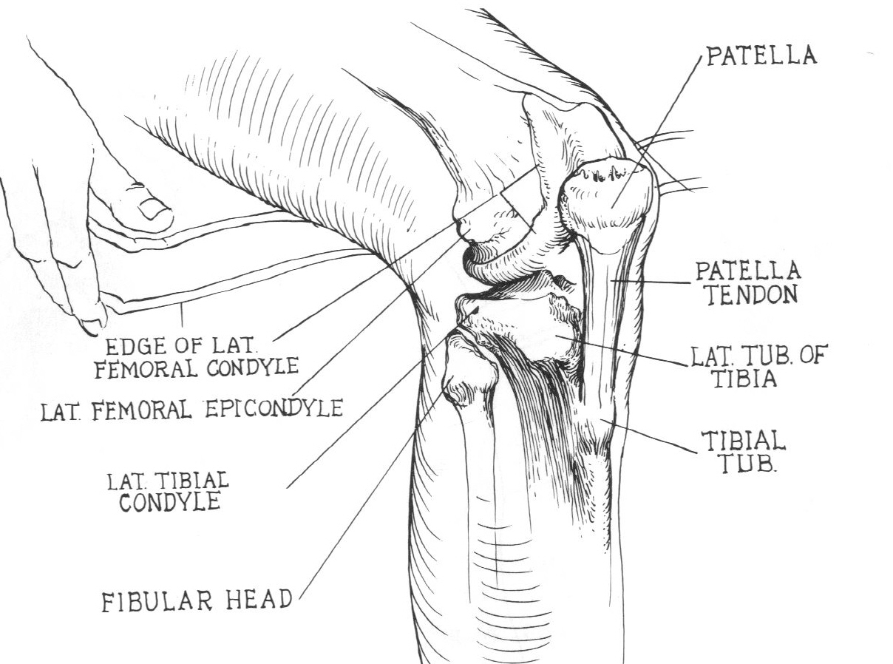
Lateral Knee

Slide 4
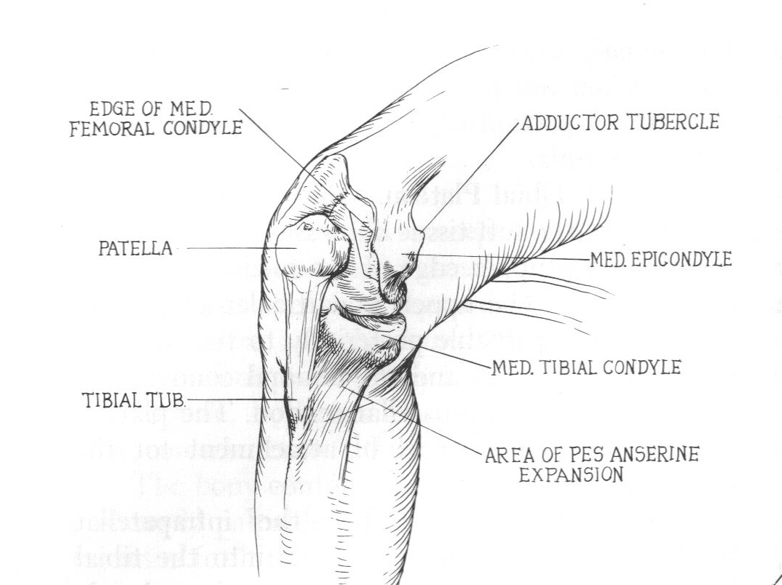
Medial Knee

Slide 5
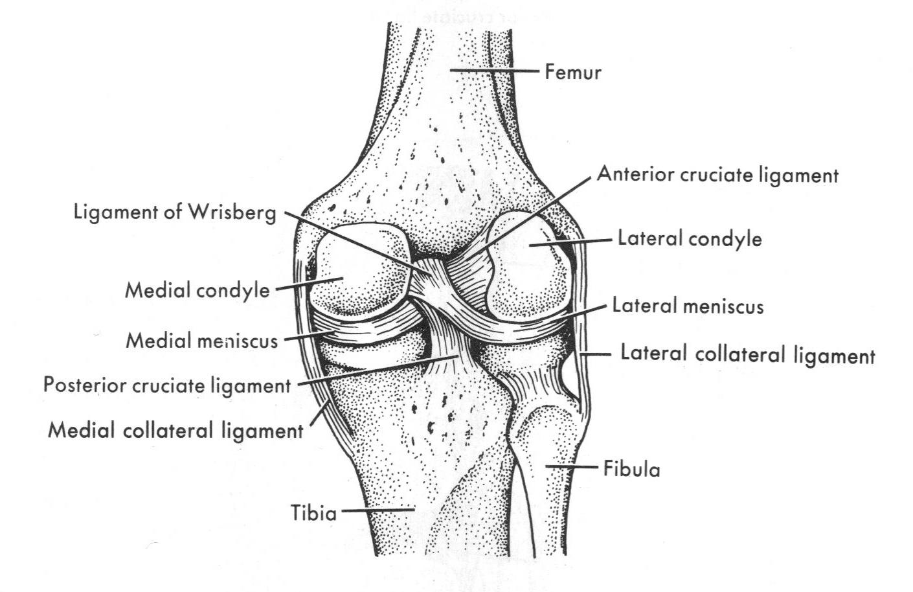
Posterior Knee

Slide 6
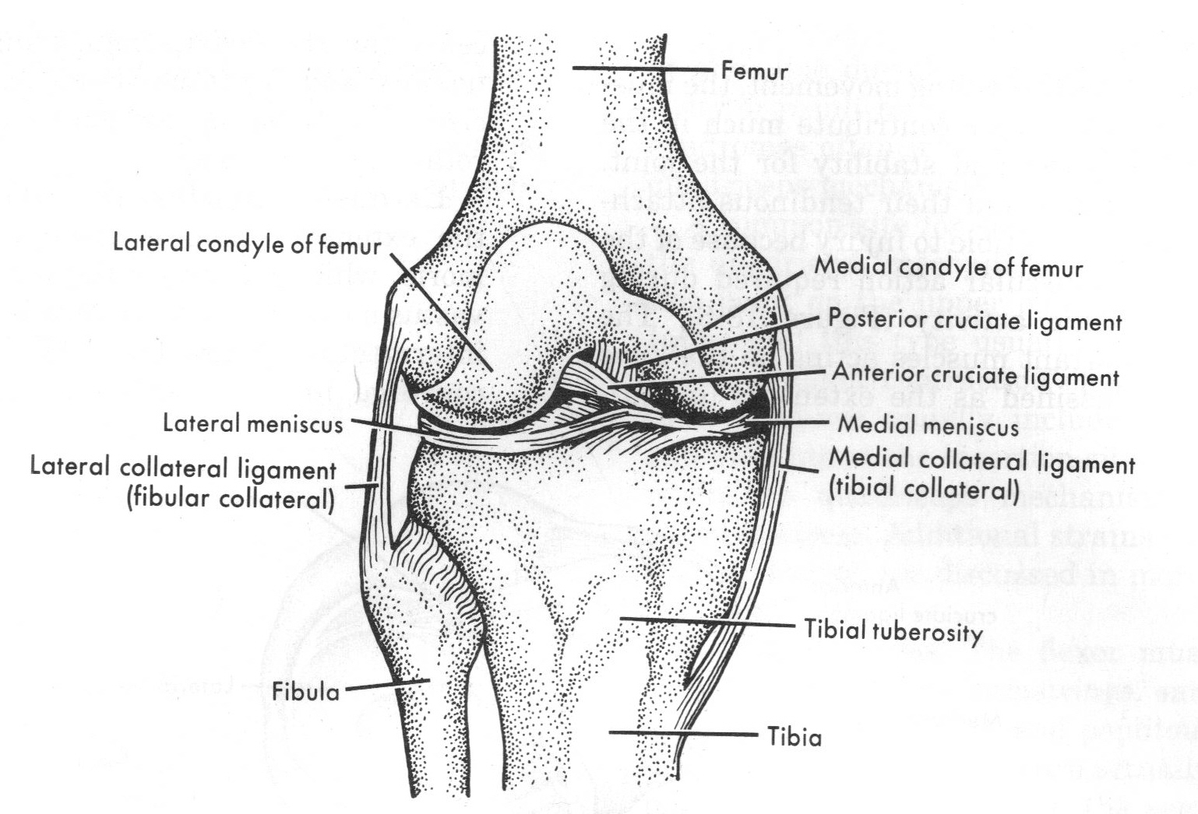
Anterior Knee (patella removed)

Slide 7
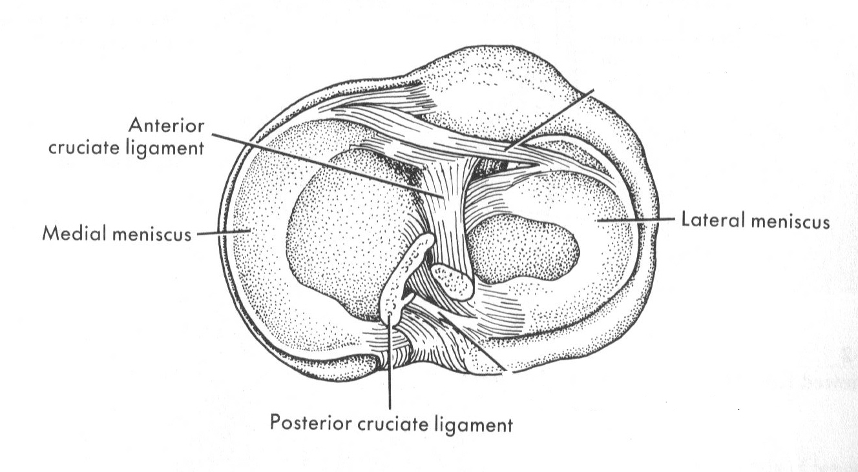
Superior Knee

Slide 8
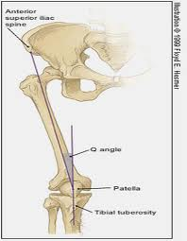
Q-Angle

Slide 9
The Knee
Injuries

Slide 10
Patellofemoral Problems
Articulation of the patella with the femur (trochlear grove)
Gradual onset of pain in the anterior knee
Crepitus
  grinding noise or sensation within a joint
Squinting patellae
Chondromalacia Patellae

Slide 11
Chondromalacia Patellae
Gradual degenerative change that occurs to the cartilage beneath the patella and on the surface of the femur
Muscle strength is not balanced causing the patella to move off center of the trochlear groove
Squats, walking down stairs, sitting for long periods cause an increase in pain
Very, very, very, common

Slide 12
Patellofemoral Treatment
Manage pain
  Ice, heat, NSAID’s
Therapeutic exercises to improve strength and flexibility
  Must continue to do exercises or pain will return
Taping and/or bracing

Slide 13
Patellar Tendonitis
“jumper’s knee”
Repeated forceful extension of the knee
Running down hill or down stairs

Slide 14
Patellar Tendonitis
Signs and Symptoms
Treatment and Prevention
Pain over the site of the patellar tendon on palpation
Mild swelling in some cases
Ice
Rest
Taping/bracing
Stretching quadriceps
Activity modification

Slide 15
Fat Pad Syndrome
Inflammation of the fat pad underneath the patella (Hoffa’s fat pad)
Pain just below the patella
Often confused with patellar tendonitis
Hurts with full knee extension
Ice and anti-inflammatory medication
Strengthening exercises and taping

Slide 16
Medial Collateral Ligament Sprain
Blow to the lateral aspect of the knee
  valgus force
Symptoms will vary depending upon degree

Slide 17
MCL Sprain
Grade I
  Mild tenderness and swelling with no joint laxity
Grade II
  Significant tenderness with some swelling and noticeable joint laxity with end point
Grade III
  Significant joint laxity and pain
  Unstable
  Most likely will have additional injuries

Slide 18
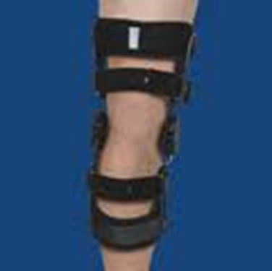
Treatment and Prevention
P.R.I.C.E.
Usually does not require surgery to fix

Slide 19

Lateral Collateral Ligament Sprain
Blow to the medial aspect of the knee
  Varus force
Not common
P.R.I.C.E.
Usually do not require surgery to fix

Slide 20
Anterior Cruciate Ligament
Usually do not follow a grading scale
Now more common in females than males
  Biomechanical factors
  Hormonal influences
  Environmental factors
  Anatomic risk factors

Slide 21
Anterior Cruciate Ligament
Mechanism of Injury
  twisting force applied to the knee while the foot is firmly planted
  can also result from a direct blow to the knee, usually the lateral side
  sometimes seen in combination with a medial meniscus tear and MCL sprain

Slide 22
Signs and Symptoms
may be an audible pop or crack at the time of injury
feeling of initial instability, may be masked later by extensive swelling
  joint effusion
extremely painful, in particular, immediately after sustaining the injury.
swelling of the knee, usually immediate and extensive, but can be minimal or delayed.
restricted movement, especially an inability to fully straighten the leg
  flexion contracture
Possible widespread mild tenderness

Slide 23
Treatment
Surgical reconstruction
  extra articular technique (taking a structure that lies outside the joint capsule such as a portion of the hamstring tendon)
  Intra articular technique (using a structure from within the knee such as part of the patellar tendon) which will replace the anterior cruciate ligament.
  Cadaver used often today
Usually a 6-12 month recovery

Slide 24
Prevention
Can ACL tears be prevented?
  Stronger hamstrings and gluteus muscles
  Landing techniques
  Bracing in some sports

Slide 25
Posterior Cruciate Ligament
less common than ACL due to the greater thickness and strength of the PCL.
direct impact to the front of the tibia usually when the knee is bent (falling with the knee bent)
pain at the time of impact which, over time, may also be felt in the calf region.
swelling, instability of the joint, perhaps associated with the feeling of the knee 'giving way.
P.R.I.C.E, sometimes surgery, brace

Slide 26
Tears of the Meniscus
Result from rotation or twisting of the knee
Menisci lose rubbery consistency, soften, and fray with age
May or may not be severe pain or loss of motion
Pain, popping, locking, or giving way of the knee

Slide 27
Treatment & Prevention
Immediate treatment is R.I.C.E.
Physical therapy to strengthen the muscles around the knee
May require surgery to fix
No prevention

Slide 28
Epiphyseal Injuries
Growth- plate injury
Younger children are less likely to tear ligaments

Slide 29
Osgood-Schlatter Disease
Inflammation or irritation of the tibia at its point of attachment with the patellar tendon
Genetic predisposition
Occurs during adolescence as a result of repeated stress on the patellar tendon
  Ex: jumping and squats in the weight training

Slide 30
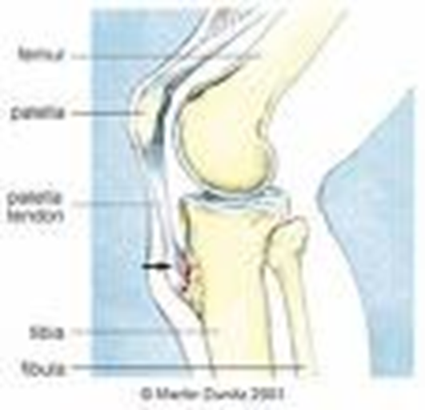
Osgood-Schlatter Disease
Signs & Symptoms
Pain on tibial tuberosity
Swelling
Weakness in quadriceps
Visible lump

Slide 31
Treatment
Manage the pain and decrease swelling
  Ice, NSAID’s, heat
Improve flexibility
  Quadriceps, hamstrings, adductors, IT Band
Protective padding over the area
Decrease activity if necessary until condition improves

Slide 32
Iliotibial Band Friction Syndrome
Inflammation of the I.T. Band
  Thick fibrous tissue that runs down the lateral side of the thigh from the ilium to the tibia
  Provide stability and assist with knee flexion
Irritation usually occurs over the lateral knee joint over the lateral portion of the femur
Sudden increase in activity is usually the cause

Slide 33
Treatment & Prevention
Analysis of the gait and training
Proper footwear
Icing and stretching

Slide 34
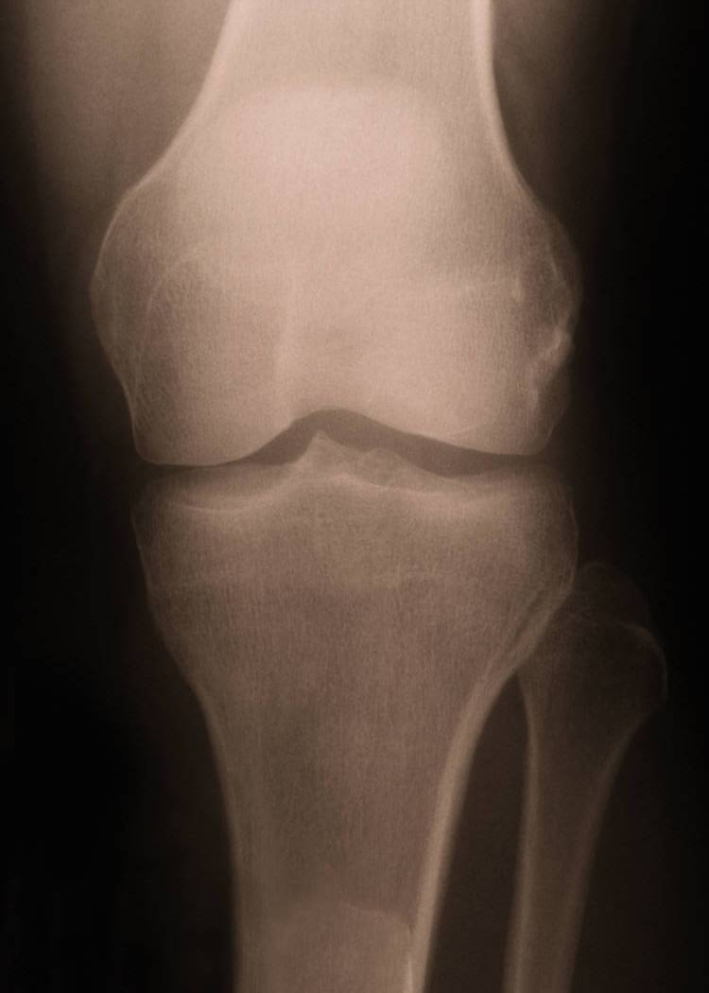
Fractures
Patella, Tibia, Fibula, Femur
Usually the result of a direct blow
Stress fractures are a possibility
Tibial Plateau

Slide 35

Dislocations and Subluxations
Usually to the patella
Usually the result of sudden internal rotation of the trunk while the foot is planted
Dislocations of the femur/tibia are medical emergencies

Slide 36
Treatment and Prevention
Icing, NSAID’s
Muscle strengthening and bracing to prevent reoccurrence

Slide 37
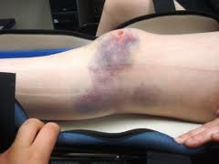
Contusions
Can cause considerable swelling which can limit range of motion
Direct blow
P.R.I.C.E.
Knee pads

Slide 38
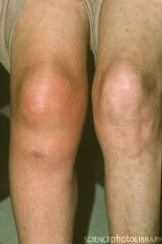
Bursitis
Prepatellar bursa is susceptible
Can cause significant swelling a loss of motion
Wrestling, volleyball, basketball
P.R.I.C.E.
Knee pads!!!

Slide 39
Evaluation
Knee

Slide 40
S.O.A.P Note
Subjective
  History
Objective
  Observation
  Palpation
  Range of motion
  Special Testing
Assessment
Plan

Slide 41
Knee Observation

Slide 42
Palpation

Slide 43
Knee Range of Motion
Zero to 135 degrees

Slide 44
Patella Grind Test
https://www.youtube.com/watch?v=pRqnODPqxFs

Slide 45
Noble’s Compression
https://www.youtube.com/watch?v=PmUGl7ryQOo

Slide 46
Patellar Apprehension Test
https://www.youtube.com/watch?v=4TnCQppTy1g

Slide 47
Valgus and Varus Stress Test
https://www.youtube.com/watch?v=sg1gk6QKARw

Slide 48
Special Tests
Anterior Drawer
Lachmans Test
https://www.youtube.com/watch?v=IdnBKv38EEQ
Positive Test https://www.youtube.com/watch?v=TX1cm8jzhHQ
https://www.youtube.com/watch?v=JFkbKNNa7xQ

Slide 49
Special Tests
Posterior Drawer
Posterior Sag Test
https://www.youtube.com/watch?v=wDIGll5wzZs
https://www.youtube.com/watch?v=7vgTMnfP4fs

Slide 50
Special Test
Apley’s Compression Test
McMurray’s Test
https://www.youtube.com/watch?v=6Z_9lfX_Pc8
https://www.youtube.com/watch?v=lwDFPAyGGgI

Slide 51
S.O.A.P Note
Subjective
  History
Objective
  Observation
  Palpation
  Range of motion
  Special Testing
Assessment
Plan

Slide 52
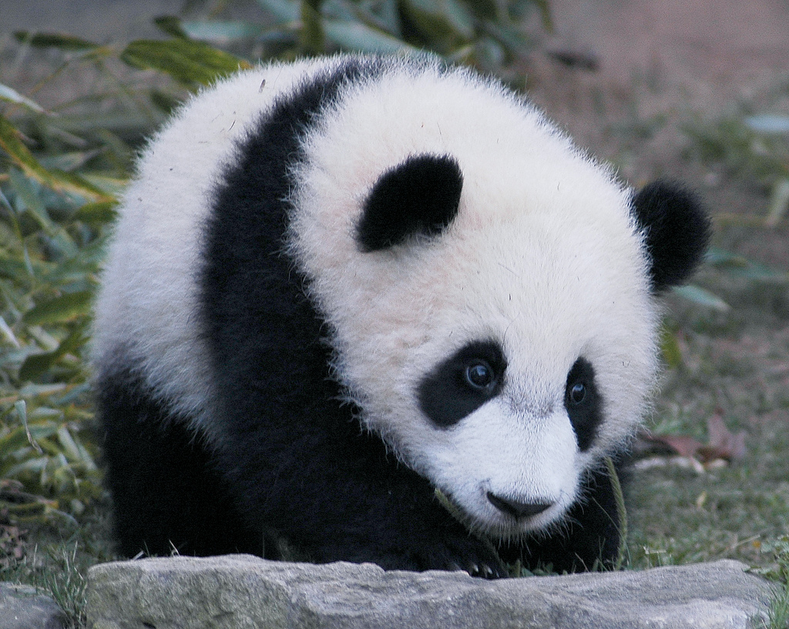
The End

