Slide 1
Elbow, Wrist, and Hand
Angie Guggino, MS, ATC, LAT

Slide 2

Learning Target
The common injuries to the elbow, wrist, and hand.

Slide 3
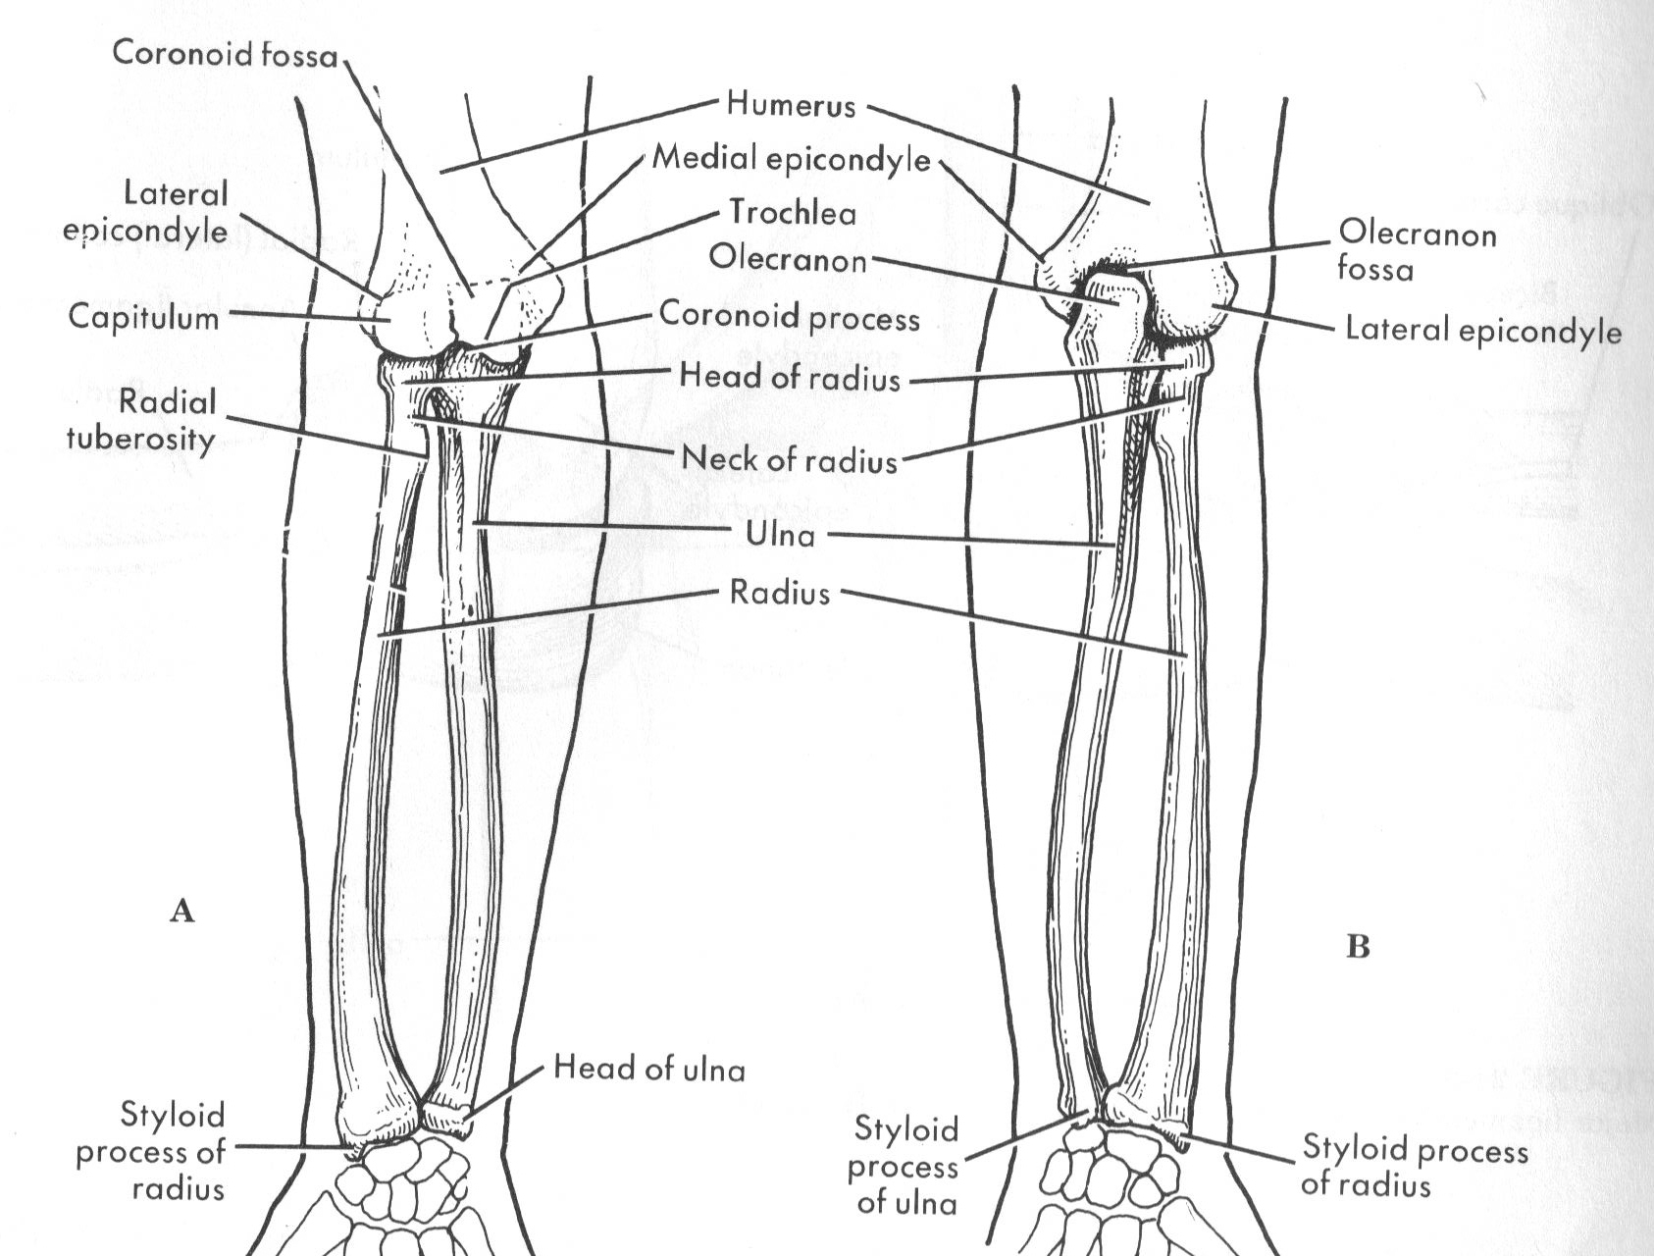
Anterior and Posterior

Slide 4
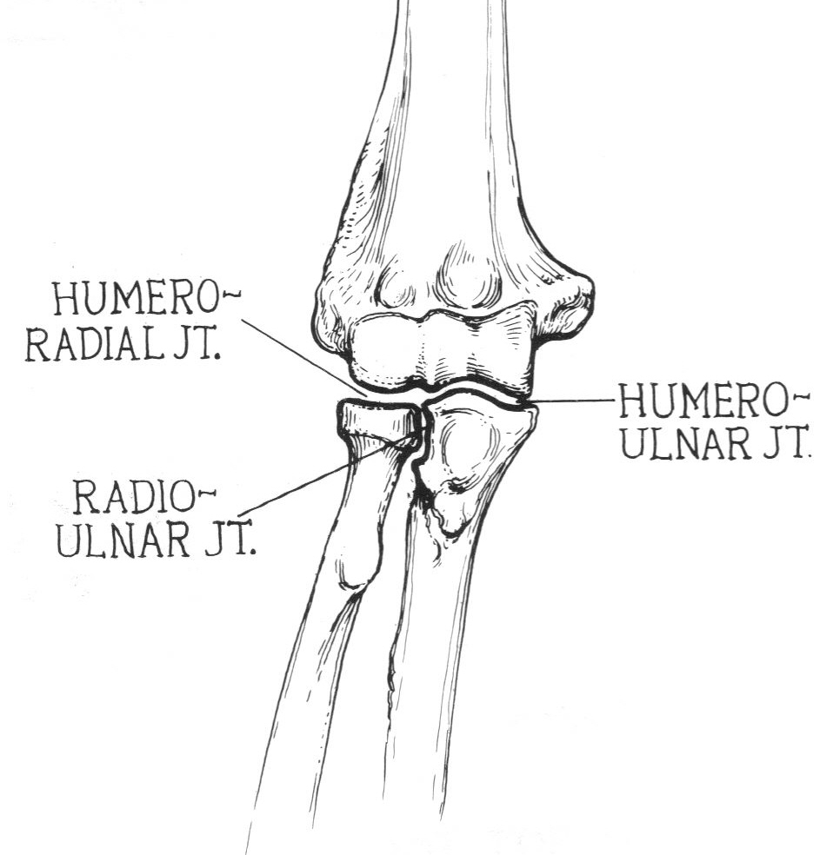
Anterior View of the Joints

Slide 5
Muscles of the elbow
Brachialis
  flexes
Triceps brachii
  extends
Biceps brachii
  flexes and supinates hand
Aconeus
  extends
Brachioradialis
  flexes

Slide 6
Contusions
Bruise
Direct blow to the area
Myositis ossificans is possible
Swelling can lead to a decrease in motion
No special tests
R.I.C.E.
Elbow padding

Slide 7
Olecranon Bursitis
Inflammation of the bursa
Olecranon bursa is the most frequently injured due to its superficial location
Can be result of repeated stressful motions or direct trauma
Swelling can be instantaneous and severe

Slide 8
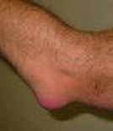
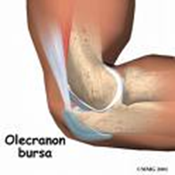
Olecranon Bursitis
Treatment & Prevention
Rest, Ice, Compression
Anti-inflammatories
Aspiration in some cases
Padding

Slide 9
Ulnar Nerve Contusion
“hitting the funny bone”
Direct blow
Immediate pain and burning sensation down the ulnar side of the forearm
No real treatment, symptoms usually resolve within minutes
Padding for prevention

Slide 10
Elbow Strains
Can be acute or chronic
Common in flexor tendon around medial epicondyle in throwing athletes
Symptoms will depend on severity of injury
  Pain, tenderness, decrease in motion and strength, palpable defect in the muscle
P.R.I.C.E. used as treatment in most cases
Strengthening the muscles in the elbow joint can prevent most strains

Slide 11
Epicondylitis
Chronic inflammation (strain) of the medial or lateral epicondyle in the elbow
Medial = golfer’s elbow, little league elbow
Lateral = tennis elbow
Tenderness of the epicondyle, pain with use, swelling
Treated with R.I.C.E.
Preventative measures include proper techniques and use of appropriate equipment

Slide 12

Elbow Sprains
Medial ligament tear in throwing athletes
“Tommy John” surgery
“click” or “pop” at time on injury
Swelling and muscle spasms

Slide 13
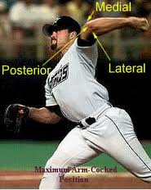
The Thrower

Slide 14
Treatment and Prevention
P.R.I.C.E.
Proper mechanics and strengthening the muscles around the elbow can help prevent injury

Slide 15
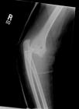
Dislocations and Subluxations
Fall on outstretched arm
Limb is twisted
Arm pulled
Posterior or Anterior translation of the Olecranon Process
Needs to be reduced by a physician

Slide 16
Fractures
Usually affect the lower end of the humerus in adults
Epiphyseal and Avulsion Fractures common on medial epicondyle or olecranon adolescents

Slide 17
Volkmann’s Contracture
Decrease in blood supply to the forearm
Caused by swelling, trauma, and/or fracture
Flexion contracture of one or more fingers depending on severity
Severe pain when fingers are straightened passively
Refer to physician immediately

Slide 18
Nerve Impingement
Ulnar nerve
  Cubital tunnel syndrome
Radial nerve
  Radial tunnel syndrome
Median nerve
  Pronator teres syndrome

Slide 19
Injury Evaluation
The Elbow

Slide 20
S.O.A.P. Note
Subjective
  History
Objective
  Observation
  Palpation
  Range of Motion
  Special Tests
Assessment
Plan

Slide 21
Elbow Observation

Slide 22
Elbow Palpation

Slide 23
Range of Motion
Flexion & Extension

Slide 24
Special Test
Valgus - Medial
Varus - Lateral

Slide 25
S.O.A.P. Note
Subjective
  History
Objective
  Observation
  Palpation
  Range of Motion
  Special Tests
Assessment
Plan

Slide 26
Wrist and Hand
Anatomy

Slide 27
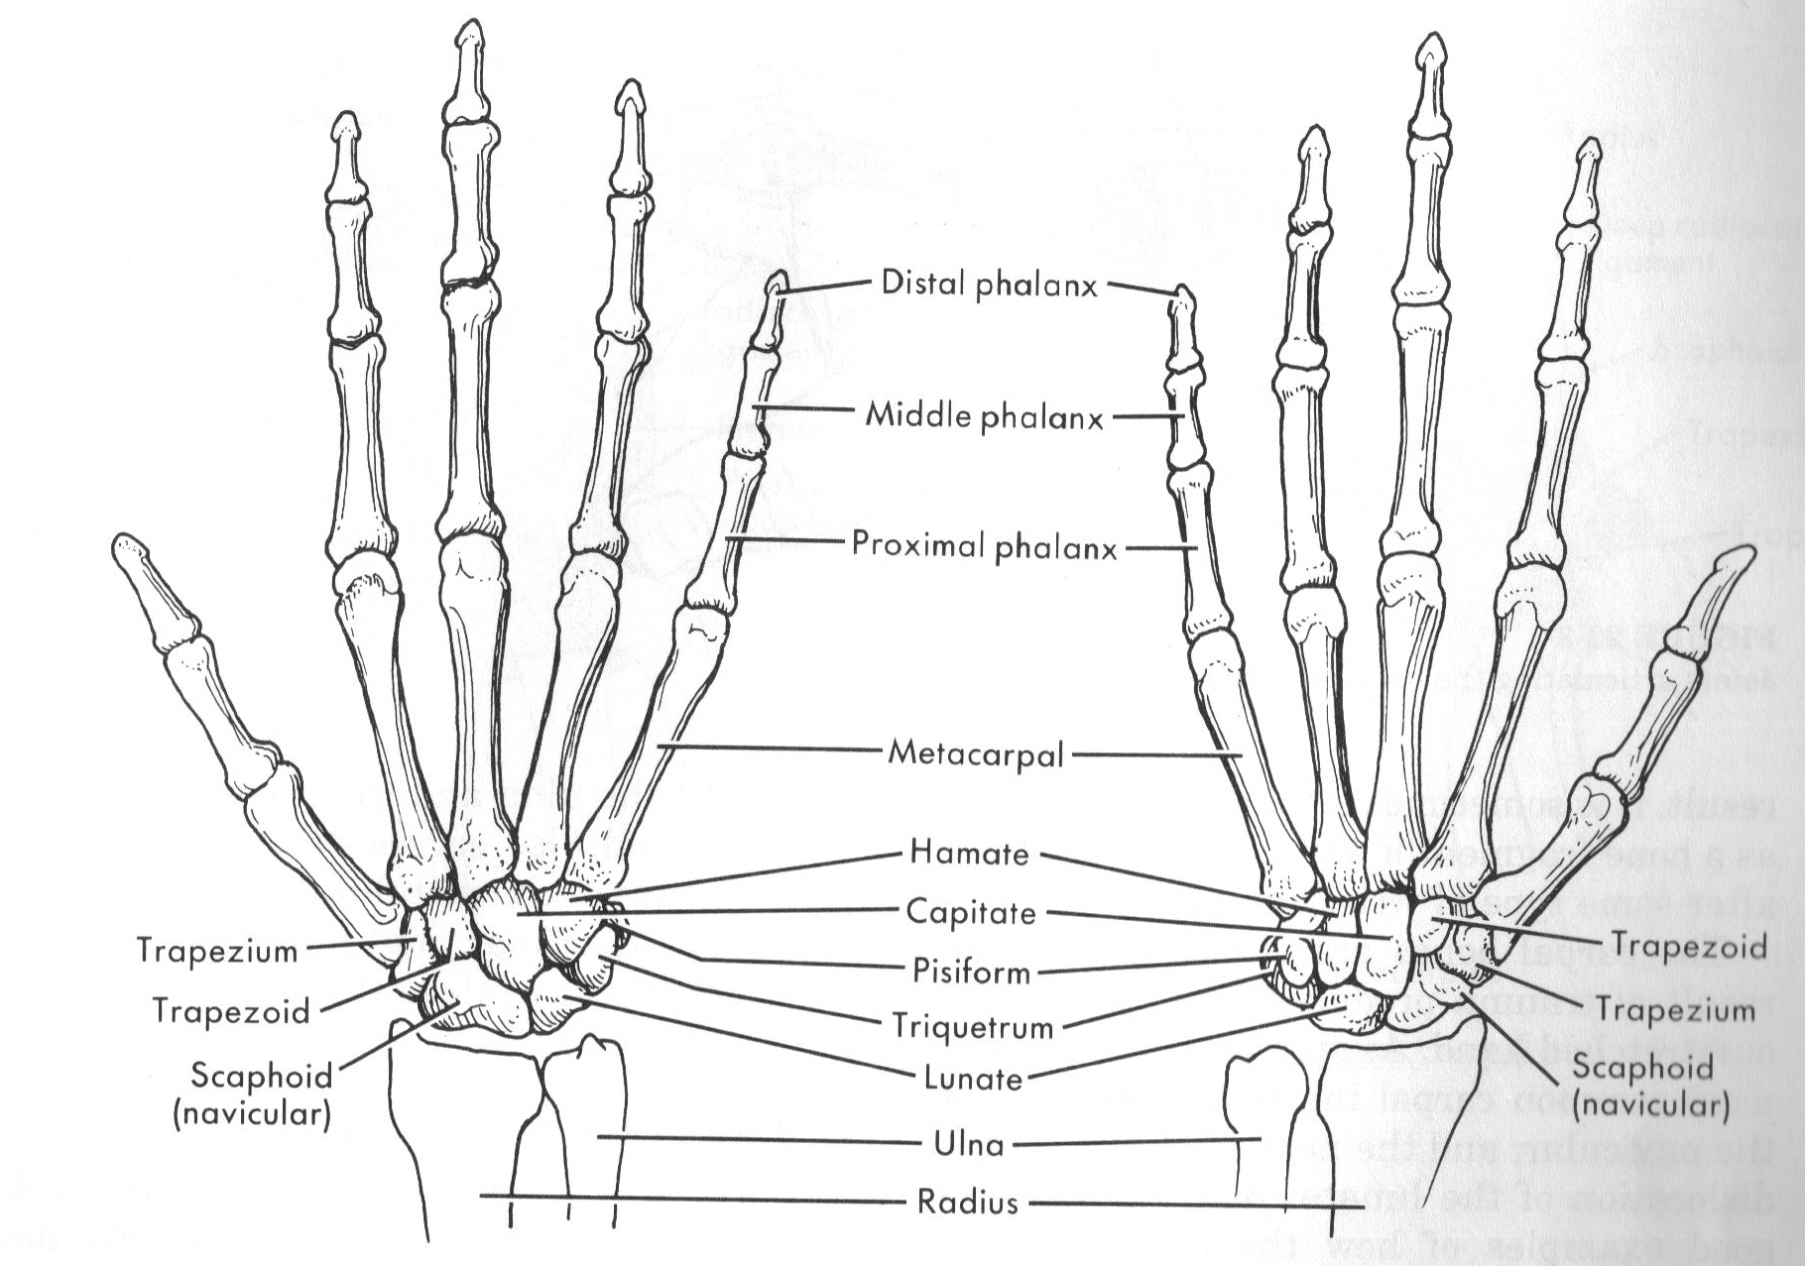
Anterior and Posterior Hand (left)

Slide 28
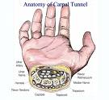
Anatomy

Slide 29
Muscles
Flex the wrist
  Flexor carpi radialis, Flexor carpi ulnaris
Extend the wrist
  Extensor carpi radialis brevis, Extensor carpi radialis longus, Extensor carpi ulnaris
Supination of forearm
  supinator
Pronation
  Pronator teres, pronator quadratus

Slide 30
Muscles
Pollicis = thumb
Flexor pollicis longus, flexor pollicis brevis
Extensor pollicis longus, extensor pollicis brevis
Adductor pollicis
Abductor pollicis longus, abductor pollicis brevis
Opponens pollicis

Slide 31
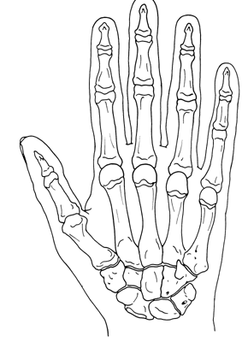
Fractures
Boxer’s Fracture
Bennett’s Fracture

Slide 32

Mallet Finger
Caused by damage to the extensor tendon
Patient will not be able to actively extend injured finger
Most are fixed with splinting (6 weeks)

Slide 33
Jersey Finger
Tear in the flexor tendon
Patient will not be able to flex the D.I.P. joint
Usually requires surgery to fix

Slide 34
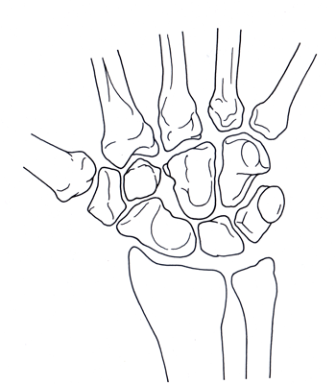
Navicular (Scaphoid) Fracture
Pain in anatomical snuffbox
Fall on outstretched hand
x-rays taken right after the injury may show no abnormality
Healing of this fracture usually takes 10 to 12 weeks
Poor blood supply

Slide 35

Colles’ Fracture
Distal Radius Fracture
Displacement of the bone such that the wrist joint rests behind its normal anatomic position
Fall on outstretched hand

Slide 36
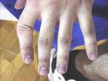
Dislocations and Subluxations
Caused by direct blow from a ball or fall

Slide 37
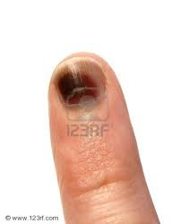
Contusions
Direct blows
May cause bleeding underneath the nail bed

Slide 38
Gamekeeper’s Thumb
Sprain to the Ulnar Collateral Ligament in the thumb

Slide 39
Finger and Wrist Sprains
Hyperextension or hyperflexion of the wrist
Jammed finger

Slide 40
de Quervain’s Tenosynovitis
Tenosynovitis vs. Tendonitis
Repeated stress or overuse
Text messages and video games

Slide 41
Carpel Tunnel Syndrome
Caused by repeated stress
Median nerve impingement
Night splints?

Slide 42

Ganglion Cyst of the Wrist
Fluid-filled sac in the synovial membrane that penetrates the tendon sheath
Often appears as a bump on the posterior aspect of the wrist

Slide 43
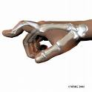
Boutonniere Deformity
Proximal joint flexes and the distal joint hyperextends due to tendon rupture
Caused by a force pushing the upper joint of the middle phalanx into excessive flexion

Slide 44
Injury Evaluation
Wrist and Hand

Slide 45
S.O.A.P. Note
Subjective
  History
Objective
  Observation
  Palpation
  Range of Motion
  Special Tests
Assessment
Plan

Slide 46
Hand Observation

Slide 47
Hand and Wrist Palpation

Slide 48
Hand and Wrist Movements
Wrist Movement
Finger Movement
Flexion
Extension
Radial Deviation
Ulnar Deviation
Flexion
Extension
Abduction
Adduction

Slide 49
Wrist Range of Motion Flexion and Extension

Slide 50
Hand Range of Motion

Slide 51
Special Test
Collateral Ligament Stress Test

Slide 52
Finkelstein’s Test

Slide 53
Special Test
Phalen’s Test
Tinel’s Sign

Slide 54
S.O.A.P. Note
Subjective
  History
Objective
  Observation
  Palpation
  Range of Motion
  Special Tests
Assessment
Plan

Slide 55

The End

