Slide 1
The Shoulder
Angie Guggino, MS, ATC, LAT

Slide 2

Learning Target
The common injuries to the shoulder.

Slide 3
The Shoulder Complex
Ligaments, cartilage, muscles
Only joint with 360 degrees of rotation
Dynamic stability

Slide 4
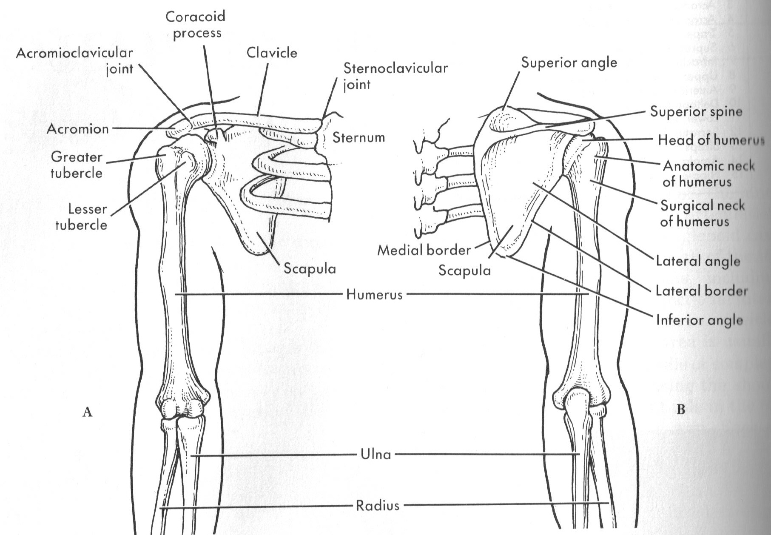
The Shoulder Complex

Slide 5
Joint Articulations
Glenohumeral joint
Acromioclavicular joint
Sternoclavicular joint
Scapulothoracic joint

Slide 6
The Rotator Cuff
Supraspinatus (external rotator)
Infraspinatus (external rotator)
Teres Minor (external rotator)
Subscapularis (internal rotator)

Slide 7
Force Couple
Two equal forces acting in opposite directions to rotate a part around an axis
Example: deltoid and rotator cuff

Slide 8
Scapulothoracic Mechanics
Where does the base of support for the shoulder complex come?
  scapula
What muscles support the scapula?
  Trapezius, rhomboids, serratus anterior, pectoralis minor

Slide 9
Shoulder Movements
Abduction
Adduction
Hyperextension
Flexion
Internal rotation
External rotation
Horizontal abduction
Horizontal adduction

Slide 10
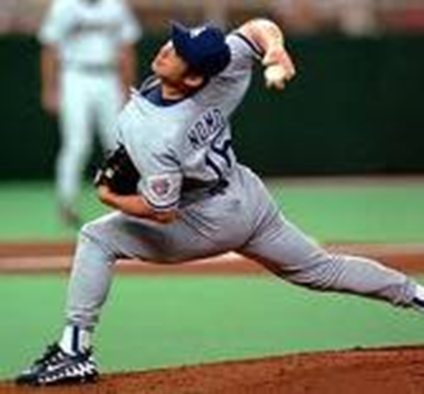
Shoulder
Injuries

Slide 11
Impingement Syndrome
The compression of soft tissue between the two ends of two or more bones due to tissue inflammation or bone displacement
Most common in the subacromial bursa associated with the glenohumeral joint
Repeated overhand activities

Slide 12
Signs and Symptoms
Pain and tenderness in the glenohumeral area
Pain or weakness with active abduction in midrange
Decrease in internal rotation
Tenderness to palpation in the subacromial bursa

Slide 13
Treatment and Prevention
Treatment
Prevention
Resting
Icing
Anti-inflammatories
Stretching
Strengthening exercises particularly for the rotator cuff

Slide 14
Rotator Cuff Tears
Repetitive-use injury usually seen in overhand throwing athletes
Sometimes can be the result of a fall
Seen in the older population as muscle and tendon tissues lose some elasticity and tear

Slide 15
Signs and Symptoms
Vague pain in the shoulder area
A “catching” sensation
In ability to sleep in the affected side
Inability to move the arm severe cases

Slide 16
Treatment and Prevention
Treatment
Prevention
Partial thickness tears usually respond well to therapy
Full thickness tears require surgery
Strengthen the muscles of the rotator cuff

Slide 17
Muscle Strains
Can be caused by overuse or traumatic injury
Pain and tenderness in area of muscle belly
General treatment is P.R.I.C.E.
Stretching and strengthening program can help prevent muscle strains
Proper warm-up

Slide 18
Biceps Tendonitis
Inflammation to the tendon of the long head of the biceps muscle
Overuse injury
Discomfort in the anterior aspect of the shoulder
Treatment is similar to an impingement

Slide 19
Biceps Tendon Rupture
Complete tear of the biceps tendon
Sudden onset of pain in the front of the shoulder associated with a “pop”
Drooping of the biceps muscle at the distal arm
Discoloration in the area
Surgery is sometimes needed to fix but several weeks of rest is usually the treatment of choice

Slide 20
Dislocations and Subluxations
Dislocations
  head of the humerus separates from the glenoid fossa usually anterior and inferior
  Occurs when the arm is abducted and externally rotated
Hill-Sachs Lesion
  indentation of the posterior humeral head resulting from the humerus hitting the glenoid during dislocation
Subluxation = individual will describe it “slipping out and back in”

Slide 21
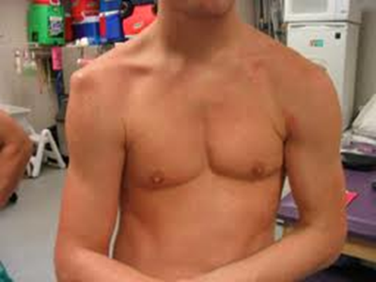
Signs and Symptoms
Pain
Inability to move the arm
Obvious deformity
No special test needed

Slide 22
Treatment and Prevention
Dislocations reduced by a medical professional
Rest, immobilization, and ice
Surgery may be needed if other structures are damage
Up to 90% likely it will happen again
Aggressive strengthening program needed

Slide 23

Labrum Injuries
Tear to the ring of cartilage (labrum) attached to the margin of the glenoid cavity of the scapula
Usually occurs with dislocations but can be overuse injury

Slide 24
Signs and Symptoms
Pain and a catching or popping sensation
Weakness in arm
Limited range of motion if severe
MRI is needed to confirm

Slide 25
Treatment and Prevention
Strengthening program for small tears
Surgery needed for most
Strengthen the rotator cuff

Slide 26
Multidirectional Instabilities
Congenital issue usually bilateral condition
Hyperflexibility
Usually not a problem until it becomes painful or the individual cannot do activity
No real signs or symptoms other than excessive movement in the joint

Slide 27
Treatment and Prevention
Strengthening program is necessary
Surgery would be necessary only if other issues occur
No real prevention

Slide 28
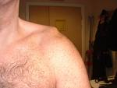
Acromioclavicualar Separation
A.C. sprain
Falling on shoulder or out stretched hand
Pain in the A.C. joint
“Piano key sign”

Slide 29
Treatment and Prevention
P.R.I.C.E.
Determined by the degree of injury
Severe cases require surgery
Proper protective equipment is needed for collision sports

Slide 30
Brachial Plexus Injury
Burner or stinger
Brachial plexus – group of nerves that leave the spinal cord and extend from the vertebrae into the shoulder
Nerves become irritated as a result of being stretched
Usually occurs when the head and neck are forcibly pushed or hit to one side

Slide 31
Signs and Symptoms
Intense pain from neck to arm
Arm goes dead or starts to burn or tingle
Inability to move the arm
Could last a few minutes or several days
No special tests, most testing done for chronic issue of thoracic outlet syndrome

Slide 32
Treatment and Prevention
Rest, Ice, anti-inflammatory medication
Chronic issue can result in elimination from contact sports
Signs and Symptoms need to resolve before individual is allow to return to play
Difficult to prevent

Slide 33
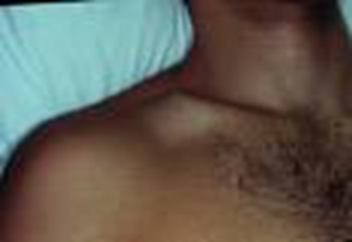
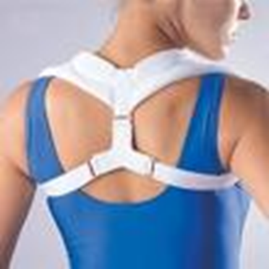
Fractures
Commonly occur to the clavicle
Direct blow or fall on outstretched hand
Deformity usually seen
Immobilization needed
Some require surgery to fix

Slide 34
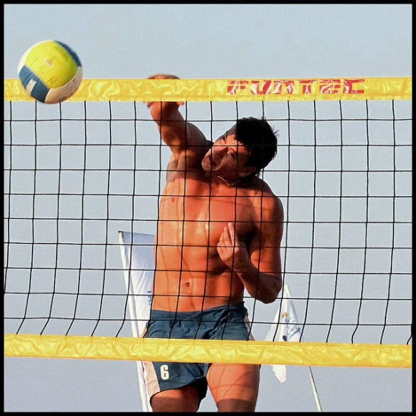
Evaluations
Shoulder

Slide 35
S.O.A.P. Note
Subjective
  History
Objective
  Observation
  Palpation
  Range of motion
  Special tests
Assessment
Plan

Slide 36
Shoulder Observation

Slide 37
Shoulder Palpation

Slide 38
Range of motion tests
Goniometer
Flexion & extension
Flexion = 170 – 180
Extension = 50-60
Internal rotation = 80-90
External rotation = 90-100
Abduction = 170-180

Slide 39
Range of Motion Tests
Internal and External Rotation

Slide 40
Special Tests
Hawkins-Kennedy
Neer

Slide 41
Special Tests
Drop Arm Test
Empty Can Test

Slide 42
Special Tests
Speed’s Test
Yergason’s Test

Slide 43
O’Brien’s Test

Slide 44
Special Tests
Apprehension
Relocation Test

Slide 45
Special Test
A.C. compression test
A.C. traction test

Slide 46
S.O.A.P. Note
Subjective
  History
Objective
  Observation
  Palpation
  Range of motion
  Special tests
Assessment
Plan

Slide 47

The End

