Slide 1
The Head and Face
Angie Guggino, MS, ATC, LAT

Slide 2

Learning Target
The common injuries to the head and face.

Slide 3
The Head
Cranium: collection of bones
  Temporal bone
  Frontal bone
  Occipital bone
  Parietal bone
Sutures: immovable joints that hold together the bones of the cranium

Slide 4
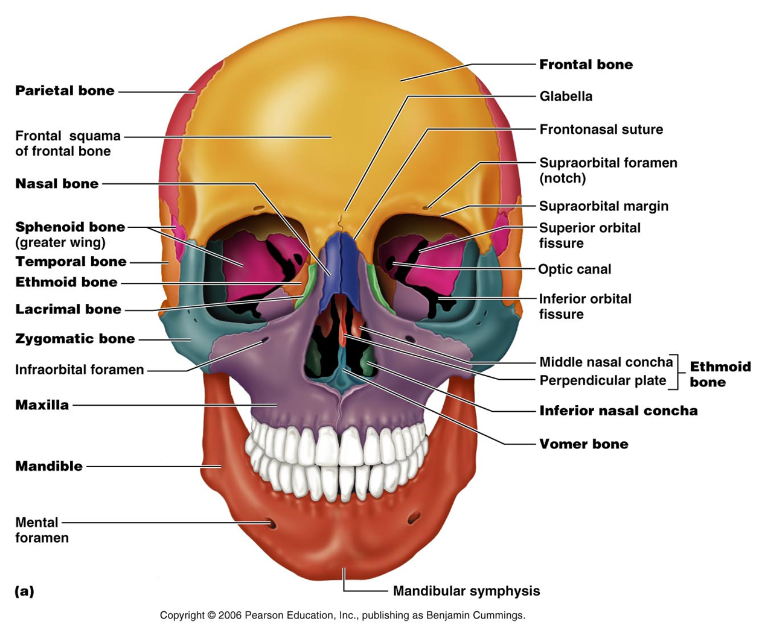
Bones
Figure 7.2a

Slide 5
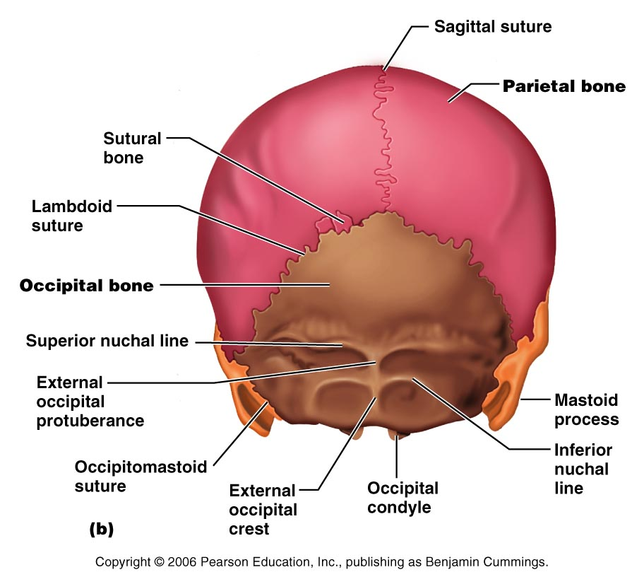
Figure 7.2b

Slide 6
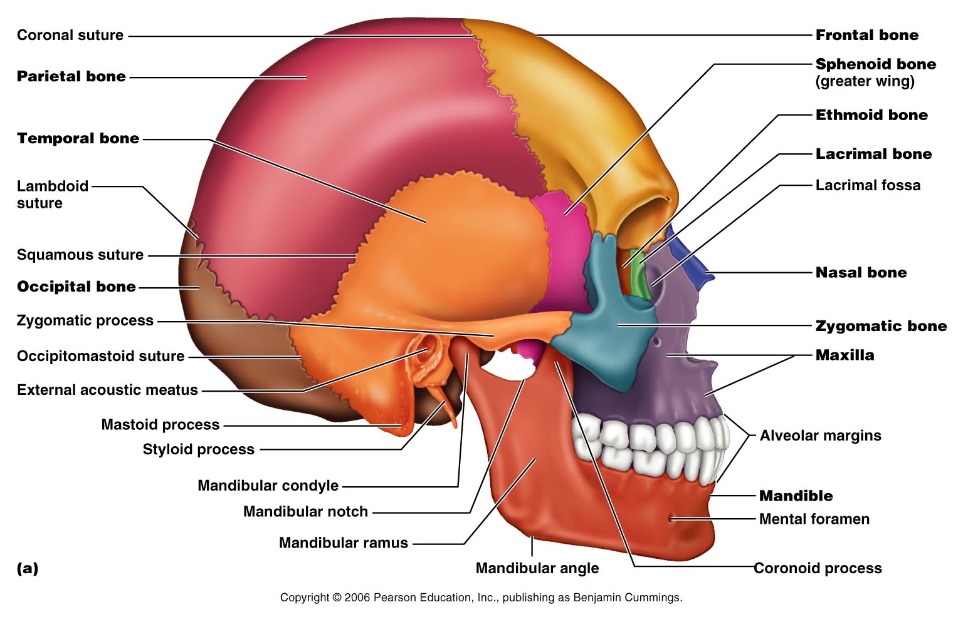
Figure 7.3a

Slide 7
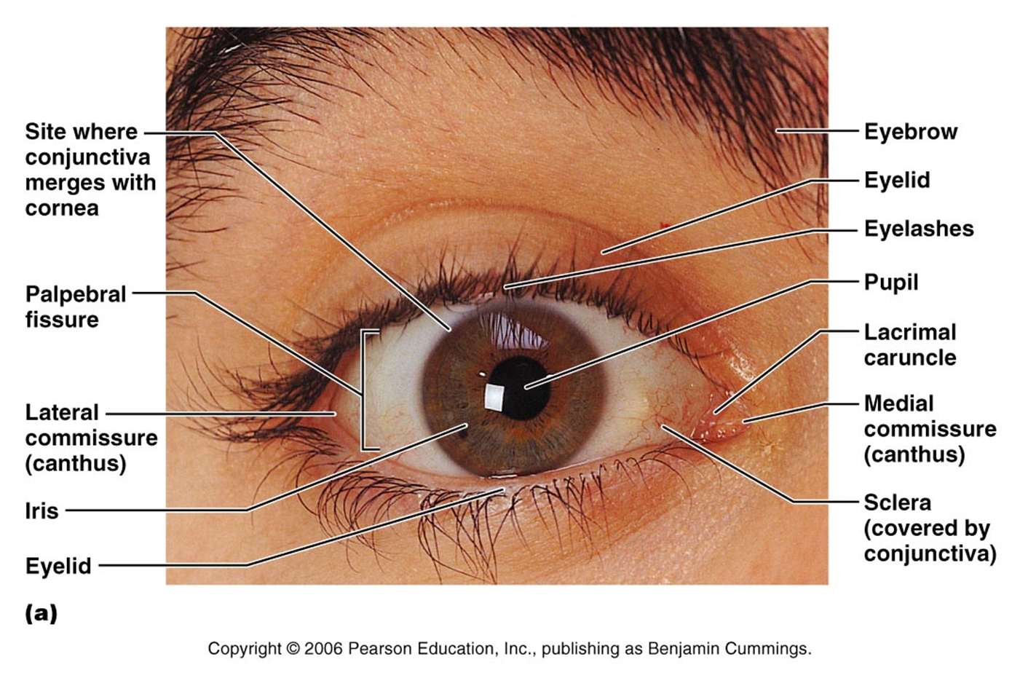
Eye Anatomy
Figure 15.1a

Slide 8
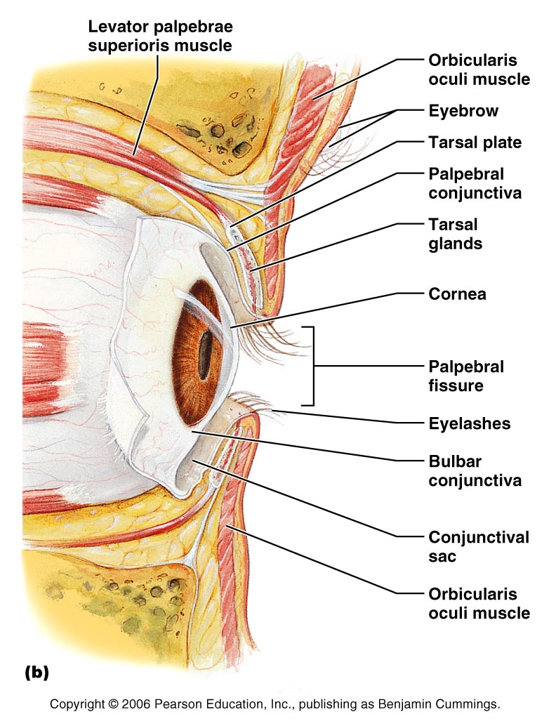
Figure 15.1b

Slide 9
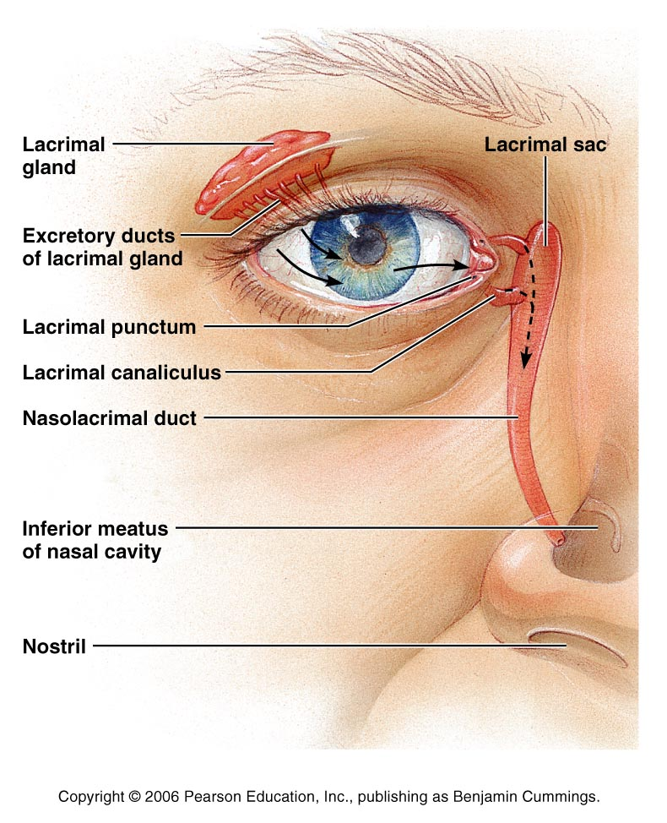
Figure 15.2

Slide 10
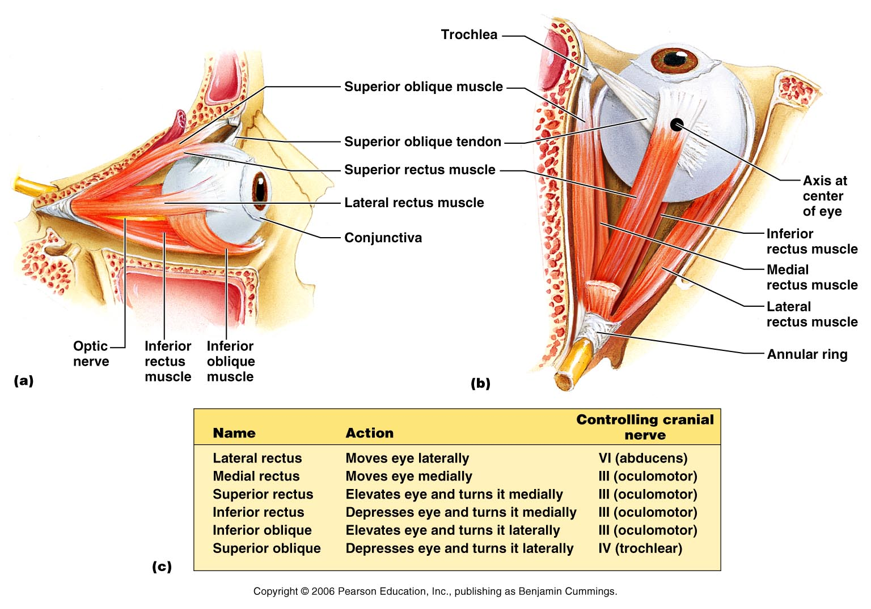
Figure 15.3

Slide 11
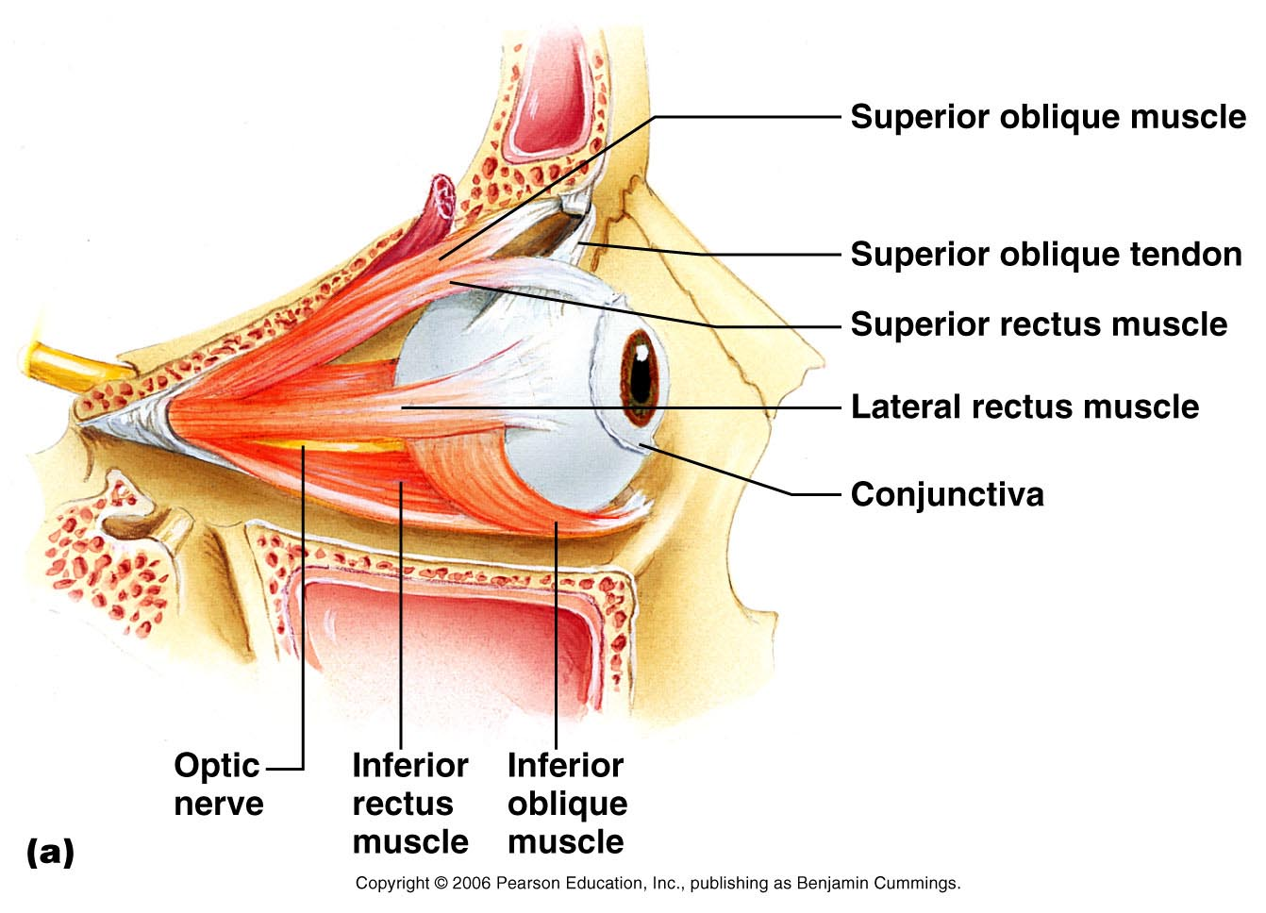
Figure 15.3a

Slide 12
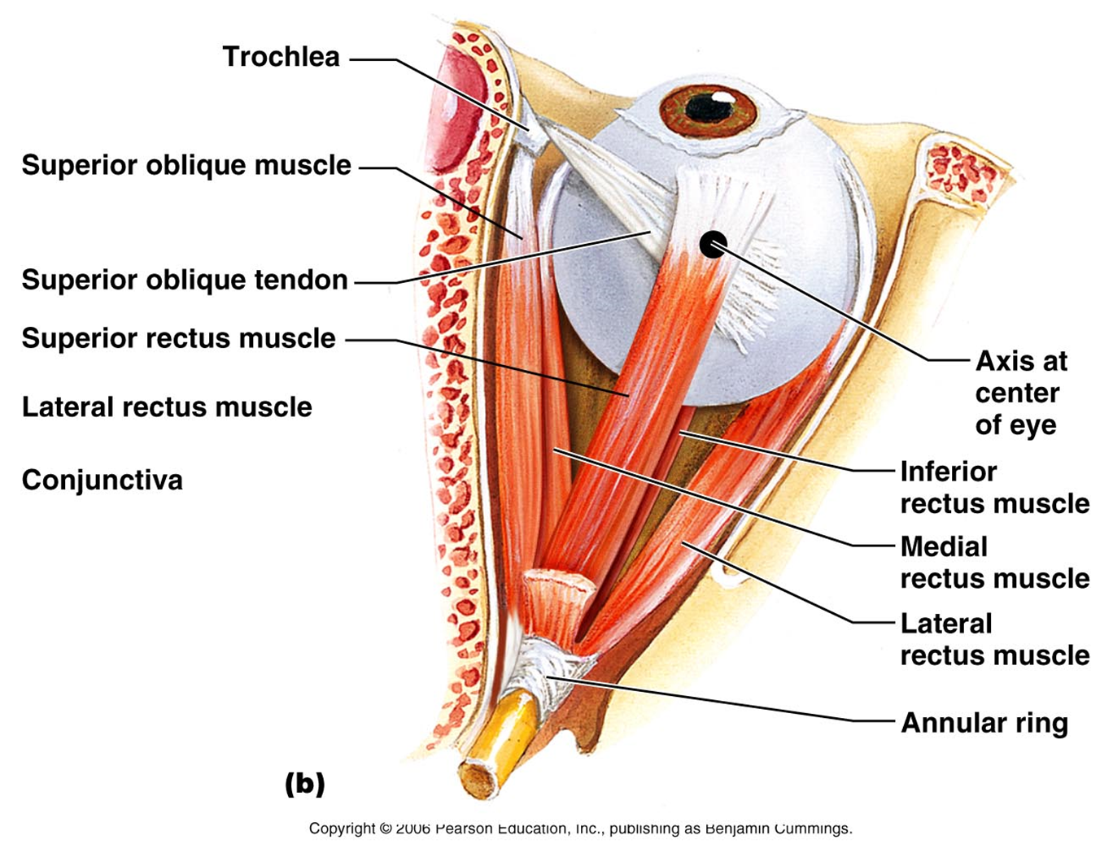
The Eye
Figure 15.3b

Slide 13
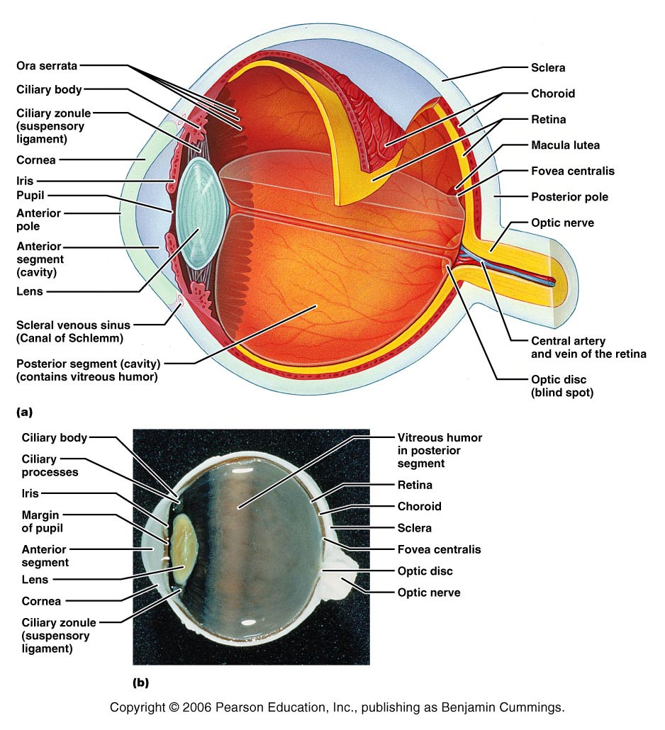
Figure 15.4

Slide 14
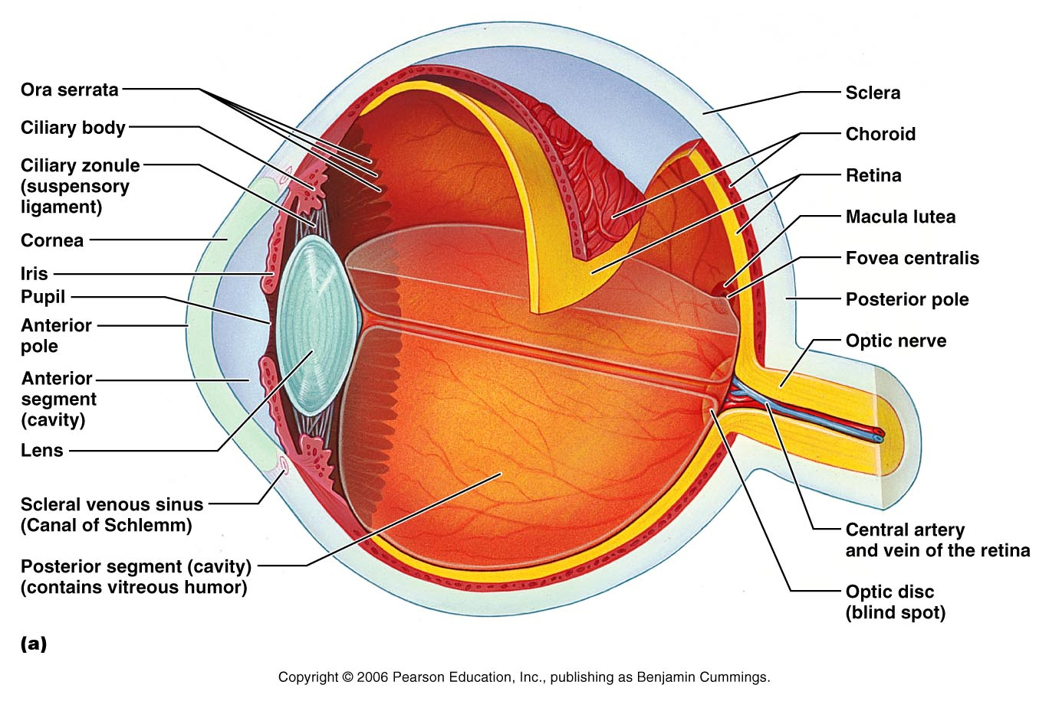
Figure 15.4a

Slide 15
The Eye
Conjunctiva
  Thin membrane that lines the eyelids and covers sclera
Sclera
  White of the eye
Extrinsic eye muscles
  Move the eye within the orbital socket
Cornea
  Clear area in front of the sclera
Choroid Coat
  Middle layer of the eye
Pupil
  Opening in the iris that controls the amount of light that enters

Slide 16
The Eye
Iris
  Colored area
Intrinsic eye muscles
  Help the iris control the amount of light that enters
Lens
  Crystal structure that refracts light rays
Suspensory ligaments
  Hold the lens in place
Aqueous humor
  Watery fluid found in the chambers of the eye
Vitreous humor
  Gelatin substance that fills the greater part of the eyeball

Slide 17
The Eye
Retina
  Innermost coat of the eye between the vitreous humor and the choroid coat
  Image is focused
Rods
  Cells in the retina sensitive to dim light
Cones
  Cells responsible for color vision and are sensitive to bright light
Optic disc
  Blind spot

Slide 18
The Eye
Why do we often need to blow our nose when we cry?
  Tears flow across the eye into the lacrimal duct which empties into the nasal cavity
What is a sty?
  An infection of the oil glands along the border of the eye lid.

Slide 19
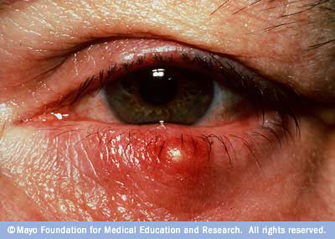
Sty
Very painful
Redness and swelling
Sometimes caused by an embedded object

Slide 20
Eye Injuries
What sports have the most common eye injuries?
  Basketball, baseball, racquet sports
Describe the following injuries, signs and symptoms, treatment, and prevention:
  Corneal Abrasions
  Contusions
  Fractures
  Hyphema
  Retinal Detachment (not in book)

Slide 21
Foreign Bodies and Embedded Objects
Eye wash usually works – use contact solution for turf pellets in eyes
If necessary to prevent eye movement, both eyes must be patched

Slide 22
Corneal Abrasions or Lacerations
Fluorescent dye test
Scratch to the corneal surface of the eye
The cornea has many nerve endings, therefore an abrasion tends to be painful and causes the eye to become red and teary.
Infection can result if left untreated

Slide 23
Contusions
Bruise
“Black Eye”
Raccoon's eyes can be a symptom of a more serious fracture – Basil skull fracture

Slide 24
Fractures
Orbital fracture – orbital roof
Blow-out fracture – break in the floor of the orbital socket
Should be suspected with a severe blow to the eye and large amounts of swelling

Slide 25
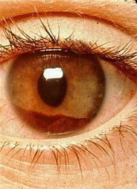
Hyphema
Bleeding within the anterior chamber of the eye
Caused by direct blow
Pain, redness in anterior chamber
Vision partially or completely blocked

Slide 26
Conjunctivitis
Pink Eye
Inflammation of the conjunctiva, the mucous membrane that lines the eyelid and eye surface
Burning and itching around the eye, swollen eye lids possible, occasional yellow discharge
Caused by a virus or bacteria
Very contagious
Proper hand washing is key

Slide 27
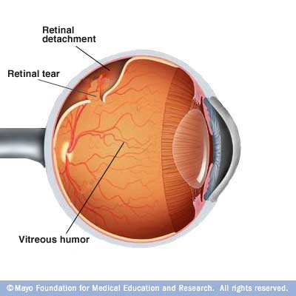
Retinal Detachment
Separation of the retina from the underlying epithelium
Painless
“Floating particles”, vision distortion, and abrupt light changes

Slide 28
Eye Infections and Disorders
Salem Health Article
What is keratitis?
What is the most common infectious cause of corneal blindness in the Untied States?
What causes conjunctivitis?
What is a cataract and why does it occur?
What is Glaucoma?
What occurs with Macular degeneration?
What causes a Sty?
What causes an Astigmatism?
What is Presbyopia?
What is Myopia?
What is Amblyopia and how is it treated?

Slide 29
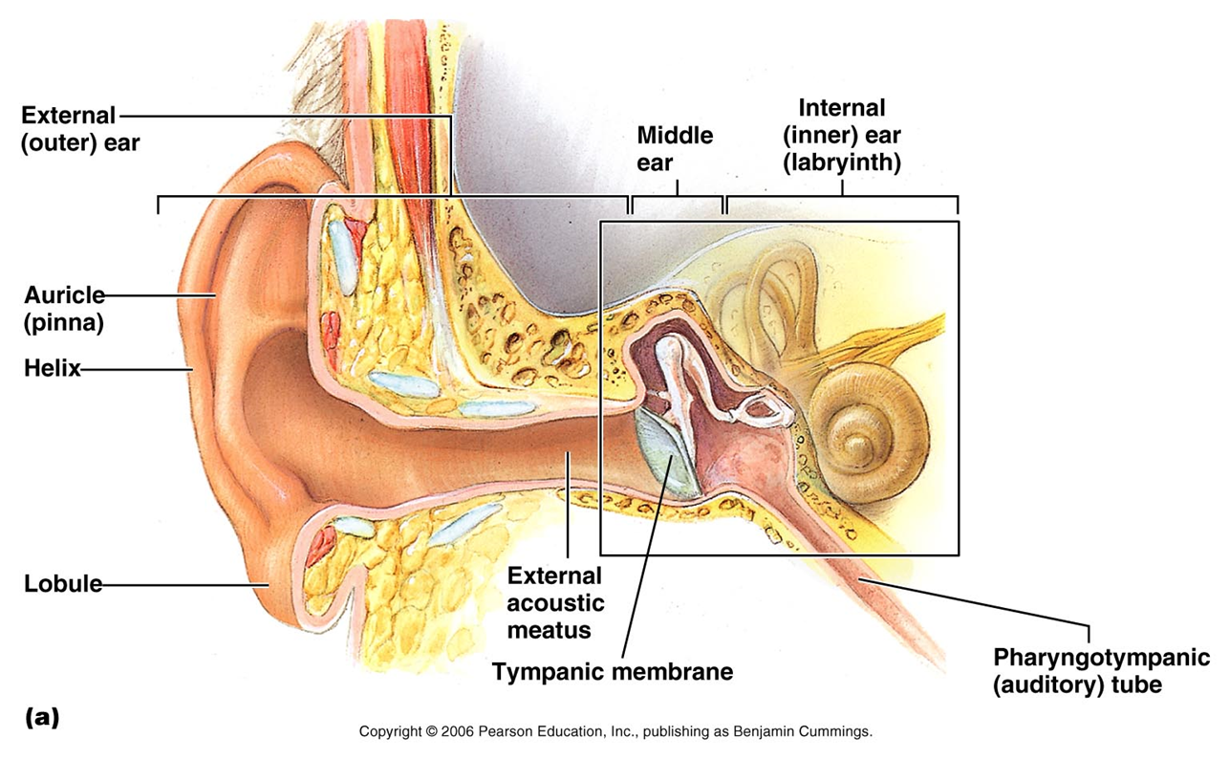
The Ear
Figure 15.25a

Slide 30
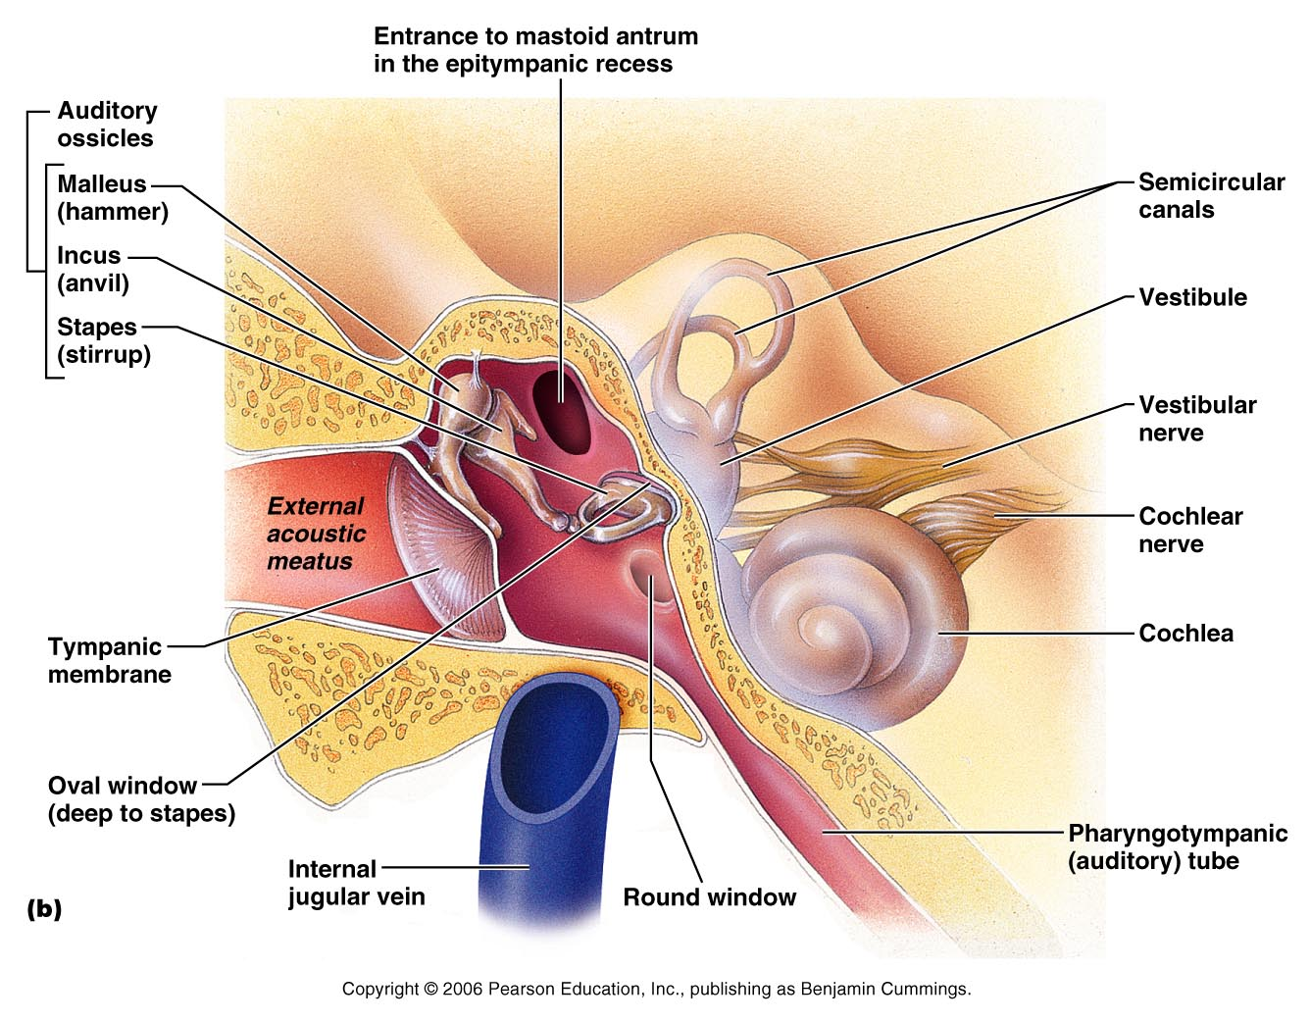
Figure 15.25b

Slide 31
The Outer Ear
Visible part
Pinna or Auricle
  Made of skin and cartilage
Ear canal or meatus
  Produce wax
  Tiny hairs trap dust and other pollutants

Slide 32
Middle Ear
Cavity between the eardrum and inner ear
Tympanic membrane
  Ear drum
Bones (Ossicles)
  Malleus (hammer)
  Incus (anvil)
  Stapes (stirrup)
Eustachian tube
  Passageway from the throat to the middle ear
  Equalizes pressure

Slide 33
Inner Ear
Vestibule
  Cavity at the beginning of the semicircular canals
Semicircular canals
  Involved with equilibrium
Cochlea
  Involved in the hearing process
Vestibulocochlear nerve
  Cranial nerve sends signals to the brain for hearing and balance

Slide 34
Today
Describe the following injuries, signs and symptoms, treatment, and prevention:
  Ruptured tympanic membrane
  Otitis Externa (Swimmer’s Ear)
  Cauliflower Ear
  Foreign bodies in the ear

Slide 35
Injuries to the Ear
Cauliflower Ear (Hematoma Auris) – tearing of the cartilage in the external ear, which results in bleeding and fluid accumulation around the ear
Swimmer’s Ear (Otitis Externa) – infection of the ear canal
Rupture of the Tympanic Membrane (ear drum)
Foreign Bodies in the Ear

Slide 36
Ear Infections and Disorders
Salem Health Article
  What is the purpose of the Eustachian tube?
  What is the purpose of ear wax?
  What are the symptoms of otitis externa?
  Why are small children more susceptible to acute otitis media?
  What is Tinnitus?
  What is presbycusis?
  How can swimmer’s ear be prevented?
  Describe the two-part treatment for acute otitis media.
  What is the name of the device used to exam the ear?

Slide 37
Injuries to the Nose
Describe the following injuries, signs and symptoms, treatment, and prevention:
  Epistaxis
  Nasal septal deviation
  Nasal fractures

Slide 38
Epistaxis
Nose bleeds
Mostly the result of direct contact but can be caused by other factors such as high blood pressure
Anterior or Posterior
What is the technique for controlling a nose bleed?

Slide 39

Fractures
Bones at the bridge of the nose (nasal bones)
Bones at the roof of the nasal passage (conchae)
Have athlete look in mirror for abnormal alignment

Slide 40
Nasal Septal Deviation
Septum is the area of cartilage between the nostrils
Blow to the nose causes septum to shift
Pain, bleeding, decrease air movement through the nostril

Slide 41
Nasal Septal Hematoma
Bleeding between the septum and the mucous membrane
Similar signs and symptoms as a fracture

Slide 42
Injuries to the Mouth
Describe the following injuries, signs and symptoms, treatment, and prevention:
  TMJ dislocations
  Jaw fractures
  Dislocations and fractures of the teeth

Slide 43
Jaw Fractures
Tongue blade test
Mandible fracture
Symptoms & Signs
  Malocclusion (abnormal bite)
  excessive drool
  jaw locked in open position

Slide 44
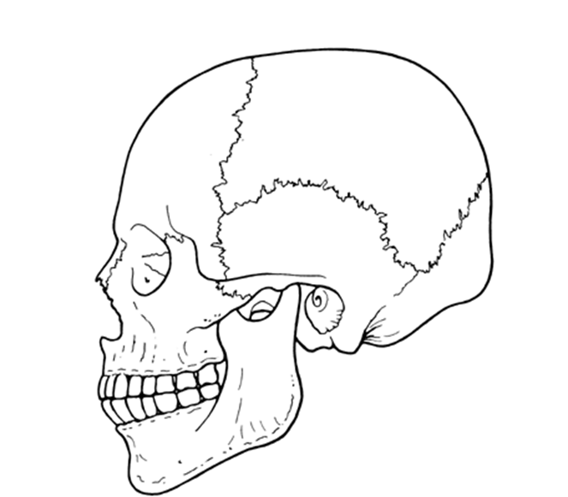
TMJ Dislocations
Side blow to an open mouth
Abnormal bite (malocclusion) or jaw locked in open position

Slide 45

Tooth Dislocations and Fractures
Teeth displaced, fractured, or knocked out
Tooth Saver Devices
If tooth is not stored properly within 30 minutes chances of saving the tooth decline
Find the tooth!!!
Nerve Exposed?

Slide 46
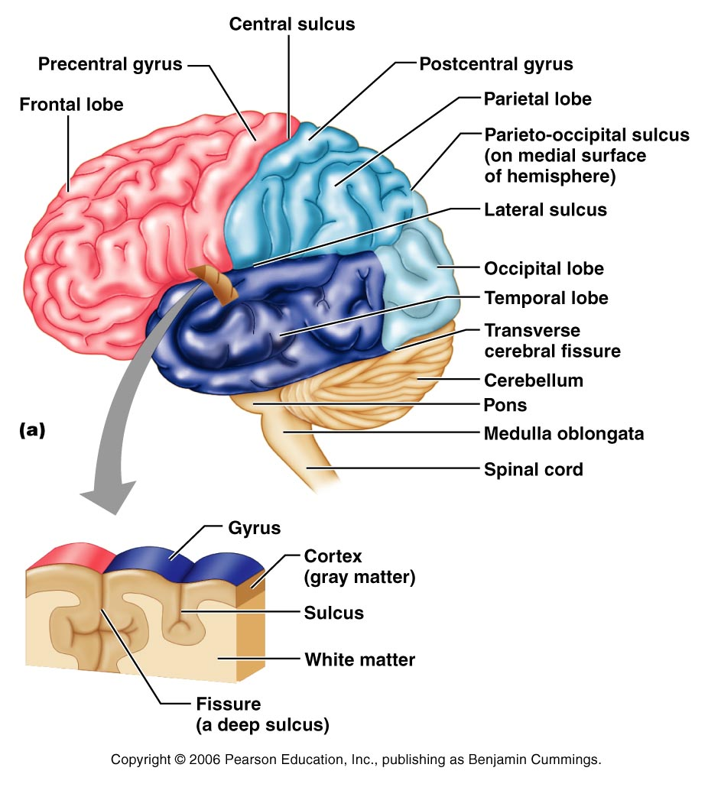
Figure 12.6a

Slide 47
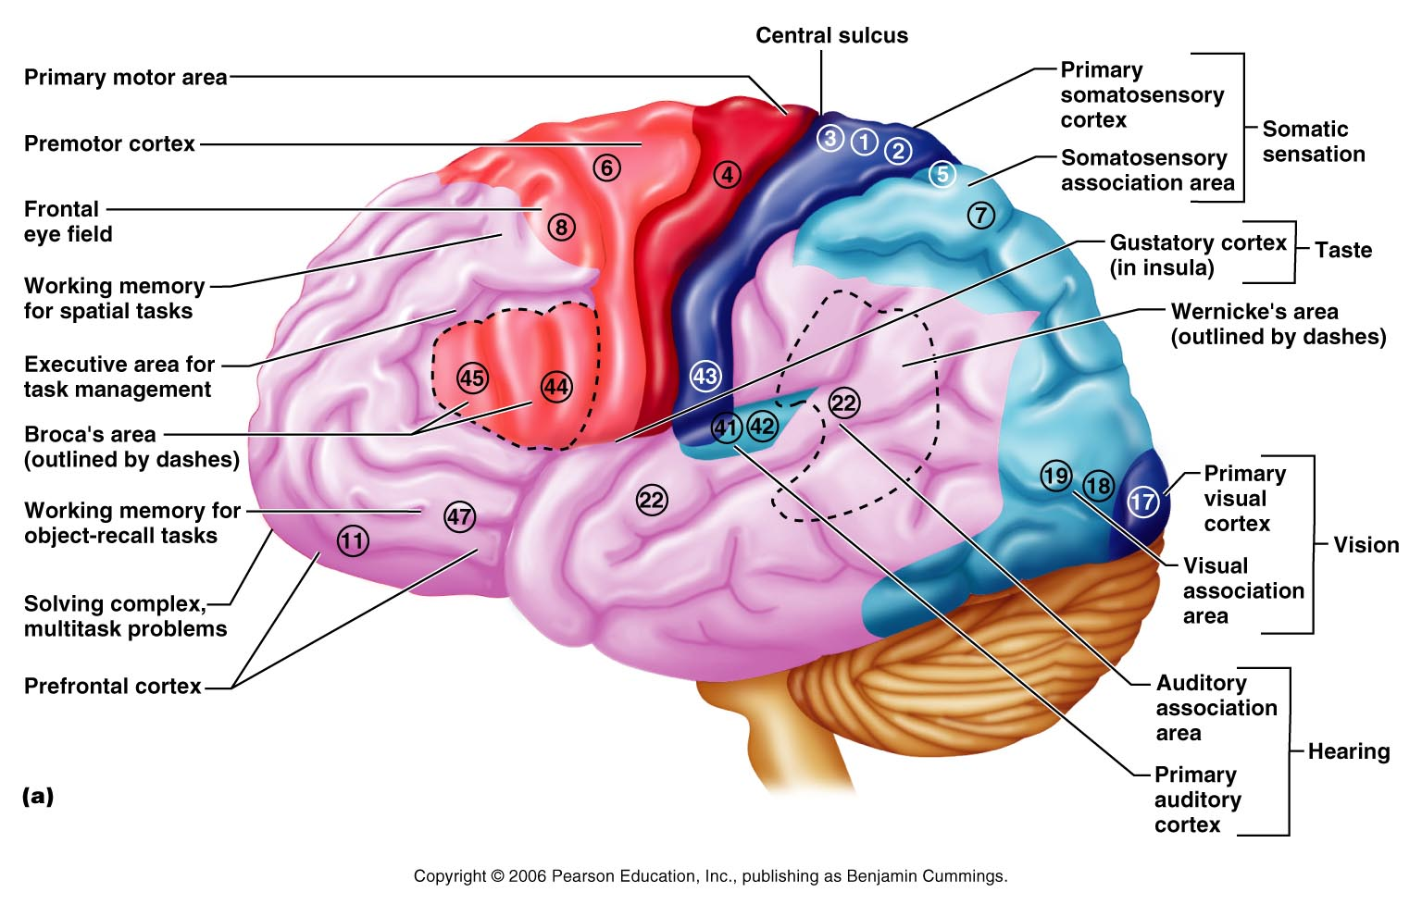
Figure 12.8a

Slide 48
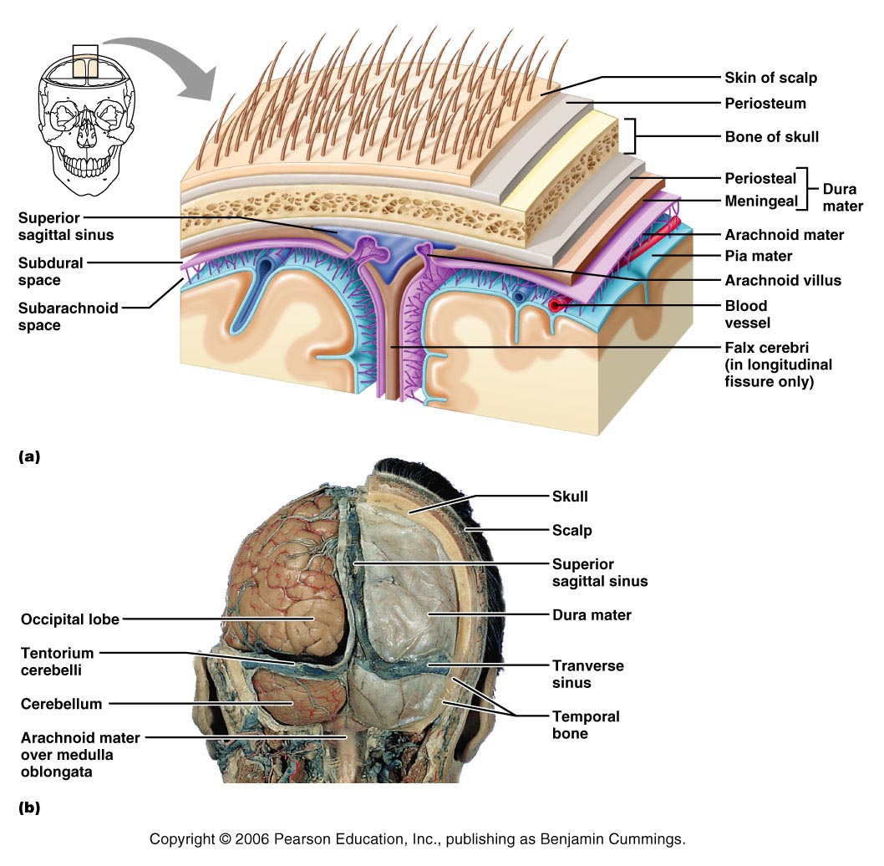
Figure 12.24

Slide 49
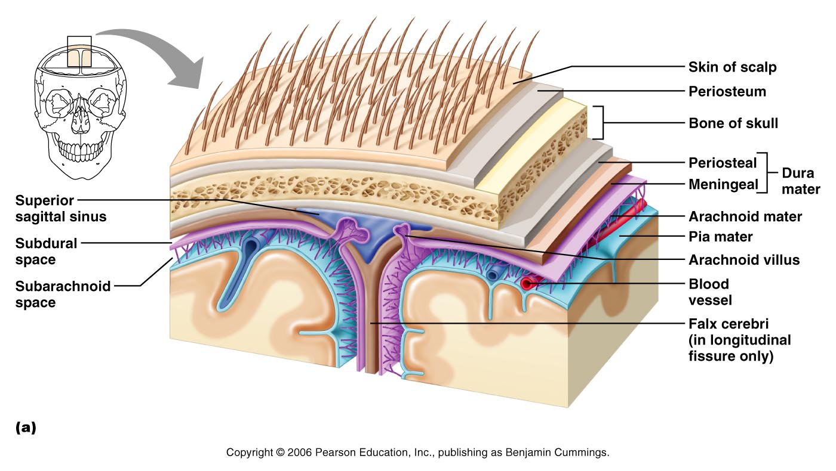
Figure 12.24a

Slide 50
The Brain
Cerebrum
  Higher thinking
Cerebellum
  Control muscular coordination and complex actions
Brainstem
  Controls life sustaining functions
Meninges
  Protective membranes covering the brain and spinal cord

Slide 51
Meninges
Dura Mater
  Outer most layer
Arachnoid
  Web-like middle protective layer
Pia Mater
  Inner most layer

Slide 52
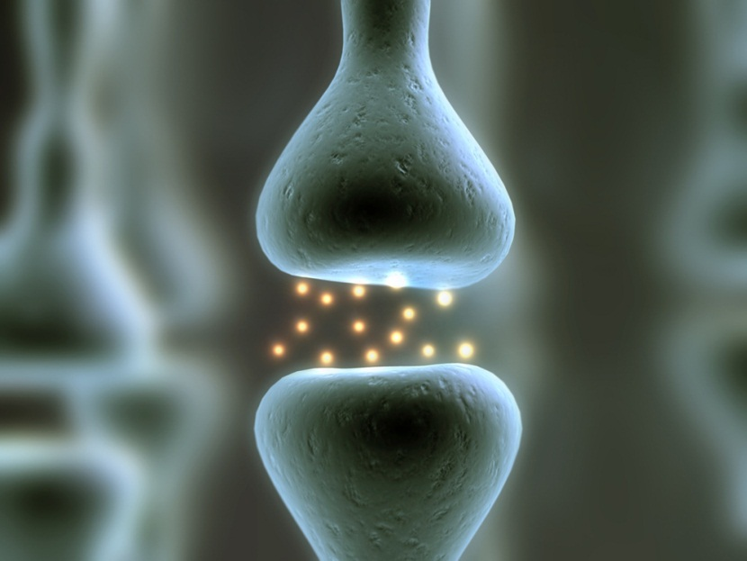
Nervous System
What is the basic structural unit of the nervous system?
  Neuron (nerve cell)
What is homeostasis?
  balance

Slide 53
Nervous system
Central nervous system
Brain
Spinal cord
Peripheral nervous system
Somatic
Autonomic
12 cranial nerves
31 spinal nerves
parasympathetic
sympathetic
Afferent
(sensory)
Efferent
(motor)

Slide 54
The Cranial Nerves
I – Olfactory = smell
II – Optic = vision, eyesight
III – Oculomotor = movement of eye muscles
IV – Trochlear = movement of eye muscles
V – Trigeminal Nerve = face muscles, chewing
VI – Abducens = movement of the eye
VII – Facial Nerve = facial expressions, taste
VIII – Vestibulocochlear = hearing and balance
IX – Glossopharyngeal = movement of throat, taste
X – Vagus Nerve = movement of throat
XI – Spinal Accessory = movement of neck muscles
XII – Hypoglossal = movement of tongue muscles

Slide 55
Cranial Nerve Video

Slide 56
Today
Describe the following injuries, signs and symptoms, treatment, and prevention:
  Scalp injuries
  Skull fractures
  Subdural Hematoma
  Epidural Hematoma

Slide 57
Scalp Injuries
May or may not involve the skull or brain
Scalp is highly vascularized and may bleed profusely
Bleeding between the skin and underlying tissues may result in a hematoma or “goose egg”
Use first aid skills to treat

Slide 58
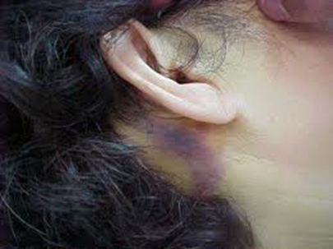
Skull Fractures
Depressed
Linear
Compound
Penetrating
“Battle Sign” - a discoloration behind the ear in the line of the posterior auricular artery, often associated with a skull fracture.

Slide 59
Intracranial Hemorrhaging
Concussion symptoms that lead to coma with 40% chance of survival
Subdural Hematoma
  Bleeding from the small veins under the dura mater
Epidural Hematoma
  Bleeding from the Dural artery usually the result of skull fracture
Intracranial Hematoma
  Develops with blood vessels within the brain are damaged

Slide 60
Concussions
Salem Health Article
  What is the definition of a concussion?
  What are the common mechanisms of injury for a concussion?
  What specifically occurs to the nerves fibers and chemical reactions in the brain with a concussion?
  What are the signs and symptoms of a concussion?
  What is Second Impact Syndrome?
  What is Postconcussive syndrome?
  Which sport would the American Academy of Neurology like to ban?
  What test can measure chemical changes in the brain?

Slide 61
Common Features of a Concussion
Vacant Stare
Headache
Slow to respond to questions or instructions
Confusion and inability to focus attention
Tinnitus
Disorientation
  walking in wrong direction
  playing wrong position
  unable to recall time, date, place
Photophobia, blurred or double vision

Slide 62
Features (Continued)
Slurred or incoherent speech
Dizziness
Gross observable lack of coordination
  stumbling, inability to perform one leg standing test; Rombergs Test)
Emotions disproportionate to circumstances
  distraught, crying for no apparent reason, paranoia, anger
Nausea
Memory Deficits
  athlete repeats same question that has already been answered
  unable to recall events/circumstances of injury
  inability to memorize and recall 3 of 3 words or 3 of 3 objects after 5 minutes
Any loss of consciousness

Slide 63
Special Tests for Balance
Romberg’s Test
Tandem Walking

Slide 64
Amnesia
Retrograde amnesia
  Loss of memory for events that occurred before the injury
Antegrade amnesia
  Loss of memory for events that occur immediately after the injury

Slide 65
Grading Concussions????
Glasgow Coma Scale (GCS)
  Evaluates eye opening, motor and verbal response
AVPU
  Alert
  response to Verbal command
  response to Painful stimulus
  Unresponsive

Slide 66
Treatment
Should not be allowed to return to play or practice on day of injury
Should not be left alone, regular monitoring for deterioration is essential
Symptoms & Signs are usually worse then improve quickly if not, a more serious head injury should be suspected
Should be evaluated by a medical professional
Return to play must follow a medically supervised, stepwise process

Slide 67
Return to Play
Symptom free
Normal neurological exam
Normal ImPACT test
Gradual progression over several days

Slide 68
Post Concussion Syndrome
Persistence of symptoms which may include headache, ringing in ears, dizziness, or confusion after a concussion

Slide 69
Second Impact Syndrome
A second concussion that is received before the signs and symptoms of the first concussion have been resolved
This is a life-threatening injury and medical emergency
Video

Slide 70

The End

