Slide 1
Injuries to the Spine
Angie Guggino, MS, ATC, LAT

Slide 2

Learning Target
The common injuries to the spine

Slide 3
Nervous system
Central nervous system
Brain
Spinal cord
Peripheral nervous system
Somatic
Autonomic
12 cranial nerves
31 spinal nerves
parasympathetic
sympathetic
Afferent
(sensory)
Efferent
(motor)

Slide 4
Definitions
Sensory or Afferent Nerve
  Carries impulses from the periphery to the CNS
Motor or Efferent Nerve
  Carries messages from the CNS to the muscles and glands
Mixed Nerve
  Contains both efferent and afferent fibers

Slide 5
Definitions
Cranial Nerves
  12 pairs
Spinal Nerves
  31 pairs
Plexus
  Network of spinal nerves

Slide 6
The Cranial Nerves
I – Olfactory = smell
II – Optic = vision, eyesight
III – Oculomotor = movement of eye muscles
IV – Trochlear = movement of eye muscles
V – Trigeminal Nerve = face muscles, chewing
VI – Abducens = movement of the eye
VII – Facial Nerve = facial expressions, taste
VIII – Vestibulocochlear = hearing and balance
IX – Glossopharyngeal = movement of throat, taste
X – Vagus Nerve = movement of throat
XI – Spinal Accessory = movement of neck muscles
XII – Hypoglossal = movement of tongue muscles

Slide 7
Definitions
Reflex
  Involuntary action
Stimulus
  Any action that excites or produces a temporary reaction
Receptor
  Sensory nerve that receives a stimulus and transmits it to the CNS
Effector
  Organ that responds to a stimulus

Slide 8
Spine, vertebrae, and disks
  What is the shape of the spine at birth?
  How many vertebrae do humans generally have?
  What is kyphosis?
  What is the name and function of the first cervical vertebra?
  What is the central portion of the disk called?
  How can dehydration cause a person to seem shorter?
  At what point in the spine does the spinal cord typically end?
  How many cervical nerves do we have?
  Where are the anterior and posterior longitudinal ligaments located?
  Where is the body’s center of gravity located?

Slide 9
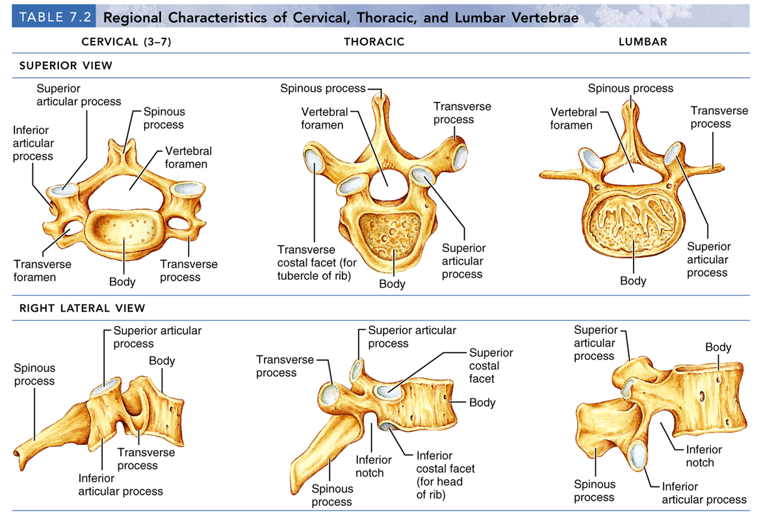
Regional Characteristics of Vertebrae

Slide 10
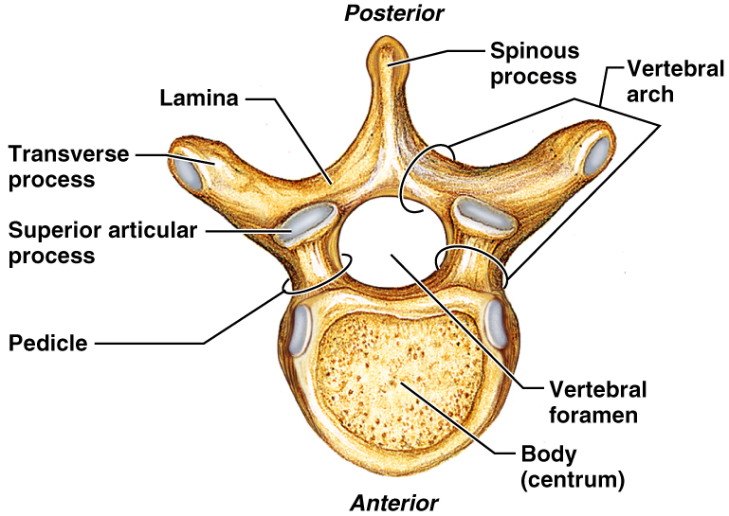

Slide 11
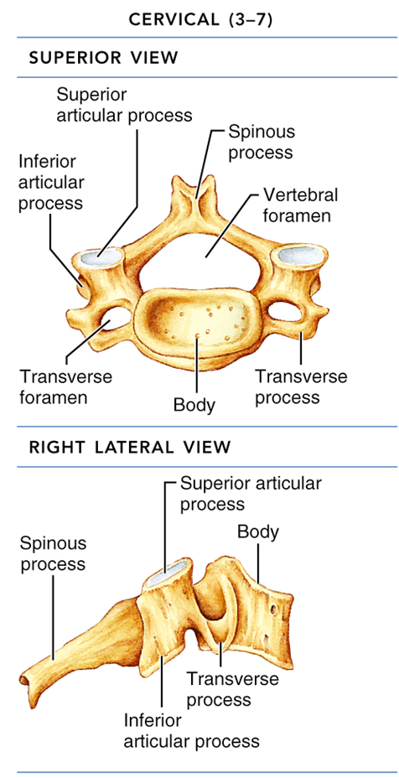
Cervical Vertebrae
Table 7.2.2

Slide 12
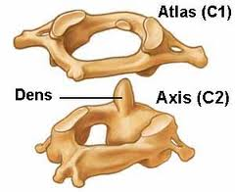
C1 and C2

Slide 13
Spinal Cord
Gray Matter
  Internal section
  Connection made between nerve fibers provide the basis for reflex actions
White Matter
  Outer portion of spinal cord
Meninges
  Membranes covering the brain and spinal cord

Slide 14
Injuries
The Spine

Slide 15
Mechanism of Injury
Most common
  Forced movement of the head on the cervical spine
  Excessive flexion, extension, or lateral movement
Most serious
  Axial loading
  Compression of the spinal cord due to a blow to the top of the head

Slide 16
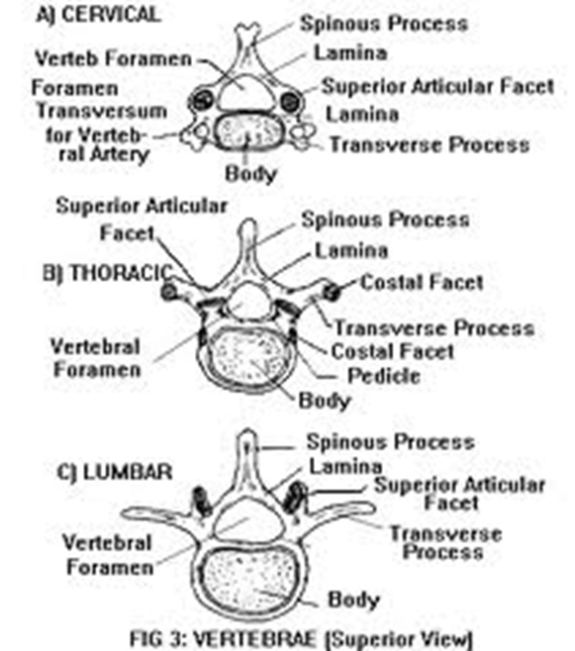
Articular Facet
Small articulation surface of the vertebrae

Slide 17
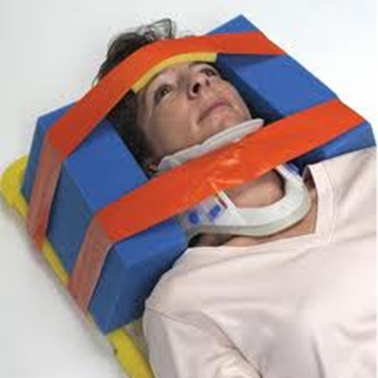
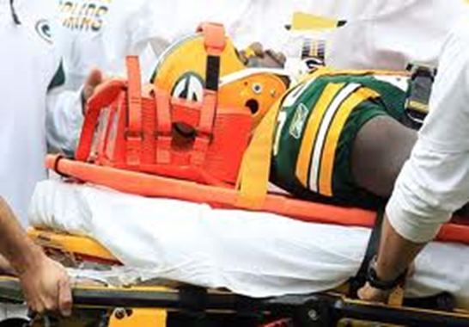
Treatment for Cervical Neck Injury

Slide 18
Complete vs. Incomplete cord injury
Complete injury renders the individual without movement or sensation below the level of injury
Incomplete leaves some movement and sensory function

Slide 19
Cervical Sprains and Strains
Limited motion and point tenderness at the sight of the injury
Serious injury needs to be seen by physician
Mild injury can be treated with P.R.I.C.E.

Slide 20
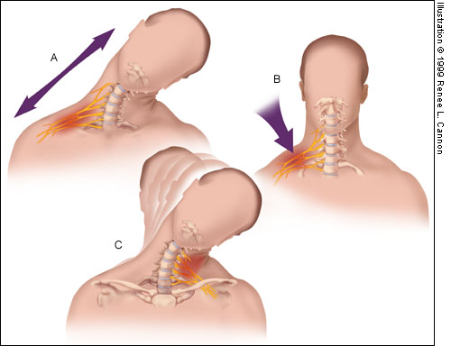
Cervical Nerve Stretch
Burner or stinger
Brachial plexus nerve injury
Caused by direct blow or stretching
Symptoms usually reside in a few minutes
Can become chronic

Slide 21
Cervical Fractures and Subluxations
One third of injuries occur at the level of C2
One half of injuries occur at the level of C6 or C7.
Most fatal cervical spine injuries occur in upper cervical levels, either at craniocervical junction C1 or C2.
Prevent movement if fracture is suspected

Slide 22
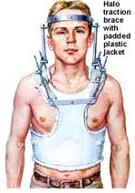
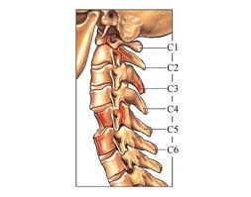
Fractures and Subluxations

Slide 23
Thoracic Spine Compression Fractures
Forced flexion of the thoracic spine
Falling violently on the buttocks
Muscle spasms, increased pain with activity, and constant localized pain
Usually treated with rest

Slide 24
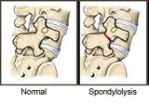
Spondylolysis and Spondylolisthesis
Some professionals may call it a stress fracture
Can be congenital
Pain with activity
Hyperextension activities increase pain

Slide 25
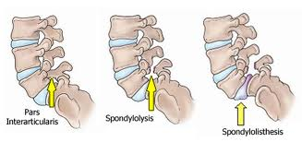
Spondylolysis and Spondylolisthesis

Slide 26
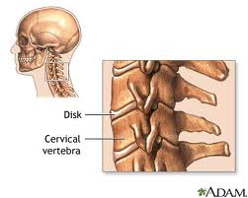
Cervical Disc Disorders
A degenerative process
Can cause radiating pain, as well as numbness and weakness in shoulders, arm, and hand

Slide 27
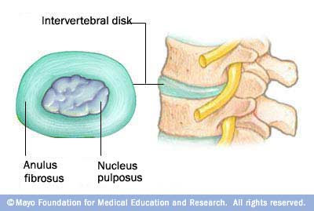
Lumbar Disc Herniation
Nucleus pulposus herniates through the annulus fibrosus and presses against the spinal cord or spinal nerve roots

Slide 28
Lumbar Disc Herniation
Common in 30 and 40 year olds
Extreme pain and stiffness in lower back
Pain in buttocks and radiating leg pain
Pain may radiate down thigh, calf, and foot
Uncomfortable when sitting, standing, or bending for long periods of time

Slide 29
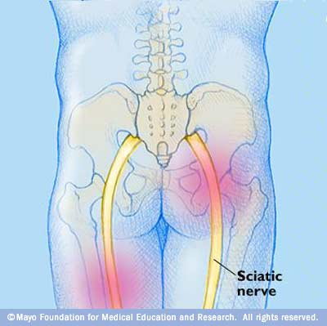
Sciatica
pain that radiates along the path of the sciatic nerve and its branches — from your back down your buttock and leg
sciatic nerve is the longest nerve in your body.
Sciatica is a symptom, not a disorder. The radiating pain of sciatica signals another problem involving the nerve, such as a herniated disk.
usually goes away on its own within a couple of months.

Slide 30
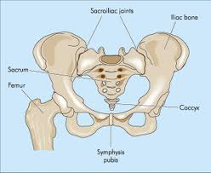
Sacroiliac Joint
Articulation between the sacrum and the ilium
Limited movement that can decrease with age

Slide 31
S.I. Sprains
Can be acute or chronic
Twisting or overuse associate with poor posture
Bad lifting techniques
Repeated strenuous maneuvers

Slide 32
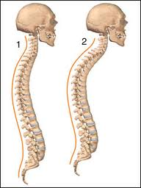
Kyphosis
Exaggerated posterior convex curvature of the thoracic spine
Scheuremann’s kyphosis is defined as rigid (structural) kyphosis because the front sections of the vertebrae grow slower than the back sections. This results in wedge-shaped vertebrae rather than rectangular shaped vertebrae that line up well

Slide 33
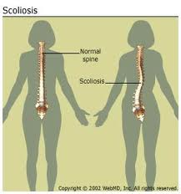
Scoliosis
Lateral curvature of the spine
Usually treated with physical therapy if diagnosed early

Slide 34
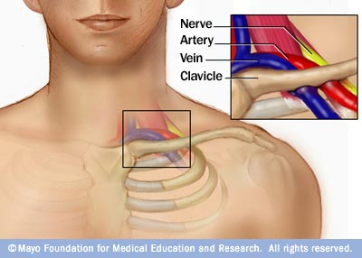
Thoracic Outlet Syndrome
A group of disorders that occur when the blood vessels or nerves in the thoracic outlet — the space between your collarbone and your first rib — become compressed
Can cause pain in your shoulders and neck and numbness in your fingers.
Common causes include physical trauma from a car accident, repetitive injuries from job- or sports-related activities, certain anatomical defects, such as having an extra rib, and pregnancy.
Treatment usually involves physical therapy and pain relief measures

Slide 35
Evaluation
The spine

Slide 36
S.O.A.P.
Subjective
  History
Objective
  Observation
  Palpation
  Range of Motion
  Special Testing
Assessment
Plan

Slide 37
Observation of the Spine
Cervical
Lumbar

Slide 38
Palpation of the Spine
Cervical
Lumbar and Hip

Slide 39
Lumbar Range of Motion

Slide 40
Special Tests
Brachial Plexus Traction Test
Cervical Compression Test

Slide 41
Special Tests
Spurling’s Test
Shoulder Abduction Test

Slide 42
Single Leg Stance Test

Slide 43
Brudzinski’s Test

Slide 44
Disc Herniation
Kernig’s Test
Milgram’s Test

Slide 45
Sprains - Sacroilliac
S.I. Compression Test
S.I Distraction

Slide 46
Sacroilliac Joint
Gaenlen’s Test
Faber’s Test

Slide 47
Scoliosis Test

Slide 48

The End

