Slide 1
The Central Training Room
Angie Guggino, MS, ATC, LAT

Slide 2

Learning Target
The optimal design of the central training room

Slide 3
What is the Training Room?
Multipurpose facility designed to accommodate a variety of needs
Easily accessible to male and female athletes
May also need a smaller satellite facility

Slide 4
Design
size
lighting
plumbing
electricity
ventilation and heating
telephone access
storage
office space
wet area
taping area
treatment area
exercise and rehabilitation areas

Slide 5
Training Room Operation
Requires coordination of staff, athletes, coaches, and custodial workers
Program director is responsible for the overall operation of the sports medicine program and facility
Rules and procedures must be followed
Daily cleaning procedures
Dress code and personal hygiene
Proper documentation of injuries and treatments is essential
Inventory and budgeting
Medical kits

Slide 6
Equipment
General First Aid materials
Consumable supplies
Non-consumable supplies
Miscellaneous equipment
Therapeutic modalities
  Mechanical
  Thermal
  Electrical

Slide 7
OSHA
Federal regulations for employees who may be at risk of blood borne pathogen exposure
  Exposure control plan
  Employees at risk of exposure to blood borne pathogens must be offered hepatitis B vaccinations
  Special containers should be available for biohazard waste only

Slide 8
OSHA
Standard Precautions
Disinfecting Procedures

Slide 9
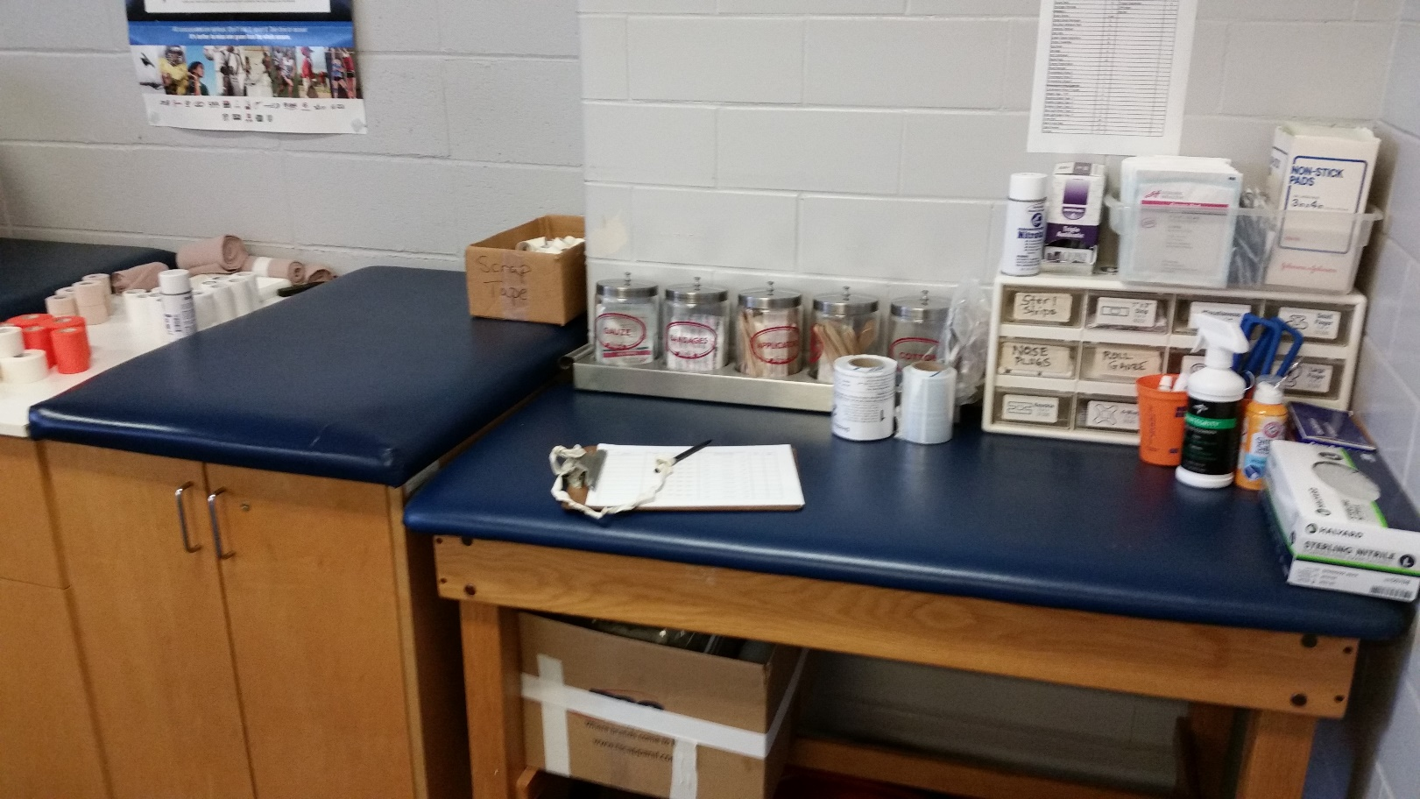
North Cobb High School Athletic Training Room

Slide 10
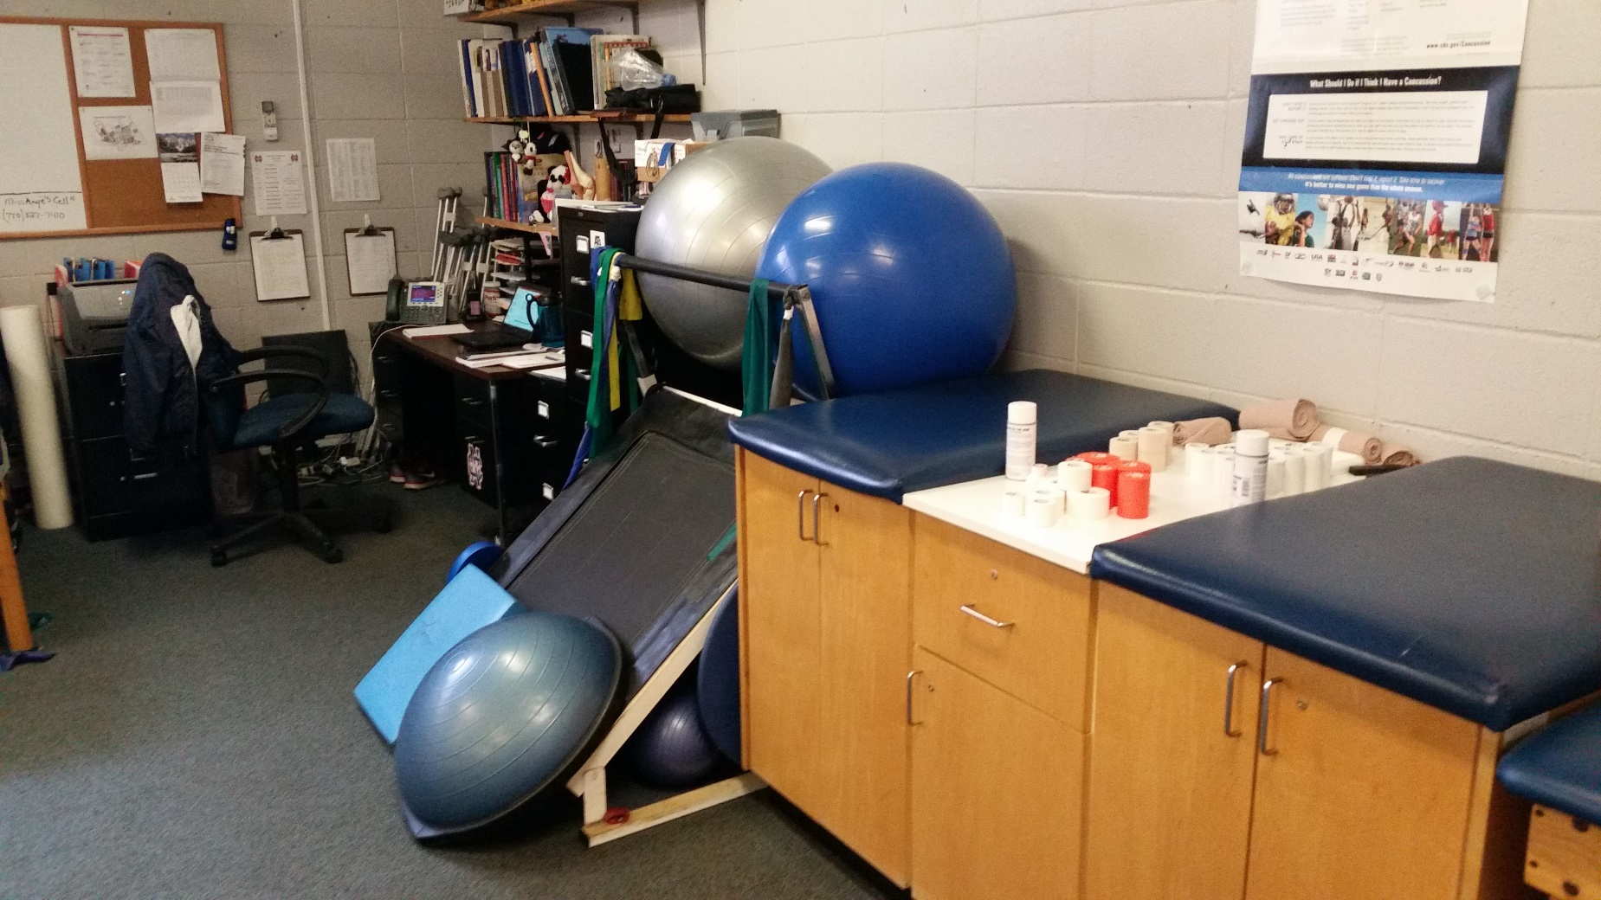
North Cobb High School Athletic Training Room

Slide 11
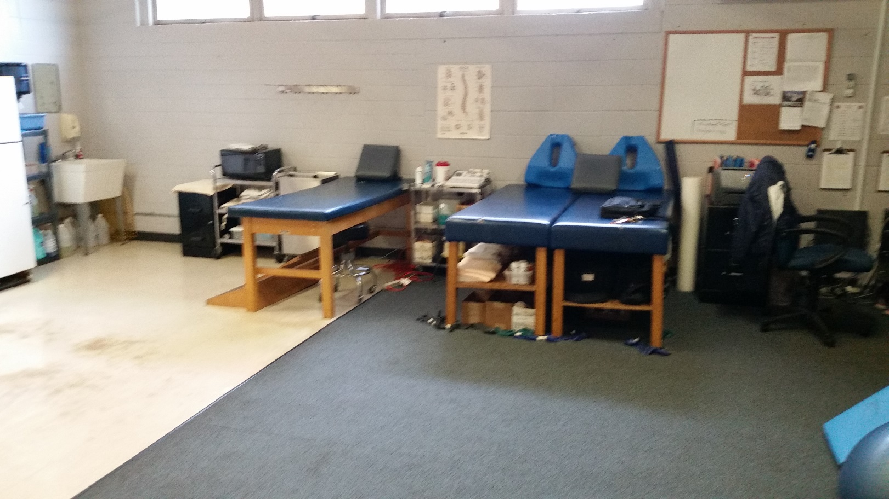
North Cobb High School Athletic Training Room

Slide 12
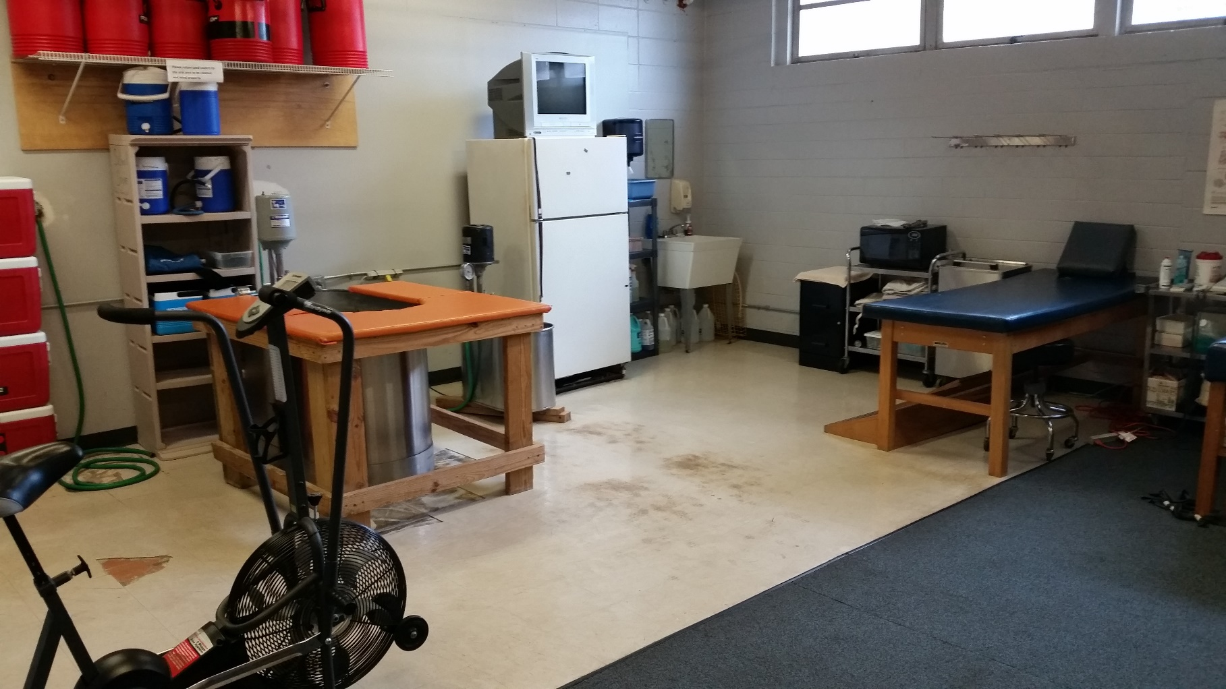
North Cobb High School Athletic Training Room

Slide 13
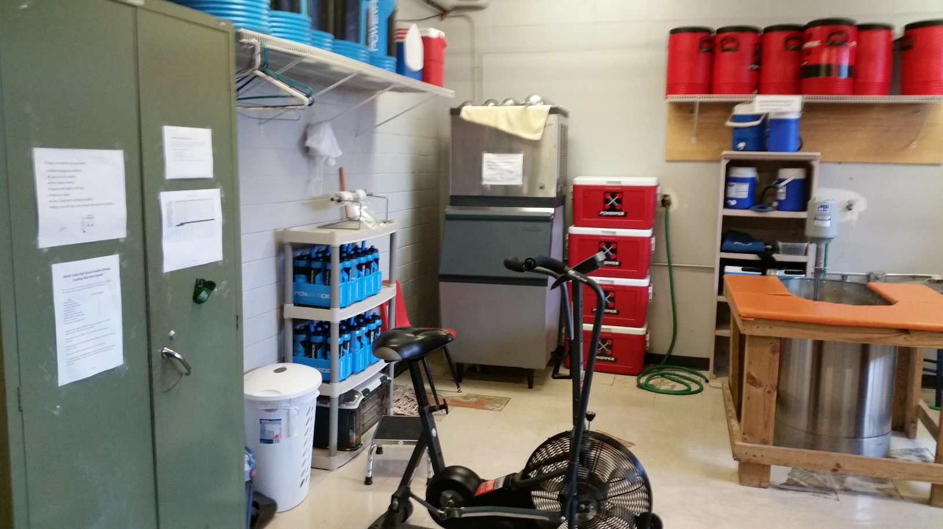
North Cobb High School Athletic Training Room

Slide 14
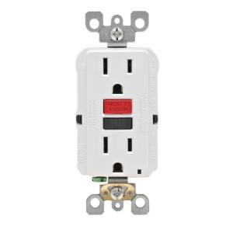
GFCI or GFI
Location of the outlets and 36 inches off the ground.

Slide 15
The End

