Slide 1
Nutrition and the Athlete
Angie Guggino, MS, ATC, LAT

Slide 2
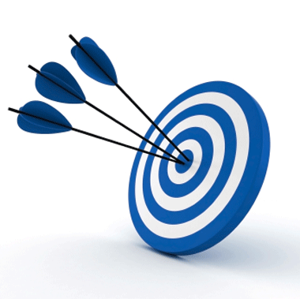
Learning Target
Good nutritional habits = increased athletic performance and good health

Slide 3
Nutrition
The process by which a living organism assimilates food and uses it for growth and for replacement of tissues
The study of science that deals with food
Proper nutrition can reduce likelihood of injury and increase performance

Slide 4
Energy in the body
Energy – power to do work or to produce heat
Energy cannot be created or destroyed
Energy is needed for:
  Maintaining body functions
  Create movement
  Growth and repair of tissue

Slide 5
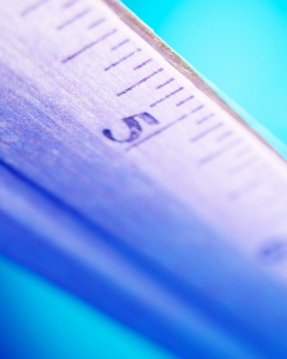
Calorie
Measurement of energy
The number of Kcals in food = energy value in food
  Carbohydrates – 4 kcal/g
  Protein – 4 kcal/g
  Fat – 9 kcal/g
  Alcohol – 7 kcal/g

Slide 6
What is metabolism?
The sum of all physical and chemical process that take place in the body
Conversion of food to energy

Slide 7
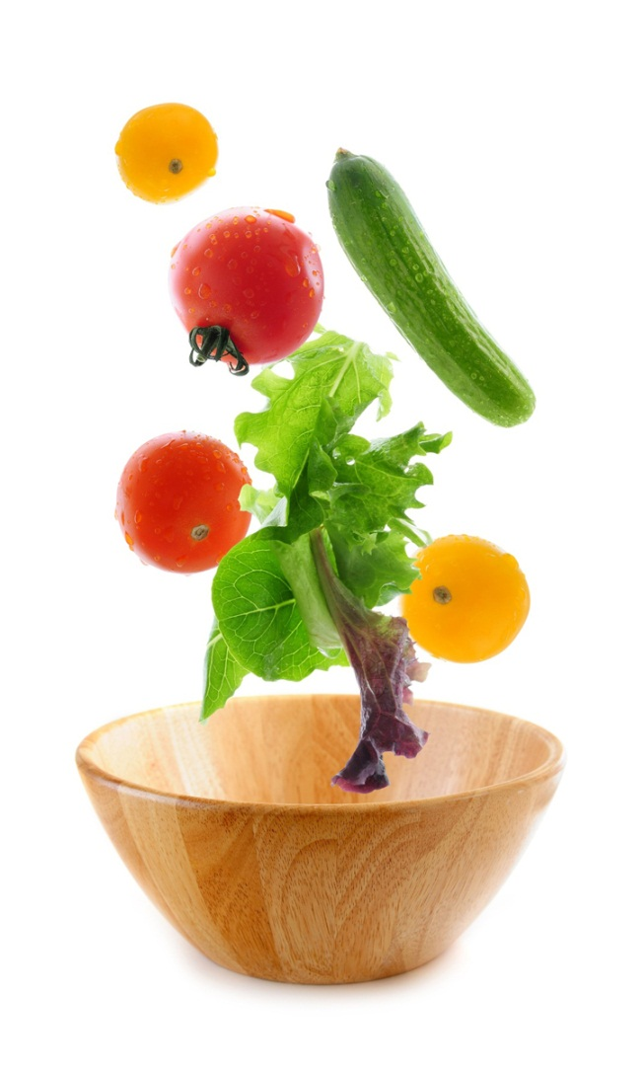
Nutrients
Carbohydrates
Fats
Proteins
Vitamins
Minerals
Water
(fiber)

Slide 8
Carbohydrates
Complex sugar that is a basic source of energy for the body
Glucose, Fructose, galactose
Only source of fuel for the brain
Complex vs. Simple
4 kcals per gram
All types are converted to glucose and stored as glycogen
Insulin

Slide 9
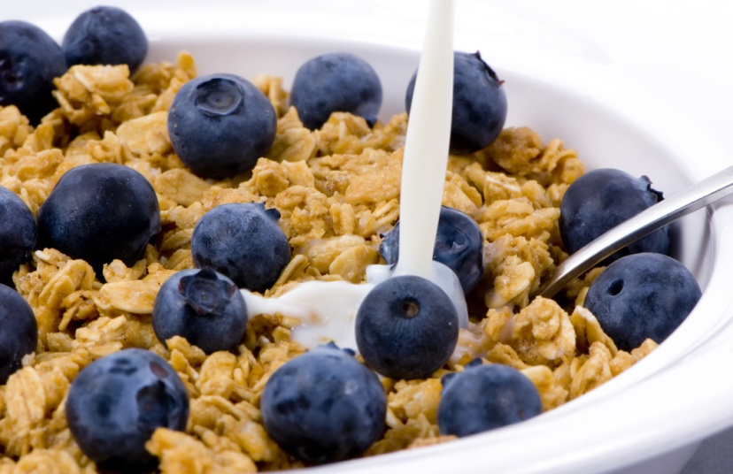
Fiber
Non-digestible form of Carbohydrate
Soluble – helps lower cholesterol levels
Insoluble – helps prevent constipation
25 grams per day
What happens with too much fiber?

Slide 10
Athletes and Carbohydrates
Modify consumption to maximize glycogen storage prior to the athletic event
Liquid products during activity
  Light activity = 3-5 g/kg body weight
  Moderate = 5-7 g/kg body weight
  High = 6-10 g/kg body weight
  Very High = 8-10 g/kg body weight

Slide 11
Protein
Any of a class of complex, nitrogenous, organic compounds that function as the primary building blocks of the body
Helps grow, build, and repair tissue
Not a main source on energy but can be during starvation or low carb-diet
Amino Acids
Complete vs. Incomplete
4 kcals per gram

Slide 12
Athletes and Protein
Takes longer to digest and convert into energy

Slide 13
Fat
Substance made up of lipids or fatty acids that is a source of energy and is vital to growth and development
Energy, vitamin storage, insulates body tissue
Saturated fats vs. unsaturated fats
Trans Fat
9 kcals per gram

Slide 14

Fat and Cholesterol
Needed by the body for the formulation of out cell membranes
High-Density Lipoproteins
Low-Density Lipoproteins

Slide 15

Athletes and Fat
Some fat is stored in muscle
Most fat is subcutaneous
Fat tissue is an energy reserve but we must have carbohydrates to burn it

Slide 16
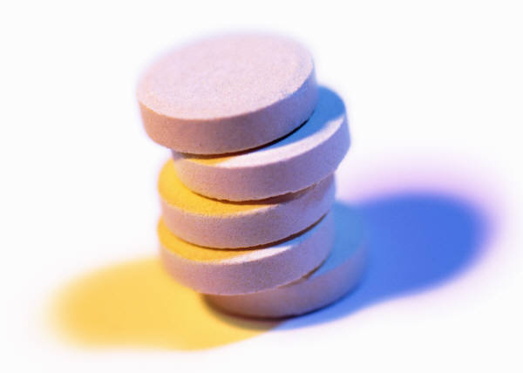
Vitamins
Organic substances that are essential in small quantities for normal body function
Do not provide energy
Fat-soluble vs. water-soluble

Slide 17
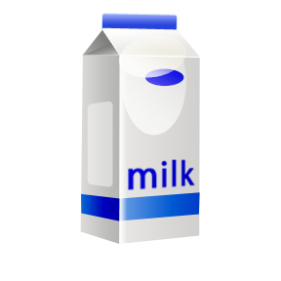
Minerals
Inorganic compounds that are essential to body function
Electrolytes
Minor minerals
  Iron, zinc, copper, iodine
Major minerals
  Calcium, phosphorus, magnesium, sodium

Slide 18
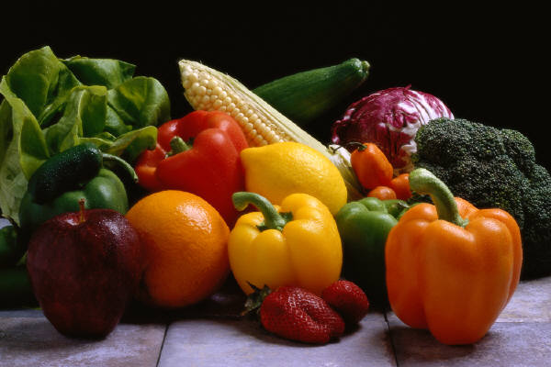
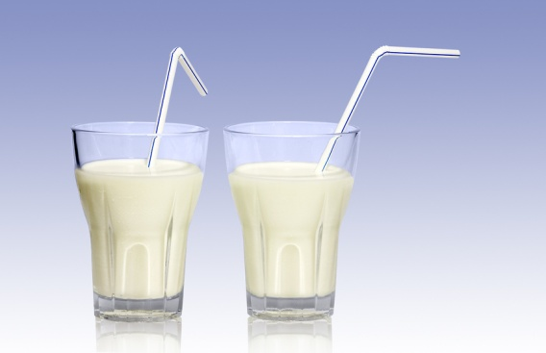
Athletes and Minerals
Calcium to build strong bones
Iron to increase hemoglobin levels
Potassium and sodium to help with electrolyte levels

Slide 19

Water
Essential to life and the most important
Controls body temperature
Helps elimination of metabolic waste
Helps with energy production
60% of the body is water
How much should you get?

Slide 20
What is dehydration?
The loss of water from the body or substance

Slide 21
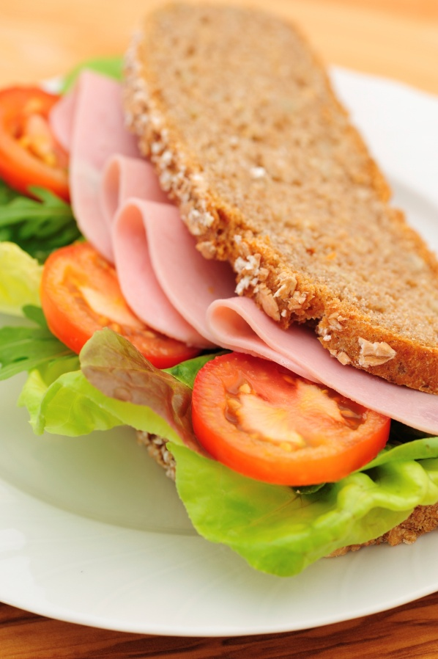
Two basic principles should be followed to create a healthy diet.
Eat a variety of foods from each of the food groups daily
Eat in moderation

Slide 22
What are Dietary Guidelines for Americans?
Recommendation for good health made by the U.S. Department of Agriculture and the U.S Department of Health and Human Services
The Dietary Guidelines for Americans, 2010, released on January 31, 2011, emphasize three major goals for Americans:
  Balance calories with physical activity to manage weight
  Consume more of certain foods and nutrients such as fruits, vegetables, whole grains, fat-free and low-fat dairy products, and seafood
  Consume fewer foods with sodium (salt), saturated fats, trans fats, cholesterol, added sugars, and refined grains

Slide 23
Food Guide Pyramid

Slide 24
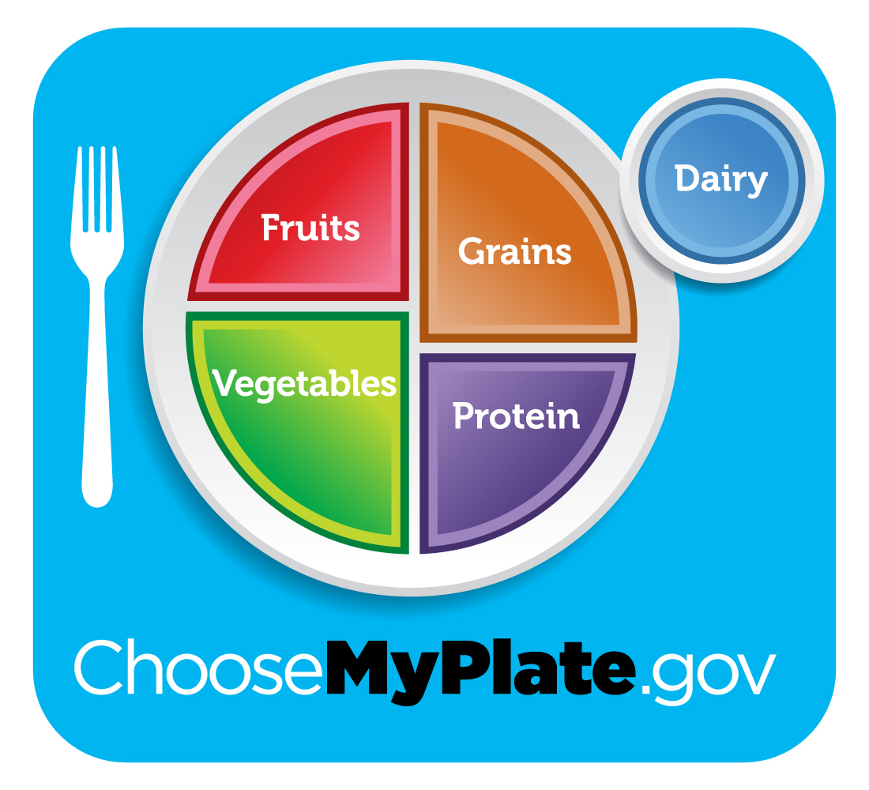
MyPlate

Slide 25
What is a “nutritional quack?”
People who claim to have skills, knowledge, or qualification they do not possess
Usually trying to sell something

Slide 26
What is energy expenditure?
Total calories used for all activities over a given period of time

Slide 27
What is energy intake?
The sum of the caloric content in food ingested
Male Avg. = 15-18 kcals/pound body weight
Female Avg. = 14-17 kcals/pound body weight

Slide 28
Weight Gain
0.5 to 1 pound per week
Goal is an extra 350 calories per day
Weight training

Slide 29
Weight Loss
1-2 pounds per week
3,500 kcals = 1 pound of fat
Need to create calorie deficit to loose weight

Slide 30
The best approach
Combining caloric restriction with exercise

Slide 31
Eating Disorders
Non-athletes = 3% to 8%
Female athletes = 15-62%

Slide 32
What is Bulimia Nervosa?
Characterized by binging and purging, fasting on day eating the next
What physical problems can they experience?

Slide 33
What is Anorexia Nervosa?
Severe loss of appetite
What physical problems can they experience?

Slide 34
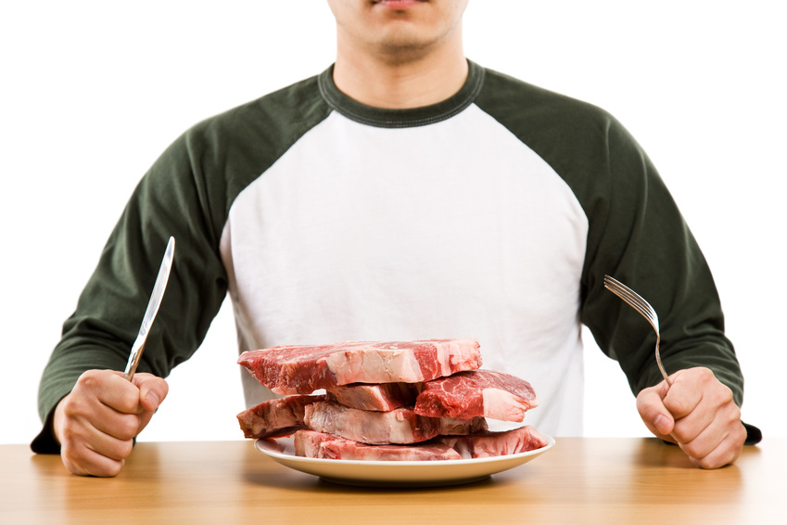
What is manorexia?
Eating disorder in men

Slide 35
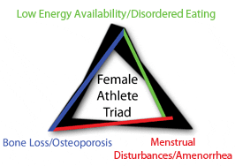
What is the Female Athlete Triad?
http://www.femaleathletetriad.org/

Slide 36
The Triad
can involve a conscious restriction of food intake, problems with body image and a high drive for thinness. Sometimes, these conditions can lead to disordered eating, or more serious eating problems, like anorexia or bulimia.
Amenorrhea – defined as no menstrual period for 3 months
higher risk for low bone mass leading to weakened bones, called osteoporosis in its severe form. This type of bone loss can cause an increased risk of fractures, including stress fractures.

Slide 37
Common Signs and Symptoms
Irregular or absent menstrual cycles
Always feeling tired and fatigued
Problems sleeping
Stress fractures and frequent or recurrent injuries
Often restricting food intake
Constantly striving to be thin
Eating less than needed in an effort to improve performance or physical appearance
Cold hands and feet

Slide 38
Risk Factors
Playing sports that require weight checks
Social isolation due to sporting activities
Exercising more than necessary for a sport
Pressure to “win at all costs”
Punitive consequences for weight gain
Controlling parents and/or coaches
Being a gymnast, figure skater, ballet dancer, distance runner, swimmer or diver where undue emphasis is placed on having a low body weight and a lean physique

Slide 39
What does a proper pre-exercise meal do for the athlete?
Prevent hunger during exercise and maintain adequate blood sugar levels
1-4 hours prior to the event
Depends on the type/length of event
What food should be avoided?

Slide 40
What type of diet helps speed the recovery following exercise?
High carbohydrate will help replace glycogen immediately after exercise

Slide 41
Ideal Weight
Body Mass Index (BMI) = weight/height/height x 703
  Normal = 18 – 25
  Overweight = 25-30
  Obese = >30
May overestimate body fat in athletes and other who have muscular build
May underestimate body fat in older persons and others who have lost muscle mass

Slide 42
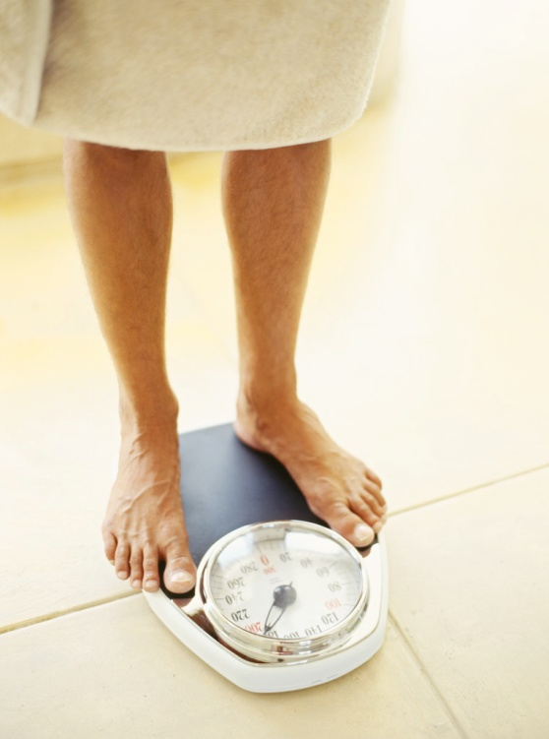
What is body composition?
Lean body mass
Body fat
Usually given as percentage of fat
Males around 15%
Females around 20-25%
How is it measured?

Slide 43

The End

