Slide 1
Dietary Supplements and Performance Enhancers
Angie Guggino, MS, ATC, LAT

Slide 2
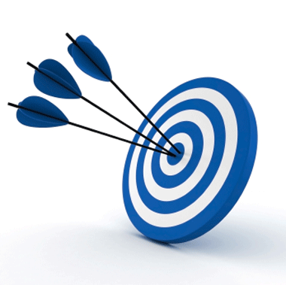
Learning Target
Dietary supplements and their effect on the body.

Slide 3
Dietary Supplements
The Dietary Supplement Health and Education Act defines a dietary supplement as:
  A product (other than tobacco) intended to enhance the diet, that contains one or more of the following:
    Vitamins
    Minerals
    Amino acids
    Herbs, and/or other botanical substances

Slide 4
Vitamins
Organic (carbon-containing) compounds that are essential in small amounts for body processes
Enable the body to use energy provided by fats, carbohydrates, and proteins
Vitamin supplements
  Vitamins taken in addition to those received through the diet
  Available in concentrated form in tablets, capsules, and drops
According to the FDA, the body cannot distinguish between a vitamin of plant or animal origin (natural) and one manufactured in a laboratory (synthetic)

Slide 5
Why do people take vitamins?
Food no longer contains the right nutrients in adequate quantities
Supplements can build muscle and enhance athletic performance
Provide needed energy
Can cure such things as colds, heart disease, and cancer

Slide 6
Minerals
Inorganic (non-carbon-containing) element
Necessary to build tissues, regulate body fluids, and assist in body functions
Contribute energy production
Found in water and natural foods

Slide 7
Herbal Supplements
Some of the world's oldest medicines
Medicinal herbs are plant matter used in the form of powders, extracts, teas, or tablets; believed to have therapeutic benefits
Considered dietary supplements and not regulated by the FDA (some changes in 2010)
Can only be removed from the market after it has been shown to be unsafe

Slide 8
Glucosamine and Chondroitin
Both substances are found naturally in the human body
Glucosamine
  Used to maintain joint cartilage
  Glucosamine sulfate
  Glucosamine hydrochloride
  N-acetyl-glucosamine
Chondroitin
  Proven abilities to treat osteoarthritis
  Also used to treat psoriasis and cancers

Slide 9

What is an ergogenic aid?
Any agent that enhances energy utilization, including energy production and efficiency
Dietary Supplements, Drugs, and food
Are they safe?
Do they work?
Are they legal?

Slide 10
Performance Enhancers
Anabolic-androgenic Steroids
Growth hormones
Androstenedione
Caffeine
Creatine Monohydrate
Ephedra

Slide 11
Anabolic-Androgenic Steroids
Man made substances related to the male sex hormone testosterone
  Anabolic = muscle building
  Androgenic = increase in masculine characteristics
  Steroid = class of drug
Legal with prescription but banned by most sports
Stacking
Side-effects
  Tumors, liver problems, hypertension, increase in LDL’s, acne
  Differ for males and females

Slide 12
Growth Hormone
Human growth hormone (HGH)
Produced naturally by the pituitary gland
Works to increase conversion of amino acids into protein
Legal with prescription but banned by most sports
Side-effects
  Heart disease, impotence, osteoporosis, death

Slide 13
Androstenedione
Andro
Steroid hormone naturally produced in both men and women that is converted to testosterone or to estrogen
Sold over-the-counter until 2004 not banned by most sports
Side-effects
  Premature cessation of bone growth, mood changes, pancreatic cancer, breast cancer

Slide 14
Caffeine
Acts as a stimulant and is believed to enhance endurance and improve reaction time
Banned by certain sports organizations if over a specific quantity
Side-effects
  Anxiety, sleeplessness, headache, stomach issues, dehydration
Diuretic

Slide 15
Creatine Monohydrate
Amino acid made by the body and found naturally in skeletal muscle
Source for quick energy
Supplements are said to increase energy to sustain strenuous exercise for longer periods of time
Side-effects
  Muscle cramping, dehydration, gastrointestinal distress, nausea, seizures, kidney issues
Legal food supplement and sold over the counter

Slide 16
Ephedra
Ma huang
Shrub-like plant found in desert regions in central Asia and other parts of the world
Stimulant containing ephedrine
Widely used for weight loss, to boost energy, and to enhance athletic performance
Similar to ephedrine found in OTC asthma medications
Banned for sale in the United States in 2004
Side-effects
  Hypertension, heart palpitations, nerve damage, stroke, insomnia, seizures, heart attacks

Slide 17
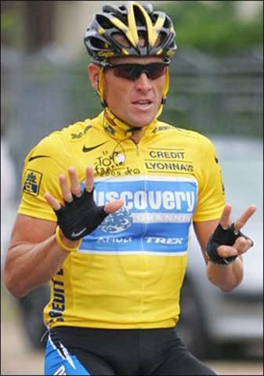
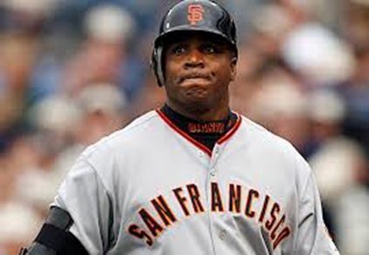
Doping
The unusual use of any substance or means to gain an unfair edge over the competition

Slide 18
Anti-Doping Agency
Protection of the health of athletes
Respect for both medical and sport ethics
Equality for all competing athletes

Slide 19
Monitoring
International Olympic Committee Medical Commission
  Created to deal with doping
National Collegiate Athletic Association
  Drug-testing program
Several professional athletic teams have written policy statements concerning the use of banned substances

Slide 20
Code of Ethics
Essential for protecting and promoting the interests of athletics and coaching profession
Ethics are basic principles of proper action
Essential elements are honesty and integrity
Code's primary purpose is to clarify and distinguish ethical practices from those that are detrimental and harmful

Slide 21
Conduct and Sportsmanship
Treat other persons as you know they should be treated, and as you would wish them to fairly treat you
Regard the rules of your game as agreements, the spirit or letter of which you should not evade or break
Treat officials and opponents with respect
Accept the final decision of any official
Honor visiting teams and spectators as your own guests and treat them as such
Be gracious in victory and defeat
Be as cooperative as you are competitive
Remember that your actions on and off the field reflect upon you and your school

Slide 22
Purpose of Athletics in Schools
To teach and instruct students in the rules, fundamentals, and skills of various individual and team sports, and to provide physical training
To provide healthy competition and cooperation within and between schools
To develop aspects of good sportsmanship that will enhance each student’s education
To maintain the spirit of true amateur competition

Slide 23

The End

