Slide 1

Effective Communication
Angie Guggino, MS, ATC, LAT

Slide 2

Learning Targets
How communication is promoted and impaired when interacting with residents/patients/clients in healthcare.
The appropriate use of technology in healthcare.

Slide 3
Communication
exchange of information, thoughts, ideas, and feelings

Slide 4
The Ways We Communicate
Verbal
Non-verbal
Spoken words
Written communication
Facial expressions
Body language
Touch

Slide 5
Effective Patient Communication
Engagement
  Connection between the healthcare professional and patient
Understanding
  Understand the healthcare professional will make patient s feel accepted
Education
  Increase knowledge and minimize anxiety
Creating a sense of partnership
  Working together on a treatment plan

Slide 6
Communication Process
Sender
  Individual who creates a message to convey information or ideas to another person
Message
  Information, idea or thought
Receiver
  Individual who receives the message from the sender

Slide 7
Effective Communication
Message must be clear
Sender must deliver message in clear and concise manner
Receiver must be able to hear and receive the message
Receiver must be able to understand the message
Interruption or distraction must be avoided

Slide 8
Feedback
Feedback is a method that can be used to determine if communication was successful.
Occurs when the receiver responds to the message
Allows the original sender to evaluate how the message was interpreted and to make any necessary adjustments or clarification.

Slide 9
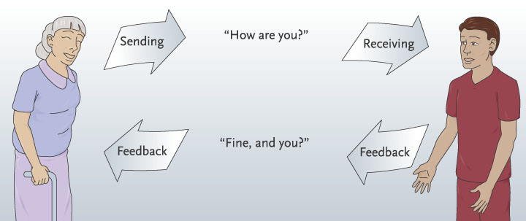
Feedback

Slide 10
Listening
Paying attention to and making an effort to hear what the person is saying
Allows you to perceive the entire message that a person is trying to convey

Slide 11
Good Listening Skills
Show interest and concern
Maintain eye contact
Avoid interrupting
Pay attention
Avoid thinking about how to respond
Eliminate your own prejudices
Watch speaker to see if actions contradict what they are saying
Reflect statements back to the speaker
Ask for clarification if you do not understand
Keep temper under control

Slide 12
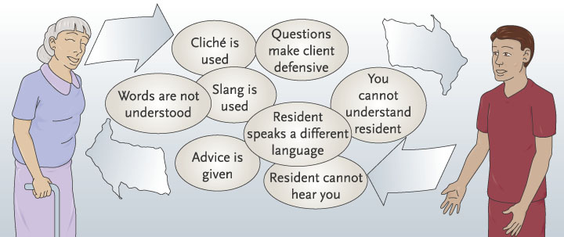
Barriers to Communication
  Physical disabilities
  Psychological attitudes/prejudice
  Cultural diversity

Slide 13
Physical Disability
Deafness/hearing loss
Blindness/impaired vision
Aphasia/speech impairments

Slide 14
Psychological
Caused by prejudice, attitudes, and personality
  Moralizing
  Lecturing
  Over-reacting
  Arguing
  Prejudging
  Advising

Slide 15
Cultural Diversity
Beliefs regarding health care
Language differences
Eye contact
Ways of dealing w/ terminal illness and/or severe disability
Touch

Slide 16
Assertive Communication
Honest and direct
Allows you to express your feelings and thoughts
Example: asking for what you need to complete a task
Passive or aggressive types of communication do not create a partnership

Slide 17
Telephone Communication
Do not give info about staff or residents over the phone
Place caller on hold if you need to get someone to take the call
Be cheerful when greeting a caller
Identify your facility
Identify yourself and your position
Listen closely to caller’s request
Get telephone number
Say “thank you” and “good-bye”
Follow facility policy on personal phone calls

Slide 18
Fax Communication
Use cover page
Confirm recipient received the fax
Call ahead when sending sensitive or confidential information

Slide 19
E-mail Communication
Messages are permanent and may be forwarded to others
Need to be professionally written (salutation at the beginning, spell check, contact information at the end)
Blind carbon copy (bcc) vs. Carbon Copy (c.c.)
Use attachments for large amounts of information
Make a phone call when appropriate

Slide 20
Computers
Electronic medical records
Diagnostic services
  CAT scans, MRI’s, ECG’s

Slide 21
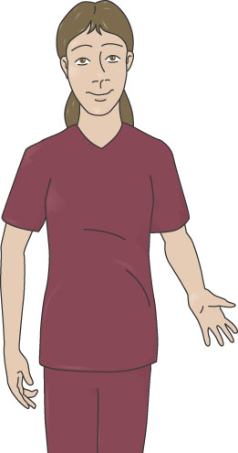
Charting and Observation
Must record and report all observations while providing care
Must listen to what patient is saying, but observe with other senses as well

Slide 22
Types of observation
Subjective
Objective
Cannot be seen or felt
Commonly called symptoms
Usually statements or complaints made by patient/resident
Report in exact words
Can be seen or measured
Commonly called signs

Slide 23
Recording/documentation
Written observations must be accurate, concise and complete as well as neat and legible
Spelling and grammar should be correct
Only objective observations should be noted
Subjective data that the health care worker feels or thinks should be avoided
Errors should be crossed out neatly with a straight line, have “error” recorded by them, and initials of the person making the error

Slide 24
Types of Forms in Documentation
Admission
History/physical exam
Care plans
Doctor’s orders
Doctor’s progress notes
Nurse’s notes
Flow sheets
Graphic record
Intake/output record
Consent forms
Lab/test results
Surgery reports
Advance directives

Slide 25
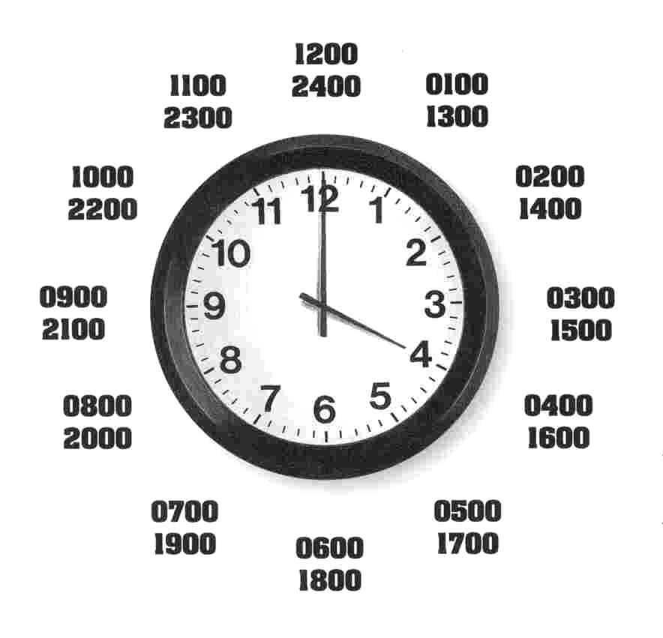
Military Time clock
Facilities use 24-hour clock to reduce confusion in am/pm hours.
To change hours simply add 12 to the original hour: 3 + 12 = 15
3:00 pm = 1500 hours
Hours from 12:00am – 12:00pm are written as 00:01-1200

Slide 26
The 24-hour Clock
The 24-hour clock uses 4 numbers without punctuation.
1:00 am is 0100
3:30 am is 0330
6:15 am is 0615
10:00 am is 1000
12:30 pm is 1230

Slide 27
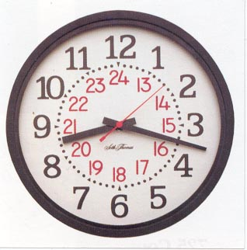
The 24-hour Clock
Once you pass 12 noon, keep numbering up to 24. That way, there is no a.m. or p.m.
1:00 pm is 1300
3:30 pm is 1530
6:15 pm is 1815
10:00 pm is 2200
11:30 pm is 2330
Midnight is 2400

Slide 28
Now You Try It
4:30 am
2:00 pm
4:15 pm
9:45 pm
11:00 pm
1:00 am
0430
1400
1615
2145
2300
0100

Slide 29
One More Time
0210
1440
1700
0945
2345
1300
2:10 am
2:40 pm
5:00 pm
9:45 am
11:45 pm
1:00 pm

Slide 30
Filing
Alphabetical
  Uses the alphabet and last names
Numerical
  Each patient has a number (ex: student ID)
Color coding
  Each letter has a color or number has a color
Chronological
  Items of the same year together
Geographic
  Done according to location

Slide 31
The End

