Slide 1

Health Maintenance Practices
Angie Guggino, MS, ATC, LAT

Slide 2

Learning Target
The steps to maintain good health practices

Slide 3
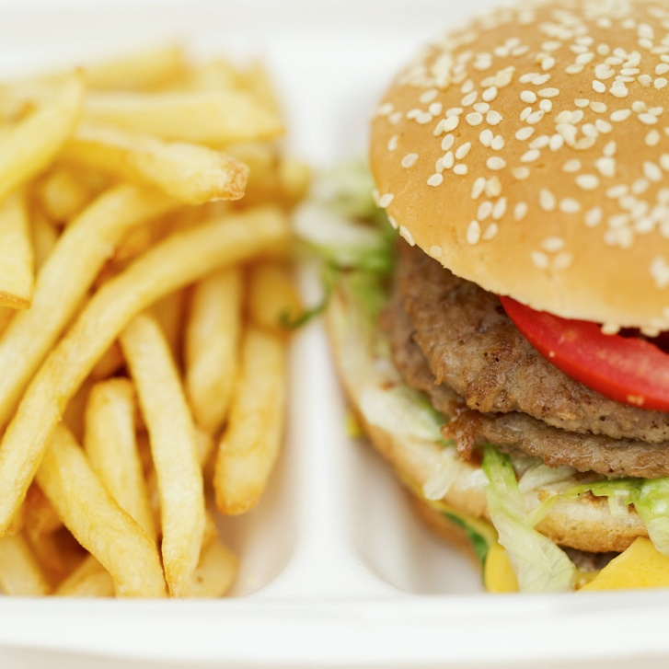

Which kills more people each year?

Slide 4
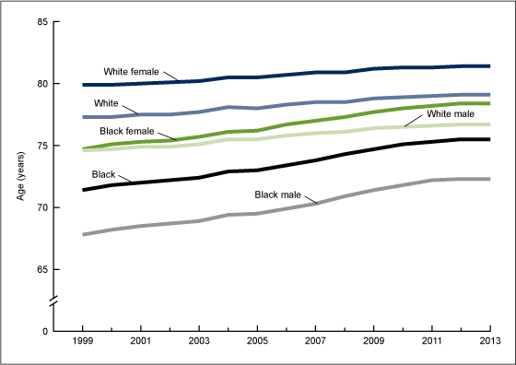
Life expectancy, by race and sex: United States, 1999–2013
SOURCE: CDC/NCHS, National Vital Statistics System, Mortality.

Slide 5
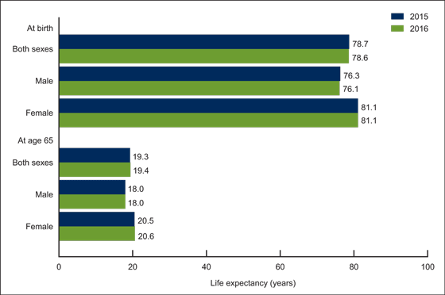
Life expectancy at selected ages, by sex: United States, 2015 and 2016
SOURCE: CDC, National Vital Statistics System, Mortality

Slide 6
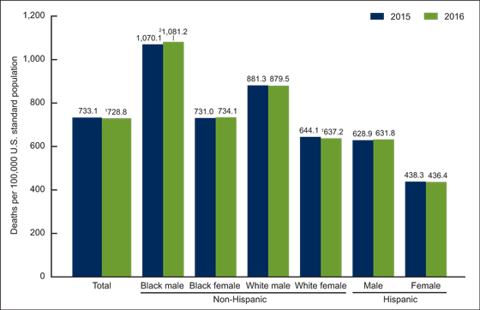
Age-adjusted death rates for selected populations: United States, 2015 and 2016

Slide 7
Leading causes of death
2016
1911
Diseases of heart
Malignant neoplasms (cancer)
Accidents (unintentional injuries)
Chronic lower respiratory diseases
Cerebrovascular diseases (stroke)
Alzheimer’s disease
Diabetes mellitus
Influenza and pneumonia
Nephritis, nephrotic syndrome and nephrosis (kidney disease)
Intentional self-harm (suicide)
Diseases of the heart
Tuberculosis (all forms)
Pneumonia (all forms) and influenza
Nephritis (all forms)
Intracranial lesions of vascular origin
Diarrhea, enteritis, and ulceration of the intestines
Accidents excluding motor-vehicle
Cancer and other malignant tumors
Premature birth
Senility

Slide 8
Leading causes of death
2014
1960
Diseases of heart
Malignant neoplasms (cancer)
Accidents (unintentional injuries)
Chronic lower respiratory diseases
Cerebrovascular diseases (stroke)
Alzheimer’s disease
Diabetes mellitus
Influenza and pneumonia
Nephritis, nephrotic syndrome and nephrosis (kidney disease)
Intentional self-harm (suicide)
Diseases of heart
Malignant neoplasms, including neoplasms of lymphatic and hematopoietic tissues
Vascular lesions affecting central nervous system
Accidents
Motor vehicle accidents
Other accidents
Certain diseases of early infancy
Influenza and pneumonia, except pneumonia of newborn
General arteriosclerosis
Diabetes mellitus

Slide 9
Data from the National Vital Statistics System
Data Brief No. 293, December 2017
Life expectancy for the U.S. population in 2016 was 78.6 years, a decrease of 0.1 year from 2015.
The age-adjusted death rate decreased by 0.6% from 733.1 deaths per 100,000 standard population in 2015 to 728.8 in 2016.
Age-specific death rates between 2015 and 2016 increased for younger age groups and decreased for older age groups.
The 10 leading causes of death in 2016 remained the same as in 2015, although unintentional injuries became the third leading cause, while chronic lower respiratory diseases became the fourth.
The infant mortality rate of 587.0 infant deaths per 100,000 live births in 2016 was not significantly different from the 2015 rate.
The 10 leading causes of infant death in 2016 remained the same as in 2015.

Slide 10
Year | Tuberculosis all forms | cancer | Cardiovascular diseases | Influenza and pneumonia | Motor Vehicle Accidents
1900 | 194.4 | 64.0 | 345.2 | 202.2 | n.a.
1910 | 153.8 | 76.2 | 371.9 | 155.9 | 1.8
1920 | 113.1 | 83.4 | 364.9 | 207.3 | 10.3
1930 | 71.1 | 97.4 | 414.4 | 102.5 | 26.7
1940 | 45.9 | 120.3 | 485.7 | 70.3 | 26.2
1950 | 22.5 | 139.8 | 510.8 | 31.3 | 23.1
1960 | 6.1 | 149.2 | 521.8 | 37.3 | 21.3
1970 | 2.6 | 162.8 | 496.0 | 30.9 | 26.9
1980 | 0.9 | 183.9 | 436.4 | 24.1 | 23.5
1990 | 0.7 | 203.2 | 368.3 | 32.0 | 18.8
2000 | 0.3 | 200.5 | 340.4 | 24.3 | 15.2
2001 | 0.3 | 194.4 | 323.9 | 21.8 | 15.4
2002 | 0.3 | 193.8 | 318.3 | 22.9 | 15.5
2003 | 0.2 | 191.5 | 310.3 | 22.4 | 15.4
2004 | 0.2 | 187.4 | 293.8 | 20.9 | 15.0
2005 | 0.2 | 188.7 | 288.8 | 21.3 | 15.3

Slide 11
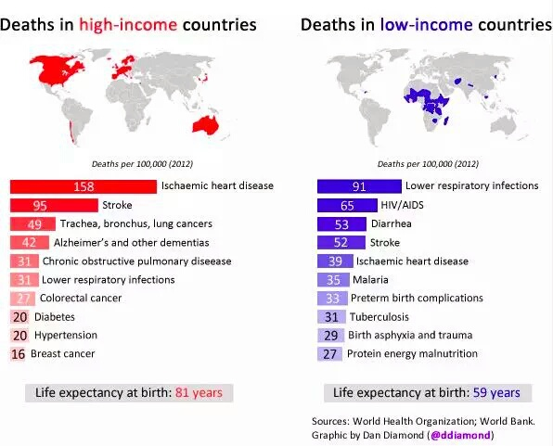
Low vs. High Income Countries

Slide 12
What is the risk of dying for people12-19 years of age?
Each year from 1999 to 2006, the annual death rate for teenagers has averaged 49.5 deaths per 100,000 population
Male teenagers are more likely to die than female teenagers at every single year of age from 12 to 19 years, and older teenagers are at higher risk of dying than younger teenagers.
At age 12, for example, the death rate for males is 46 percent higher than the rate for females
At age 19 the death rate for males is almost three times the rate for females.
CDC Data Brief No. 37, May 2010

Slide 13

Causes of death in teenagers
An average of 16,375 teenagers 12–19 years died in the United States every year from 1999 to 2006. This is less than 1 percent of all deaths that occur every year in the United States.
The five leading causes of death among teenagers are Accidents (unintentional injuries), homicide, suicide, cancer, and heart disease. Accidents account for nearly one-half of all teenage deaths.
As a category of accidents, motor vehicle fatality is the leading cause of death to teenagers, representing over one-third of all deaths.
Among teenagers, non-Hispanic black males have the highest death rate
Homicide is the leading cause of death for non-Hispanic black male teenagers. For all other groups, accident is the leading cause.

Slide 14
How do we take care of ourselves?

Slide 15
Nutrition
Includes all body processes related to food
Digestion, absorption, metabolism, circulation, and elimination

Slide 16
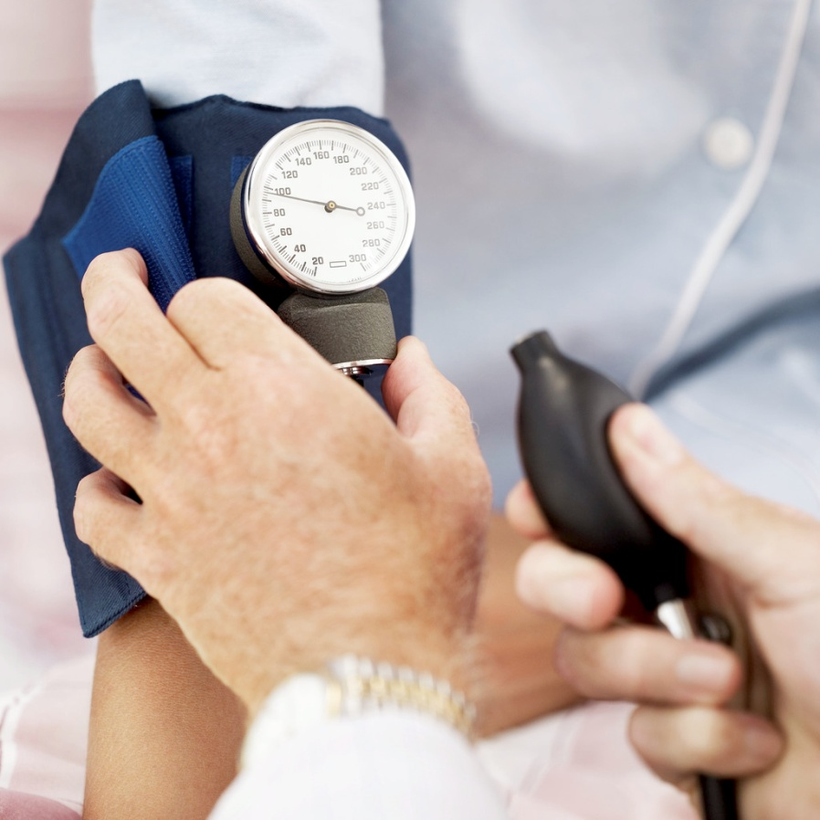
Nutrition and Diseases/Conditions
Hypertension
Atherosclerosis
Osteoporosis
Malnutrition

Slide 17
Essential Nutrients
Carbohydrates
Lipids (fats)
Proteins
Vitamins
Minerals
Water

Slide 18

Carbohydrates
Simple vs. Complex
Fiber
4 kcals per gram
Sugars, starches, whole grains
Main source of energy for the brain

Slide 19

Fats
Saturated vs. unsaturated
Trans fats
9 kcals per gram

Slide 20
Proteins
Complete vs. Incomplete
Amino acids
4 kcals per gram

Slide 21
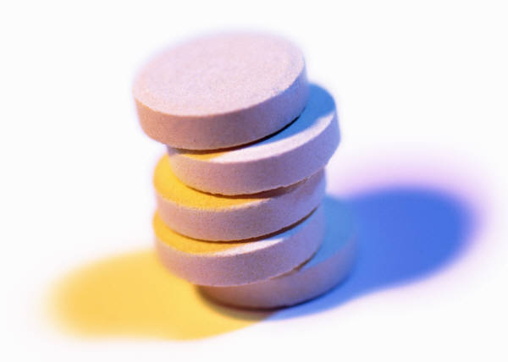
Vitamins
Water soluble vs. Fat Soluble
No energy value

Slide 22
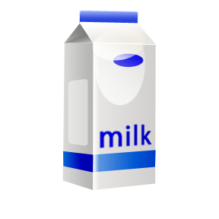
Minerals
Sodium, Calcium, Potassium, Iron
No energy value

Slide 23

Water
No energy value
How much should you get each day?

Slide 24
How do you know if you are getting all the essential nutrients?

Slide 25
Food Guide Pyramid

Slide 26
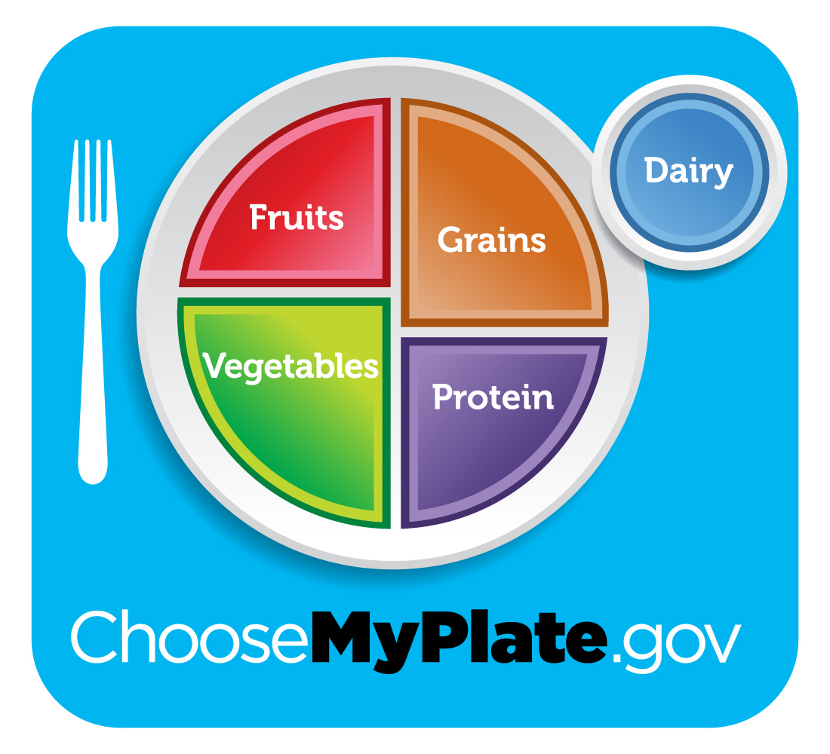
MyPlate

Slide 27
The Life of Food
Digestion
Absorption
Metabolism
Circulation
Elimination

Slide 28
Measuring Food Energy
Amount of heat produced during metabolism
Kilocalorie (kcal)
One pound of body fat = 3,500 kcals

Slide 29
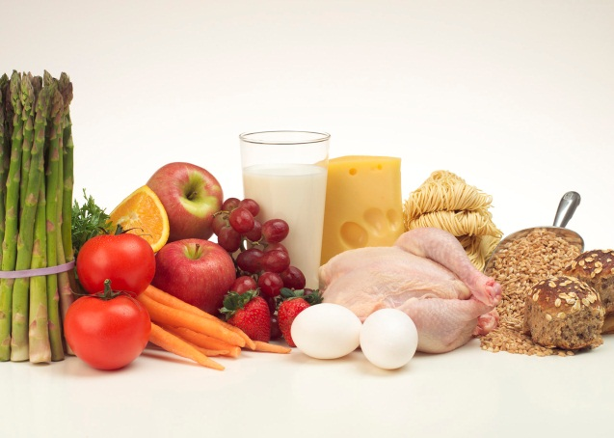
Maintaining Good Nutrition
Eat a variety of foods
Maintain healthy weight
Diet low in fat, saturated fat, and cholesterol
Diet with plenty of vegetables, fruits, and whole grains
Use sugars and salt/sodium in moderation
Alcohol in moderation

Slide 30
How does poor nutrition affect the body?
Anemia
Anorexia nervosa
Bulimia
Constipation
Dull Hair and Eyes
Mental Slowdown
Obesity
Osteoporosis
Rickets
Dehydration
Poor skin conditions

Slide 31
Malnutrition in the Elderly
Why is malnutrition prominent among the elderly?
  Sensory loss especially in taste and smell
  Poor dentition
  Difficulty obtaining and preparing food
  Disease

Slide 32
What are therapeutic diets?
Diets that modify a patient’s normal diet in order to treat an illness
Often very different from the foods they normally eat

Slide 33
Purposes of Therapeutic Diets
Regulate the amount of food in metabolic disorders
Prevent or restrict edema by restricting sodium intake
Assist body organs to regain and/or maintain normal function
Aid in digestion by avoiding food that irritate the digestive tract
Increase or decrease body weight by adding or eliminating calories

Slide 34
Therapeutic Diets
Clear Liquid
Full Liquid
Soft
Bland
Low Residue
Low Carbohydrate (Diabetic)
Low Fat
Low Cholesterol
Low Calorie
High Calorie
Low Sodium
High Protein

Slide 35

Religious Dietary Restrictions
Christian Science
Mormons
Conservative Protestants
Greek Orthodox
Muslim
Orthodox Jewish
Roman Catholic
Buddhist
Hindu
Notes:
Page 478

Slide 36
Don’t Forget
Regular Exercise
Regular Physical Activity
Sleep

Slide 37
Mental Health
Mental illness – health condition that changes a person's thoughts, emotions, and behavior
  Affects the person’s ability to undertake daily functions

Slide 38
Types of Mental Illness
Anxiety disorders
Mood disorders
Personality disorders
Attention disorders
Eating disorders
Drug abuse
Alzheimer’s disease

Slide 39
What causes mental illness?
Biological factors
  Genetic traits
Environmental factors
  Head injury, poor nutrition
Social factors
  Abuse, exposure to violence

Slide 40
Anxiety Disorders
Anxiety – feeling of worry and fear
  Panic disorder
  Phobias
  Obsessive-compulsive disorder
  Post-traumatic stress disorder

Slide 41
Mood Disorders
Causes people to have inappropriate emotional reactions
  Bipolar disorder
  Depression

Slide 42
Personality Disorders
Schizophrenia – person looses touch with reality
  Paranoia
  Unusual thought process or difficulty organizing thoughts
  Awkward movement or clumsiness
  Little facial expression and flat voice
  Difficulty starting and engaging in social activities
  Difficulty making decisions based on information
  Inability to retain something they just learned

Slide 43
Attention Disorders
Attention Deficit Hyperactivity Disorder
  Inattention
  Hyperactivity
  Impulsiveness
Inattentive
Hyperactive and/or impulsive
Inattentive, hyperactive, and/or impulsive

Slide 44
Eating Disorders
Psychological/mental component and often happen with another mental illness
  Anorexia Nervosa – abnormal fear of gaining weight
  Bulimia Nervosa – cycles of binging and purging

Slide 45
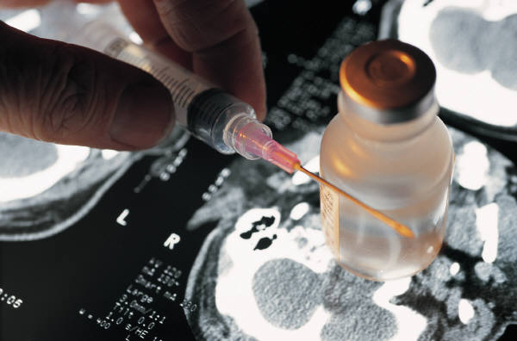
Drug Abuse
Often related to other mental illnesses
Usually starts in adolescence or early adulthood
Uncontrolled use of a drug

Slide 46
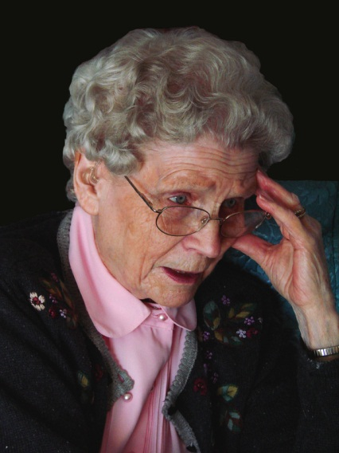
Alzheimer’s Disease
Dementia – sustained loss of intellectual functions and memory
Causes death of cells in the brain
Genetic, head injury, female, lower education level
Usually appears in people age 60 or older

Slide 47
Stages of Alzheimer’s
Early-stage
  Memory loss or other deficits are noticeable but the individual can compensate and function independently
Mid-stage
  Personality changes and physical problems develop, forgets their own history
Late-stage
  Loss of control over bodily functions and requires full care; doesn’t recognize family members

Slide 48
Treating Alzheimer’s Disease
Effects cannot be reversed but the progress can be slowed
Treatments are designed to stimulate the memory and keep a patient engages with the people around him or her
Patients will have good days and bad days

Slide 49
Treatment of Mental Illness
Medication
Psychotherapy
Hospitalization

Slide 50
Not Treating Mental Illness
May result in more advanced symptoms of mental illness
May attempt suicide
May cause violent thoughts or actions towards others

Slide 51
Medications
Often used to treat mental illness
Because of uncomfortable side effects, some patients may decided to stop taking medicines

Slide 52
Psychotherapy
Mental health professional and patient discuss problems and feeling related to mental illness
Psychiatrist vs. Psychologist
  Change thought patterns and behaviors
  Recognize how past experience affect their current behaviors
  Help learn skill to deal with mental illness
  Helps professions monitor patient’s response to treatment/medication

Slide 53
Withdrawal
Uncomfortable physical and psychological symptoms that arise when a drug addict stops using a drug
Can result in death
Hospitalization may be needed to treat drug abuse

Slide 54
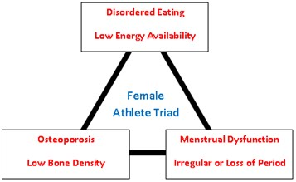
Female Athlete Triad

Slide 55
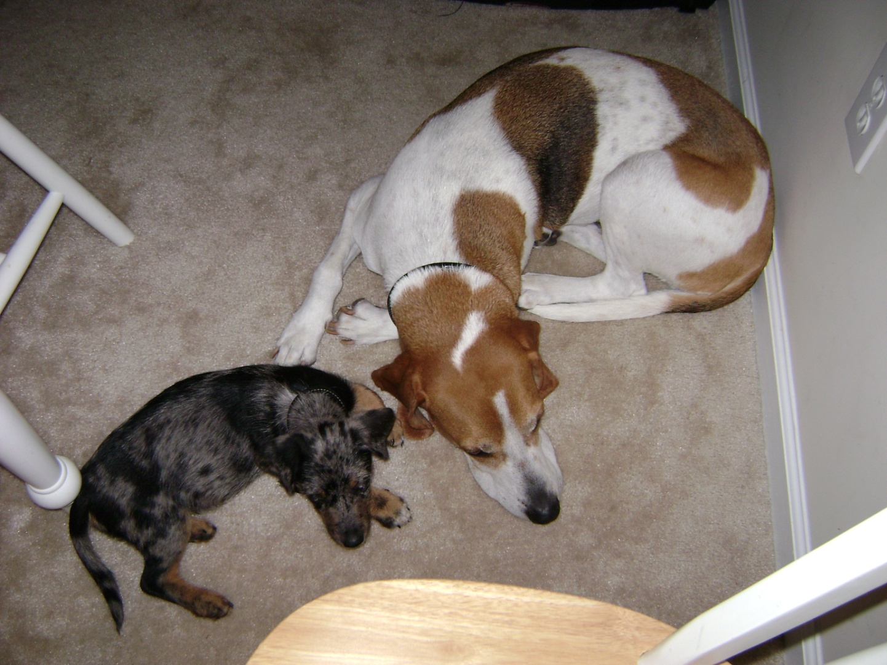
The End

