Slide 1
Infection Control
Angie Guggino, MS, ATC, LAT

Slide 2

Learning Targets
The factors affecting asepsis in the health environment
Steps to maintain asepsis
The chain of infection
The importance of asepsis

Slide 3
Answer the Following
What is a microorganism?
Explain the difference between a pathogenic and nonpathogenic microorganism.
Explain the difference between a virus and a microorganism.
What type of environment do microorganisms prefer?
How do nonpathogenic microorganisms work in the body?
What can happen when nonpathogenic microorganisms leave their normal environment in the body?
Describe the following types of pathogens:
  Bacteria
  Protozoa
  Fungi
  Rickettsiae
  Viruses
Explain the difference between an endogenous and exogenous infection.
What is an opportunistic infection?
How do pathogens cause disease?
What are the steps or links in the Chain of Infection?
List 5 ways Microorganisms and viruses are spread.
Describe the signs and symptoms of a generalized infection and a localized infection.

Slide 4
Microorganisms
Microorganisms are small living organisms invisible to the naked eye and can only be seen under a microscope
Two main categories of microorganisms
  Pathogens
  Nonpathogens

Slide 5
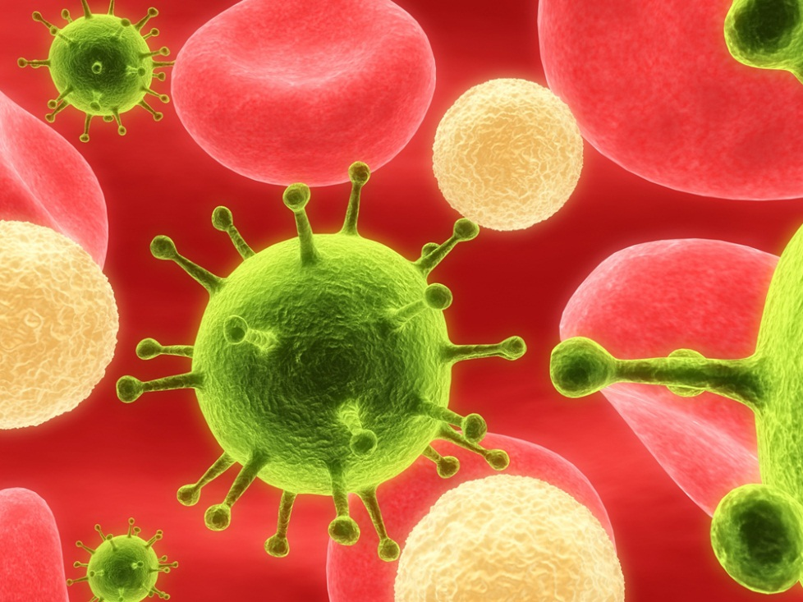
Pathogenic vs. Nonpathogenic
Pathogenic microorganisms cause diseases while nonpathogenic microorganisms help with normal body function

Slide 6
How do the nonpathogenic work?
Work in the digestive system to break down food elements that the body cannot use
Help control growth of pathogenic organisms

Slide 7
What happens when they get out?
They become pathogens
  E. coli
  Salmonella

Slide 8
Virus vs. Microorganism
Very small
Do not eat
Cannot reproduce on their own
Not considered “living” like the others

Slide 9
Growth of Microorganisms
Most prefer warm, moist, dark environments
Also need a food source
Human body

Slide 10
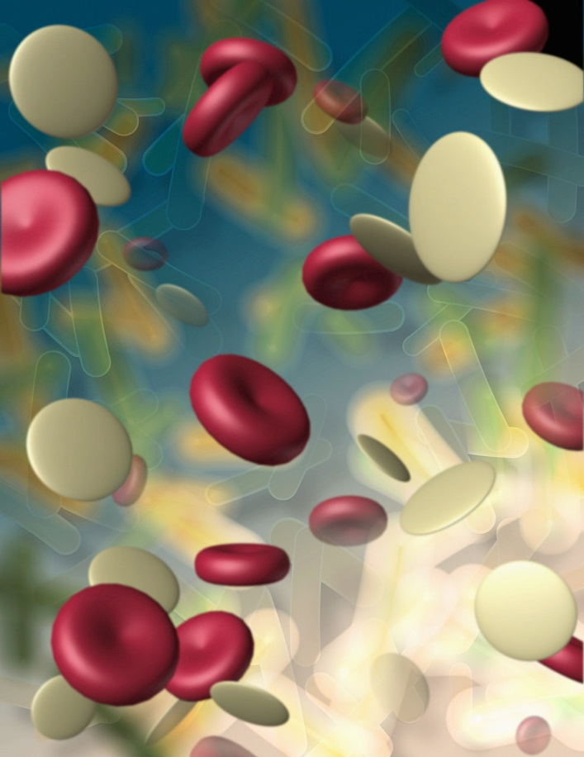
Types of Pathogens
bacteria
protozoa
fungi
rickettsiae
viruses

Slide 11
Bacteria and Viruses
Bacteria
Viruses
Cocci - round
  (MRSA, strep throat)
bacilli - rods
  (TB, botulism)
Spirilla - spirals
  (syphilis, cholera)
Viruses
cannot reproduce without a cell
major risk to healthcare workers and are blood borne
Hepatitis C, Hepatitis B, HIV

Slide 12
Other Pathogens
Protozoa – one cell animal-like organisms found in water and soil environments
  malaria
Fungi – plant-like organisms such as molds and yeast
  Ringworm, Athlete’s foot
Rickettsiae – parasites that live in lice, fleas, ticks and mites
  Typhus, spotted fever

Slide 13
How do pathogens cause disease or infection?
Produce toxins
  bacterial food poisoning
Destroy cells
  Viral infections
Allergic reactions
  Typical allergies

Slide 14
Infections
Endogenous
  originate inside the body
  tumor
Exogenous
  originate outside the body
  poison
Opportunistic
  infections that only affect the immunosuppressed
  pneumocystis carnii
Nosocomial
  acquired in healthcare facilities
  Staph MRSA

Slide 15
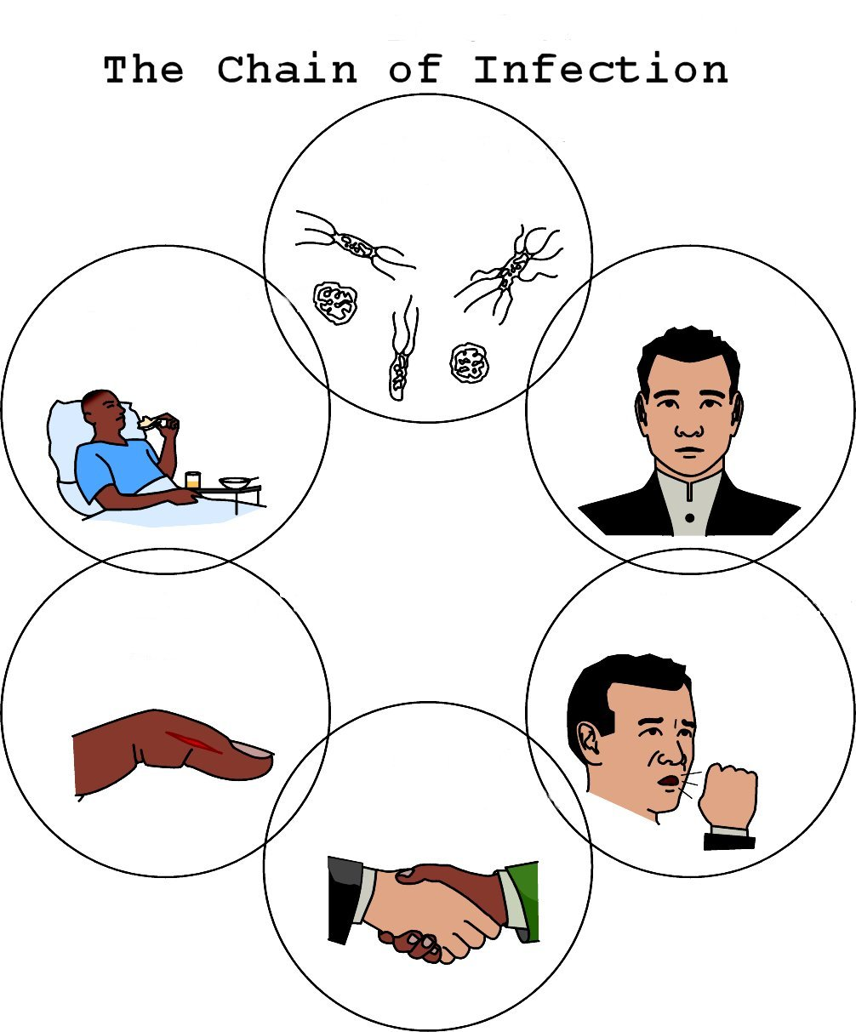
Infectious Agent
Susceptible Host
Reservoir
Portal of Entry
Portal of Exit
Mode of Transmission

Slide 16
Mode of Transmission
Direct contact
Indirect contact
Airborne
Oral route
Insects and pests

Slide 17
Signs & Symptoms of Infection
Generalized
  Headache, fatigue, fever, increase HR and respiration
Localized
  Redness, swelling, heat, drainage

Slide 18
Answer the Following
What is medical asepsis?
How is medical asepsis accomplished?
Give examples of an aseptic technique.
In general, what are the Standard Precautions?
What government agency explained or developed the Standard Precautions?
What government agency is responsible for enforcing the Standard Precautions?
What must employers provided to employees at risk of infection within 10 days of hire?
What body fluids can transmit disease?
How do the HBV and HIV infections occur?
What is surgical asepsis? How does it differ from medical asepsis?
What is disinfection?
What is sterilization?
When should you always wash your hands?

Slide 19
Breaking the Chain of Infection
How is it done?

Slide 20
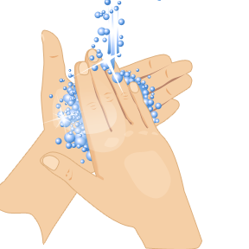
Medical Asepsis
Destruction of the environment that allows pathogens to live, grow, and spread
Aseptic Technique
  Used to make the environment, worker, and patient as germ-free as possible

Slide 21
Examples of Aseptic Techniques
Proper hand washing
Employees being neat and clean
Proper handling of all equipment
Using sterile procedures when necessary
Proper cleaning solutions
Following the Standard Precautions

Slide 22
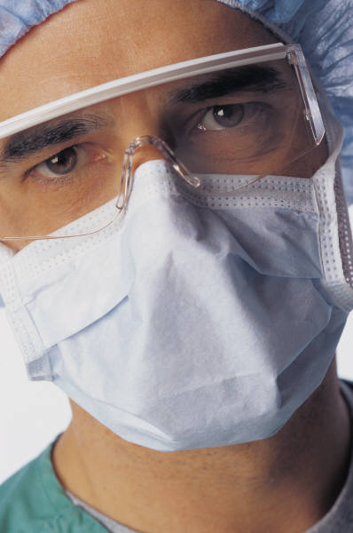
Standard Precautions
Guidelines, developed by the CDCP for protection of health care workers from exposure to blood-borne pathogens in body secretions.
Enforced by OSHA

Slide 23
CDCP Standard Precautions
Wear gloves
Wear protective eyewear and a mask
Wear disposable gowns
Thoroughly wash your hands
Avoid giving direct mouth-to-mouth resuscitation
Avoid direct patient contact with open wounds
Wash your hands after each patient
Carefully and properly dispose of all sharp objects

Slide 24
Employers Must Provide
Hep B vaccine at no charge
Training in the appropriate use of PPE
Annual updates and review of rules and procedures

Slide 25
Body Fluids that Transmit Disease
Blood
Vaginal secretions
Pericardial fluid
Fluids with visible blood
Amniotic fluid
Peritoneal fluid
Tissue specimens
Cerebrospinal fluid
Interstitial fluid
Semen
Pleural fluid

Slide 26
HBV and HIV Infections
Direct injection with infected blood
Contact of infected body fluids with mucous membranes (eyes and mouth)
Sexual contact
Pregnancy

Slide 27
Surgical Asepsis
Sterile technique
All practices to keep the area completely free of microorganisms
What is Sterilization?
  Process of killing all microorganisms
Autoclave

Slide 28

Disinfection
Process of freeing from microorganisms by physical or chemical means
10% bleach solution

Slide 29
When should you wash your hands?
Before and after contact with a patient
Before and after eating
After using the bathroom
After handling any contaminated fluid or object
After touching body fluids, even if wearing gloves

Slide 30
How should you wash your hands?

Slide 31
Answer the Following
For who are Transmission-based precautions designed?
List the three types of transmission based precautions.
What is protective isolation?

Slide 32
Transmission-Based Precautions
Designed for patients suspected to be infected with pathogens spread by airborne or droplet transmission, contact with dry skin, or contact with contaminated surfaces
  Chicken pox
  Tuberculosis
  Pertussis
  Certain types of pneumonia

Slide 33
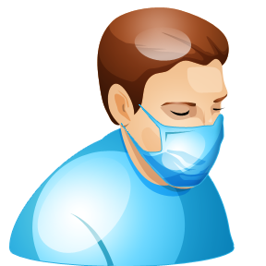
Types of Transmission-Based Precautions
Airborne precautions
Droplet precautions
Contact precautions

Slide 34
Protective Isolation
Type of isolation used for patients who are not contagious, but whose immune system is so weak that they must be protected from other people that might carry disease
  Burn patients
  Chemotherapy patients
  Newborns

Slide 35
Answer the Following
Describe the following bloodborne diseases:
  Hepatitis B
  Hepatitis C
  HIV
How are bloodborne diseases usually passed between healthcare providers and patients?
What are Universal Precautions?
What protective equipment is used with Universal Precautions?
What are the legal rights for healthcare workers who have a bloodborne disease?

Slide 36
Bloodborne Diseases
Hepatitis B
  Disease that attacks the liver
  Vaccine available
Hepatitis C
  Virus attacks the liver
  Major complication of blood transfusions prior to 1992
HIV
  Attacks body’s immune system
  Causes AIDS

Slide 37
Healthcare Workers and Disease Transmission
Accidental needle sticks
Cuts from sharp instruments
Direct contact with infected blood

Slide 38
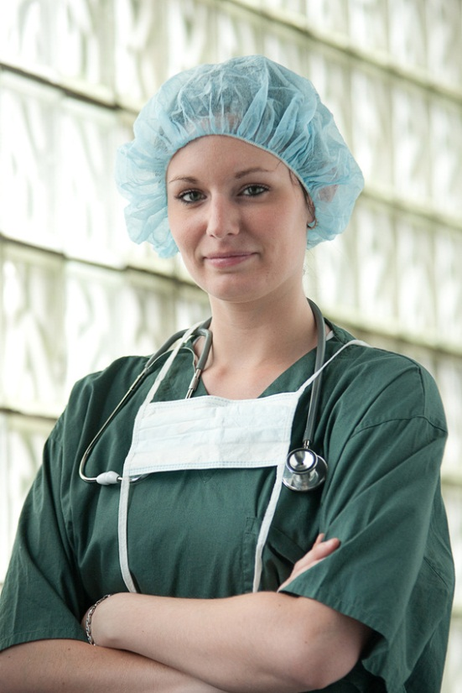
Universal Precautions
Set of precautions that prevents the transmission of bloodborne pathogens when providing healthcare

Slide 39
Universal Precautions Equipment
Gloves
Gowns
Aprons
Masks
Protective eyewear
Resuscitation equipment

Slide 40
Legal Rights for Healthcare Workers
Confidentiality
Treatment and testing must be voluntary
Adequate information on must be offered to individuals with the disease
Make an effort to warn people at risk in a confidential manner

Slide 41
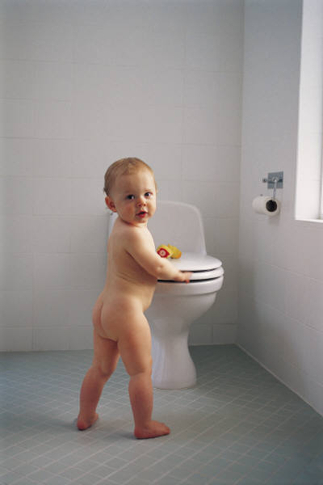
The End

