Slide 1
Overview of the Human Body
Angie Guggino, MS, ATC, LAT

Slide 2

Learning Targets
How the body is organized.
The function of cells and tissues
How the organism grows, develops, and changes throughout the life span.

Slide 3
Anatomy, Physiology, and Pathophysiology
Anatomy
  the study of the form and structure of an organism
Physiology
  the study of the processes of living organisms or why and how they work
Pathophysiology
  the study of how disease occurs and the responses of living organisms to disease processes

Slide 4
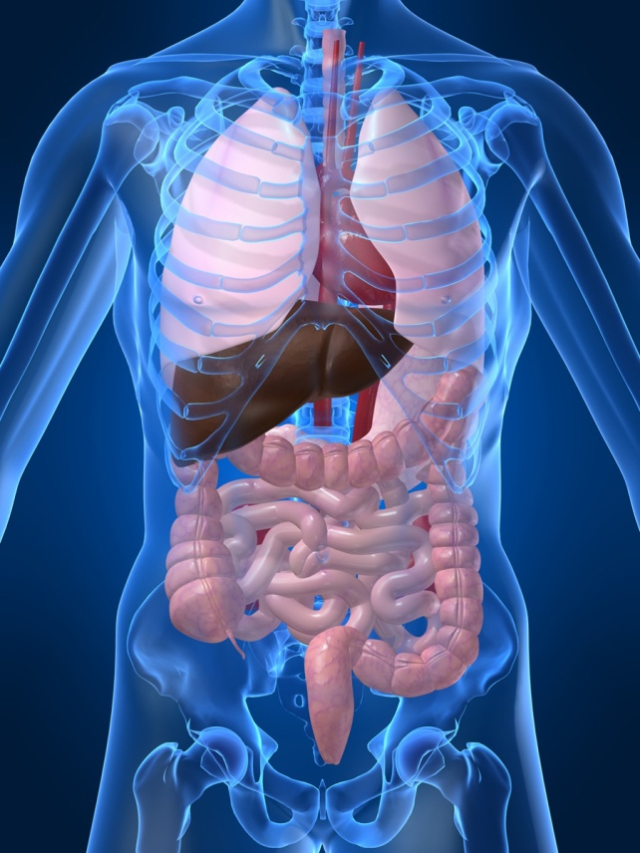
The Human Organism
Atom or ion of an element
Molecule
Organelle
Cell
Tissue
Organ
Organ system
Organism

Slide 5
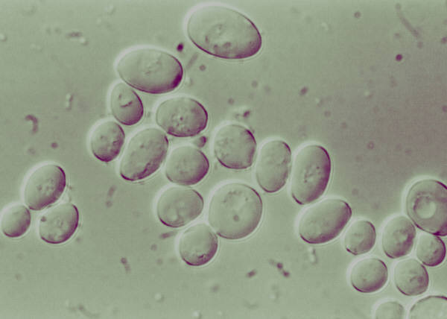
Cells
What are cells?
  Basic structural unit of the body (building blocks)
What are the functions of cells?
  Grow
  Reproduces
  use oxygen and nutrients
  digests food for energy
  Eliminates waste
  Produces heat and energy
What part of the cell is call the “powerhouse”?
  mitochondria
What is mitosis?
  Cell reproduction
What is meiosis?
  Sex cells reproduce

Slide 6
Tissue
Epithelial
  secrete and protect
  skin
Connective
  support and connect
  Adipose, ligaments, tendons, cartilage, bone
Nerve
  control and communicate
  Brain and spinal cord
Muscle
  move and protect
  Skeletal, cardiac, visceral (smooth)

Slide 7
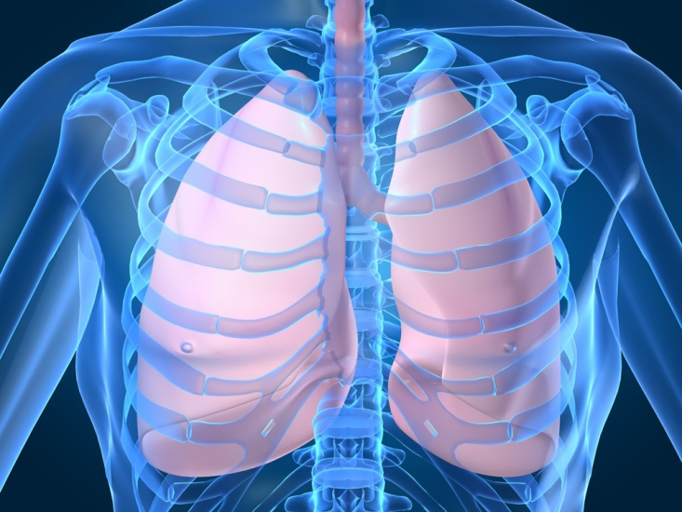
Organ Systems
Integumentary
Skeletal
Muscular
Nervous
Special senses
Circulatory
Lymphatic
Respiratory
Digestive
Urinary
Endocrine
Reproductive

Slide 8
The Anatomical Position

Slide 9
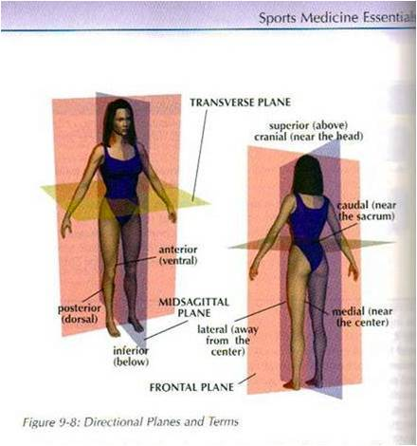
The Body Planes

Slide 10

Directional Terms
Superior vs. inferior
Cranial vs. caudal
Medial vs. lateral
Ventral vs. dorsal
Anterior vs. posterior
Proximal vs. distal

Slide 11
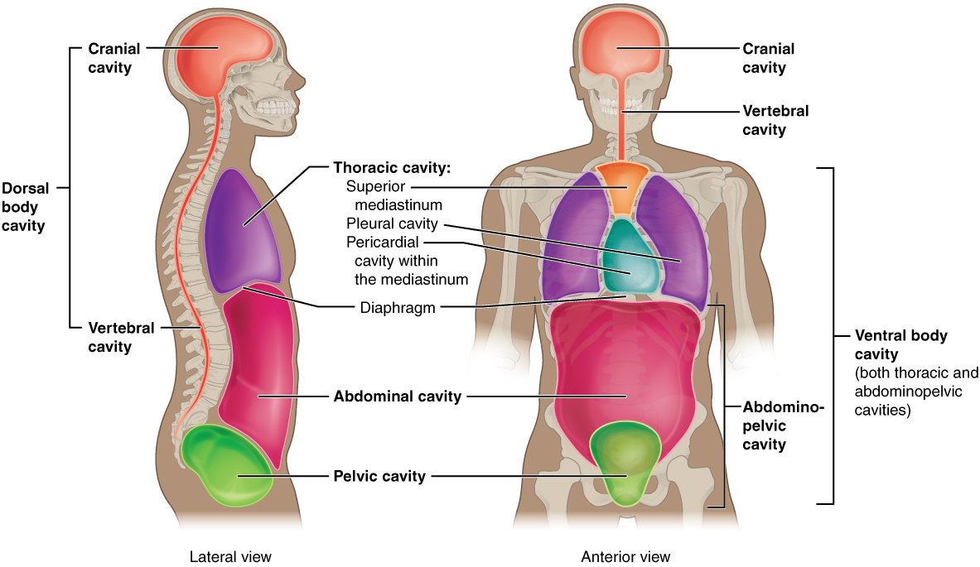
Body Cavities
Dorsal cavity
Cranial cavity
Ventral cavity
Thoracic cavity
Abdominal cavity
Pelvic cavity
Orbital cavity
Nasal cavity
Buccal cavity
Pericardial cavity

Slide 12
Abdominal Quadrants
RUQ
LUQ
RLQ
LLQ

Slide 13
Abdominal Regions
Right Hypochondriac Region | Epigastric Region | Left Hypochondriac Region
Right Lumbar Region | Umbilical Region | Left Lumbar Region
Right Iliac Region | Hypogastric Region | Left Iliac Region

Slide 14
The Skeletal System

Slide 15
Skeletal System
What structures compose the skeletal system?
  Bone, ligaments, cartilage
What are the different types of bones?
  Long, short, flat, irregular
What are the functions?
  Framework for the body
  Protection
  Storage area
  Produce blood cells
  Allow flexibility
What bones make up the axial skeleton and the appendicular skeleton?
  Axial: skull, vertebrae, ribs, sternum
  Appendicular: arms, legs, hands, feet, pelvis

Slide 16
Joints
What is a joint?
  Place where two bones meet
  Immovable, slightly moveable, freely moveable
What are ligaments?
  Connect bone to bone
What is cartilage?
  Connective tissue that forms pads at the end of bones and found in the nasal septum and external ear

Slide 17
Diseases or Abnormal Conditions
Arthritis (osteoarthritis)
Osteoporosis
Osteomyelitis (bone infection)
Kyphosis (Curve in thoracic)
Lordosis (Curve in lumbar)
Scoliosis
Bursitis
Dislocation
Sprain
Fractures

Slide 18
Types of Fractures
Compound
Avulsion
Stress
Greenstick
Oblique
Spiral
Transverse
Comminuted
Blowout (facial, nose)

Slide 19
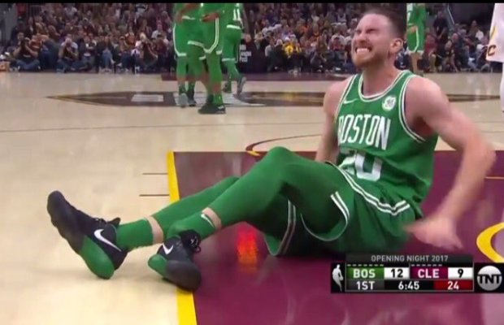
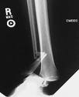
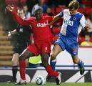
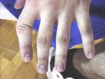

Slide 20
The muscular system

Slide 21
Muscle System
What are the three main functions of muscles?
  Produce heat
  Produce movement
  Maintain posture
What are the three types of muscle tissue?
  Skeletal
  Cardiac
  Smooth (visceral)
What is the difference between a voluntary muscle and an involuntary muscle?
  Voluntary under control
  Involuntary contract automatically
What is a muscle contraction?
  Tightening or narrowing of a muscle (shorten)

Slide 22
Characteristics of Muscle
Excitability
  Ability to respond to a stimulus
Extensibility
  Ability to be stretched
Contractibility
  Ability to become short and thick
Elasticity
  Ability to return to its original shape

Slide 23
Muscle Movements
Adduction vs. abduction
Flexion vs. extension
Rotation
Circumduction
Pronation vs. Supination
Inversion vs. Eversion
Dorsiflexion vs. Plantarflexion
THESE ARE THE MOVEMENTS YOU WILL PERFORM IN YOUR VIDEOS.

Slide 24
Diseases and Abnormal Conditions
Atrophy (decrease in muscle mass)
Hypertrophy (increase of muscle mass)
Fibromyalgia (musculoskeletal pain)
Strain (micro tears of muscle)
Muscular dystrophy (weakening and wasting of muscles)
Tendonitis (inflammation of tendon)
Muscle spasms (involuntary contraction)

Slide 25
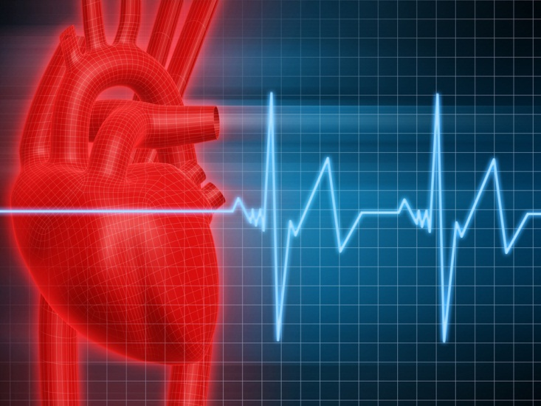
The circulatory system

Slide 26
Circulatory System
What structures make up the circulatory system?
  Blood, heart, blood vessels
What is the function of the circulatory system?
  Delivers oxygen and nutrients to the cells and removes waste
List and describe the different types of blood vessels?
  Arteries: carry blood away from the heart
  Capillaries: nutrient exchange
  Veins: carry blood to the heart
List and describe the three types of blood cells?
  Red blood cells (erythrocytes)
  White blood cells (leukocytes)
  Platelets (thrombocytes)

Slide 27
Diseases and Abnormal Conditions
Arteriosclerosis
Atherosclerosis
Hypertension
Myocardial Infarction
Varicose Veins
Aneurysm
Anemia
Leukemia
Hemophilia
Congestive Heart Failure

Slide 28
The respiratory system

Slide 29
Respiratory System
What structures make up the respiratory system?
  Pharynx
  Epiglottis
  Larynx
  Trachea
  Diaphragm
  Bronchi
What is respiration?
  breathing
What are the two stages of respiration?
  Inspiration and expiration

Slide 30
Diseases and Abnormal Conditions
Asthma
COPD
Emphysema
Lung cancer
Pneumonia
Tuberculosis
URI
Epistaxis
Influenza
Bronchitis
Laryngitis
Rhinitis
Sinusitis

Slide 31
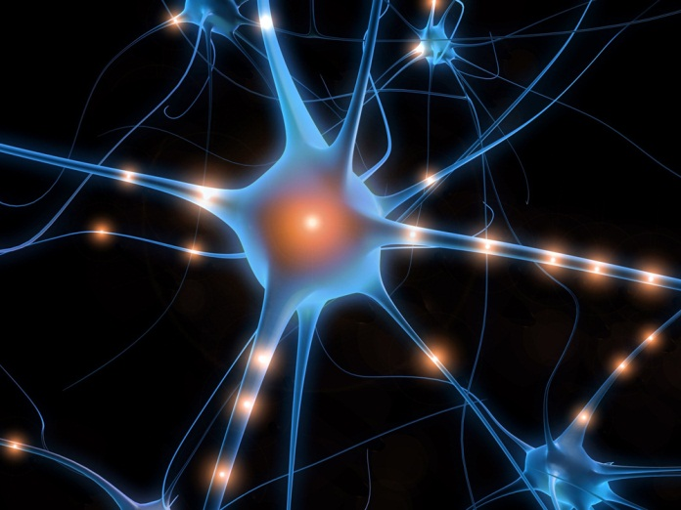
The nervous system

Slide 32
Nervous system
Central nervous system
Brain
Spinal cord
Peripheral nervous system
Somatic
Autonomic
12 cranial nerves
31 spinal nerves
parasympathetic
sympathetic
Afferent (sensory)
Efferent
(motor)

Slide 33
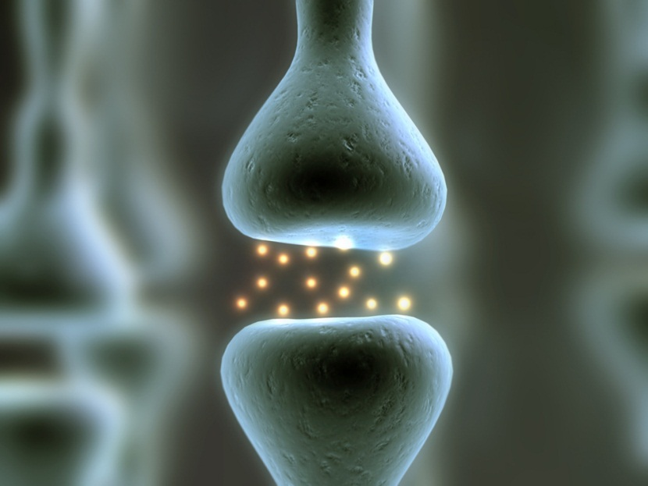
Nervous System
What is the basic structural unit of the nervous system?
  Neuron (nerve cell)
What is homeostasis?
  balance

Slide 34
Diseases and Abnormal Conditions
Neuritis
Parkinson’s Disease
Shingles
Cerebrovascular accidents (stroke)
Epilepsy
Meningitis
Multiple Sclerosis
Paralysis
  Quadriplegia
  Paraplegia
  Hemiplegia

Slide 35

The Integumentary system

Slide 36
Integumentary System
What is it?
  Skin, hair, nails
What three layers make up the skin?
  Epidermis
  Dermis
  Subcutaneous or hypodermis
What are the four types of glands?
  Sweat glands
  Sebaceous glands
  Ceruminous glands
  Mammary glands
What are the functions of the integumentary system?
  Protection
  Regulate body temperature
  Eliminate wastes through perspiration
  Store energy in fat
  Senses
  Produce vitamin D

Slide 37
What are the common eruptions of the skin?
Vesicles
  Blisters or sacs full of fluid
Papules
  Firm raised areas on the skin
Crusts
  Areas of dried pus and blood
Pustules
  Sacs filled with pus
Macules
  Flat spots on the skin
Wheals
  Itchy, elevated areas with an irregular shape
Ulcer
  Deep loss of skin surface that may extend into the dermis

Slide 38
Diseases and Abnormal Conditions
Acne
Athlete’s foot
Cancer of the skin
Contact dermatitis
Eczema
Impetigo
Psoriasis
Ringworm
Verrucae (warts)

Slide 39

