Slide 1
Safety
Angie Guggino, MS, ATC, LAT

Slide 2

Learning Targets
Safety and emergency guidelines for the classroom and healthcare setting
Creating a safe environment for patients
Preparing for disasters
Using good body mechanics

Slide 3
Safety Guidelines
What is the role of the Occupation Safety and Health Administration?
Define the term ergonomic.
Define the term biohazard.
How do chemical hazards cause harm?
What is a MSDS Sheet?
What does the Hazard Communication Program explain?
What does an Exposure Control Program provide?
List 15 general safety rules for a healthcare facility.

Slide 4
Importance of Safety in Healthcare
Ensures Patient safety
Ensures Employee safety
Protects employees from physical and health hazards in the work place
Ensures better health for all concerned

Slide 5

O.S.H.A.
Occupational Safety and Health Administration
Division of the U.S. Department of Labor
Establishes guidelines for a safe work environment

Slide 6
Regulations
Ergonomic Program
Injury and Illness Prevention Program
Hazard Communication Program
Exposure Control Plan

Slide 7
Ergonomics
Applied Science used to promote safety and well being of people by adapting the environment and using techniques to prevent injuries.
  Correct placement of furniture and equipment
  Training in required muscle movements
  Efforts to avoid repetitive motions
  An awareness of the environment to prevent injuries.
The prevention of accidents and injury centers around people and their immediate environment

Slide 8
Ergonomics
Uses anatomy, physiology and psychology to design and make products.
supports body mechanics in that they are taken into consideration when products are designed.

Slide 9

Biohazards
Biological materials or infectious agents that may cause harm to human, animal, or environmental health
What is the most common?
  blood

Slide 10
Chemical Hazards
Cause harm when a chemical is mixed with another chemical causing a reaction

Slide 11
M.S.D.S.
Material Safety Data Sheet
  Product identification
  Hazardous ingredients
  Emergency and first aid procedures
  Spill procedures
  Safety precautions

Slide 12
Hazard Communication Program
Explains how the employer plans to keep people safe when chemicals are present
  Type of chemicals
  PPE
  Storage
  Clean-up and disposal
  First aid

Slide 13

Exposure Control Program
Provides steps to reduce employee or student exposure to bloodborne pathogens
  What are the possibilities of exposure?
  Is the plan being enforced?
  Post exposure evaluation

Slide 14
General Safety
Walk, don’t run.
Walk on right side of hallway
Use handrails on stairs
Watch for swinging doors
No horseplay
Check labels
Wipe-up spills
Dispose of sharps properly
Follow instructions
Report injuries immediately
Do not use damaged electrical cords
Report shocks from electrical cords
Do not use malfunctioning equipment
Make sure supplies are secure
Report unsafe conditions

Slide 15
Patient Safety
How can you confirm you are working with the correct patient?
What is an ambulation device?
What is a transporting device?
What are postural supports?

Slide 16

Identifying the Patient
Correct room number?
Identification band
Ask the patient

Slide 17
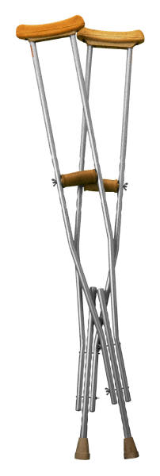
Ambulation Devices
Assist in walking
  Clean
  No damage
  Non-slip tips

Slide 18
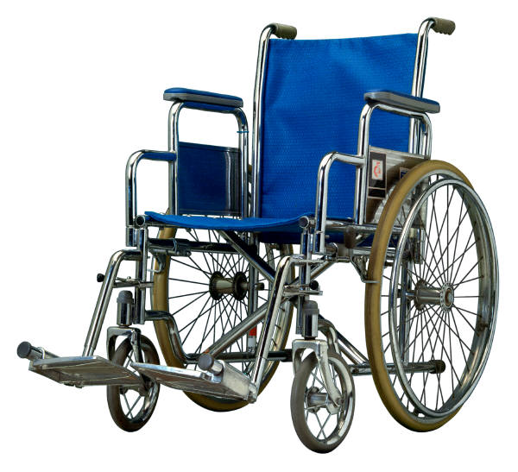
Transporting Devices
Used to move patients from one place to another
  Clean
  Don’t leave unattended
  Go backwards

Slide 19
Postural Supports
Restraints used to protect residents
Usually used with elderly individuals
Requires physician’s order by law

Slide 20
Disaster Preparedness
What is a disaster?
What three elements must be present to start a fire?
List three ways fires can be prevented.
A class A fire extinguisher is used on what type of fire?
A class B fire extinguisher is used on what type of fire?
A class C fire extinguisher is used on what type of fire?
A class D fire extinguisher is used on what type of fire?
A class ABC fire extinguisher is used on what type of fire?
What is R.A.C.E.?

Slide 21
Disaster
Anything that causes damage and injury to a group of people
Medical facilities by law are required to have a disaster plan

Slide 22
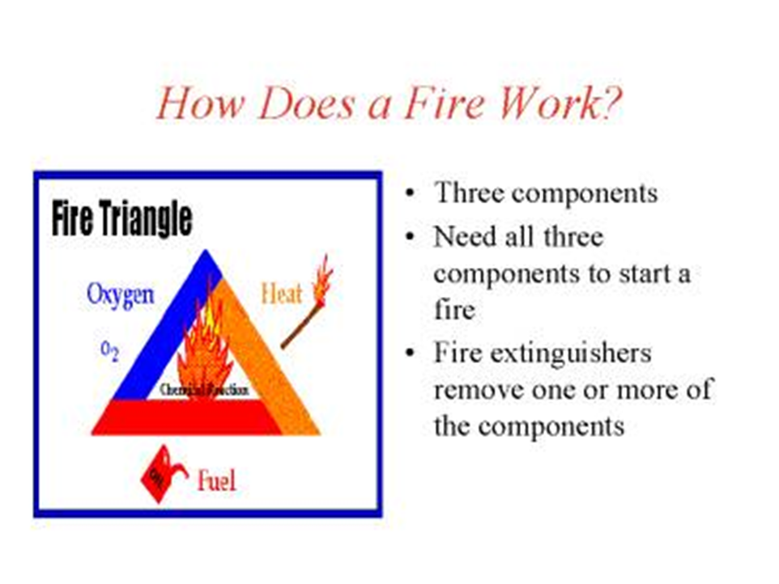
Elements needed to start a fire

Slide 23

Fire Prevention
Smoke in designated areas
Check electrical equipment
Proper storage and usage of flammable liquids

Slide 24
Fire Extinguishers
Class A
  Pressurized water used on combustibles
Class B
  Carbon dioxide used on gas, grease, oil
Class C
  Potassium bicarbonate or potassium chloride used on electrical
Class ABC
  Graphite type chemical used on type A, B, or C fires
Class D
  Sodium chloride or copper power used on combustible metals such as magnesium

Slide 25
Fighting a Fire
R.A.C.E.
Rescue anyone in immediate danger
Activate the alarm
Confine the fire: close windows/doors, shut off electrical equipment and oxygen
Extinguish the fire

Slide 26


Slide 27
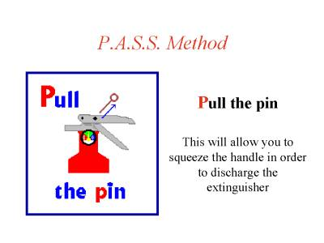
Know P.A.S.S.

Slide 28
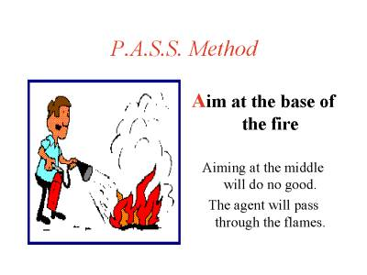

Slide 29
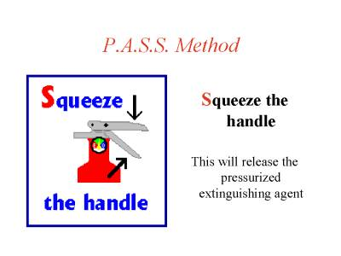

Slide 30
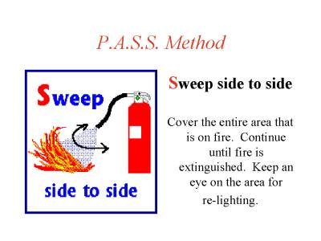

Slide 31
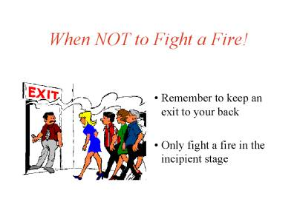

Slide 32
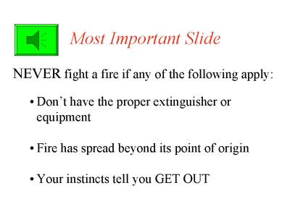

Slide 33
Good Body Mechanics
What is the simplest and most effective item for decreasing injuries to healthcare workers and the patient?
List four simple rules for good body mechanics.

Slide 34
Body Mechanics

Slide 35
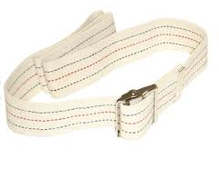
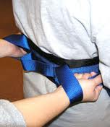
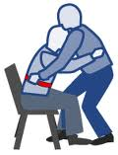
Most Effective Item
Gait belts

Slide 36
Body Mechanics
The way in which the body moves and maintains balance with the most efficient use of all its parts
Goal is to decrease injuries to employees
Teaches proper techniques for lifting, bending and moving

Slide 37
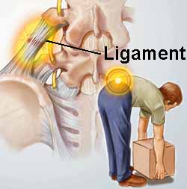
Reasons to use good body mechanics
Muscles work better when used correctly
Correct muscle used means easier lifting, pulling and pushing
Prevents strain and fatigue and saves energy
Prevents injuries to self and others

Slide 38
Basics Rules of Body Mechanics
Keep back straight
Bend at hips and knees
Keep wide base of support (about 8 inches)
Use strongest muscles of your legs
Do not twist
Use weight of body to help push or pull

Slide 39
Things to remember
always have authorization before performing a procedure on a patient
make sure you have the correct patient
follow instructions during procedures, ask questions if you don’t know
read/follow policy and procedure
never perform something on a patient that they refuse
observe patient and carefully report any abnormal findings
always explain what you are doing to a patient first

Slide 40
PERSONAL SAFETY
Always use correct body mechanics
report any injury or incidents to your supervisor
wash hands between patients, procedures, breaks
wear safety equipment when in contact with body fluids

Slide 41
Personal Protective Equipment (PPE)
Barriers that are used when an employee will come in contact with body fluids
  Gloves: any contact with pt during procedures
  Goggles: splashing, droplet's
  Gowns: splashing, droplets, blood
  Masks: respiratory protection, splashing
  Paper hats/Shoes

Slide 42
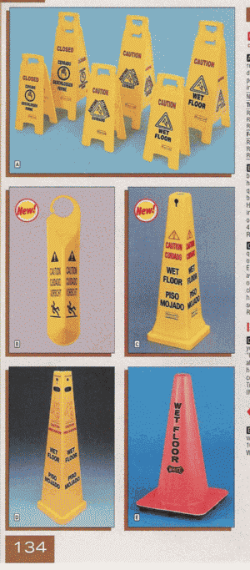




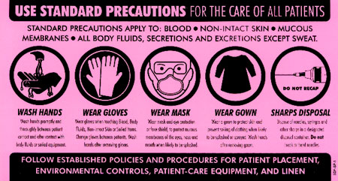
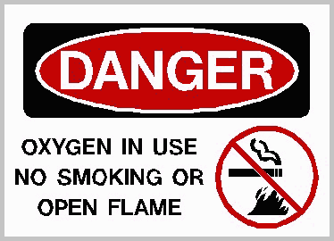
SAFETY LABELS

Slide 43
EMERGENCY CODES:
used to alert staff /employees of danger and a need for response
Examples:
  Fire
  Inclement weather
  Tornado
  Pt out of Control
  Hurricane
  Cardiac Arrest
  Bomb Threat
  Intruder/Kidnapping
  Sniper

Slide 44
Examples:
Numbers can be used:
  10: bomb
  99: cardiac arrest
  18: medical emergency
Names can be used:
  Adam: child missing/kidnapped
  Preemie: Neonatal cardiac arrest
  Delta: Internal/External Disaster

Slide 45
Examples
Colors are used:
  Code Blue: Cardiac Arrest(Code)
  Code Red: Fire
  Code Yellow: Bomb
  Code Pink: Infant/Child abduction
  Code Green: Evacuation
Codes are different in each hospital. It is necessary to learn the codes in your work place .
Disaster plans for each code have been written and are located in a disaster policy manual in your work area.
All employees must know their role in a disaster should one occur.

Slide 46
The End

